Slide 1
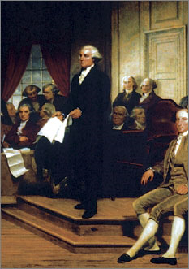
Lesson 9:
How was the Philadelphia Convention Organized?

Slide 2
Purpose
This lesson describes the important people and their first steps at the Constitutional Convention in Philadelphia, 1787.
The structure and rules set forth for debate played a major role by providing a framework for civil discourse.
The Virginia Plan created the agenda for subsequent discussion & debate.

Slide 3
Objectives
Describe the organizing phase of the convention.
Explain the significance of rules and agendas for effective civil discussion.
Evaluate, take, and defend positions on
determining what interests should be represented in a constitutional convention
the advantages and disadvantages of secrecy in governmental deliberations

Slide 4
Terms to Know
civil discourse
Reasoned discussion as opposed to emotional display.
Constitutional Convention
The meeting held in Philadelphia from May to September 1787 at which the US Constitution was written.
delegate
(1) (noun) A person chosen to act for or represent others. (2) (verb) To entrust someone to represent your interests.
federal system
A form of government in which power is divided and shared between a central government and state and local governments.
national government
The organization having central political authority in a nation; the representative unit of political organization.
proportional representation
In the context of American government, the electoral system in which the number of representatives for a state is based on the number of people living in the state. Proportional representation is used to determine the number of each state's representatives in the U.S. House of Representatives.

Slide 5
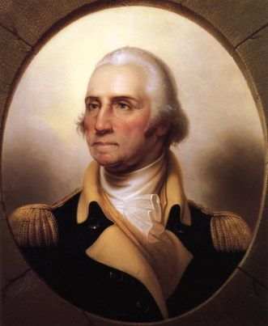
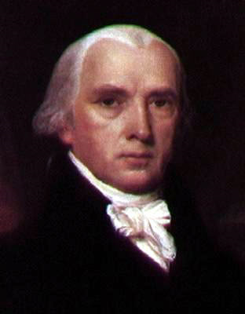
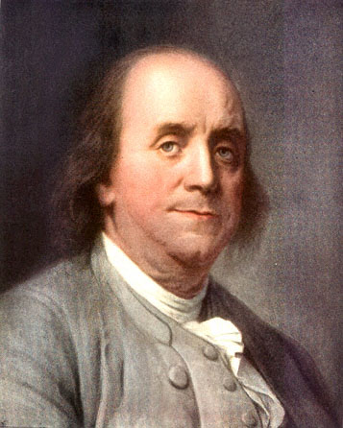
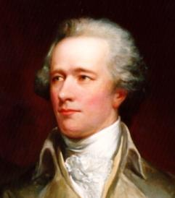
Those in Attendance of Philadelphia Convention
55 delegates from states (Framers)
Ave. age 42, ¾ had served in Congress
Most were prominent political leaders, very qualified
George Washington
Most respected Military Leader in nation
James Madison
Had greatest influence on organization of national gov’t
Benjamin Franklin
81, poor heath, but internationally renown statesmen
Alexander Hamilton
Most prominent supporter of strong national gov’t

Slide 6
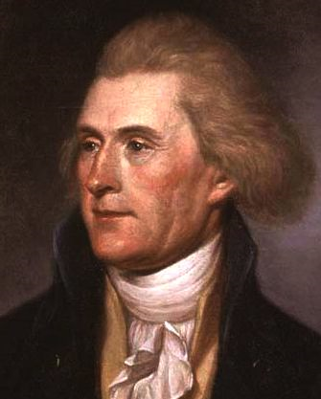
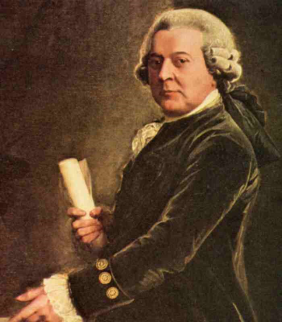
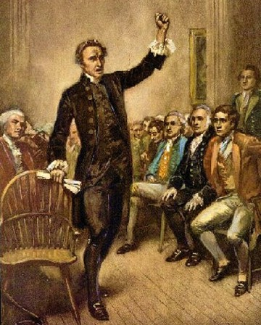
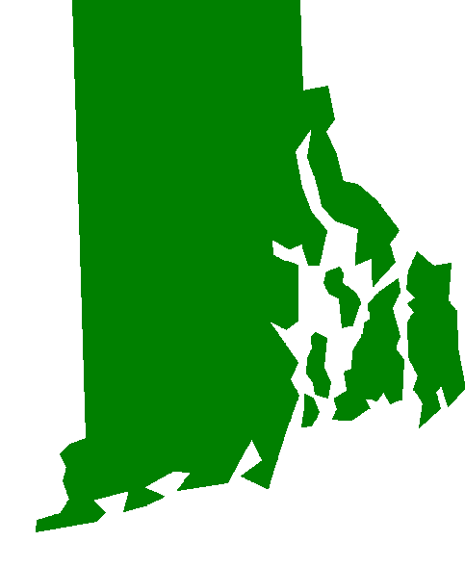
Who Did Not Attend?
Thomas Jefferson
In Paris as US minister to France
John Adams
US ambassador to Great Britain
Patrick Henry
Refused to attend, suspicious of convention / “I smell a rat!”
RI
Opposed to stronger national gov’t

Slide 7
Convention Rules
At least 7 states must be present each day
While speaking, others had to listen
Member could not speak more than 2x on same question
Committees appointed as necessary
Any decision subject to change until entire plan complete
Convention’s proceedings kept secret

Slide 8
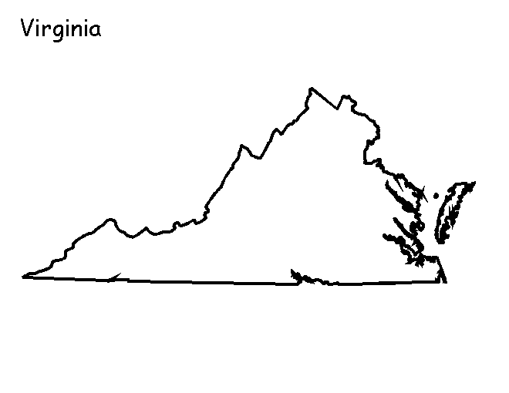
The Virginia Plan
Many delegates wanted to completely scrap Articles, not just amend
Madison proposes new, stronger government
Two governments, national & state (Federal system)
Three braches of national government
Legislative – make laws (most powerful)
Executive – enforce laws
Judicial – interpret laws
Legislature (congress) would have two branches
House of Representatives – elected by the people
Senate – Proposed by States, selected by the House

Slide 9
The Virginia Plan Continued
Representation from each state in both houses based on population or amount contributed to federal treasury.
Proportional representation means that states with a larger population have more representation
Congress would have power to make laws that states were not able to make
Ex) regulating trade between states

