Slide 1
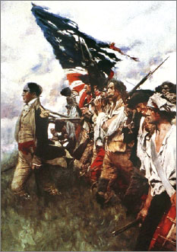
Lesson 8:
What were the Articles of Confederation, and Why Did Some Founders Want to Change Them?

Slide 2
Purpose
This lesson examines the government formed by the Articles of Confederation.
This document reflects the political realities and divisions among the states as well as the need for unity.,
Many Americans felt the US government under the Articles lacked sufficient authority to meet the nation’s needs.

Slide 3
Objectives
Describe the Articles of Confederation.
Explain why some thought the Articles were too weak.
Evaluate, take, and defend positions on..
The strengths and weaknesses of the Articles
The significance of the Northwest Ordinance
American’s mistrust of a strong national government

Slide 4
Terms to Know
Articles of Confederation
(1781-1789) The first constitution of the United States, created to form a perpetual union and a firm league of friendship among the thirteen original states. It was adopted by the Second Continental Congress on November 15, 1777, and sent to the states for ratification.
Confederation
A form of political organization in which the sovereign states combine for certain specified purposes, such as mutual defense. Member states can leave a confederation at any time. The United States was a confederation from 1776 to 1789.
Shays' Rebellion
An armed revolt by Massachusetts farmers seeking relief from debt and mortgage foreclosures. The rebellion fueled support for amending the Articles of Confederation.

Slide 5
Why & How Were the Articles of Confederation Created?
Americans realized that they would need some centralized leadership to address the following issues
Manage relationships between states
Resolve border disputes
Conduct relations with rest of world
Along with Declaration of Independence, Second Continental Congress creates the first US government, the Articles of Confederation (1776)

Slide 6
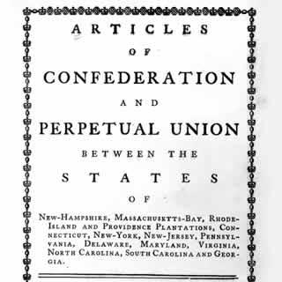
Problems with the “Articles”
Fear of a Strong Central Gov’t
To many, their state was their country.
British government’s “abuse” of power could characterize a strong US government
Study of history suggested that republican gov’t can only succeed in small communities
Articles considered a “firm league of friendship”
Most powers of government were given to states
Ex) Congress could not collect taxes, could not regulate trade

Slide 7
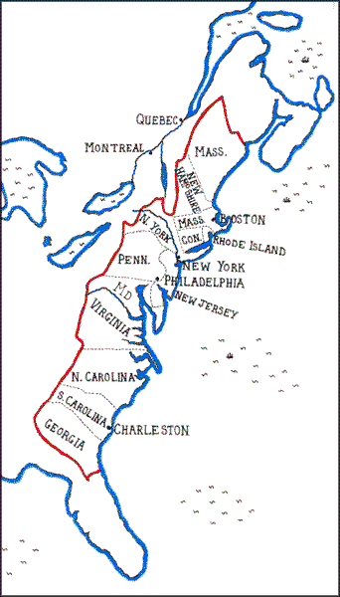
Problems Continued…
Fear that some states would dominate central government
The following issues pitted states against each other
Representation and voting in Congress
Payment for war expenses
Territorial claims in the West

Slide 8
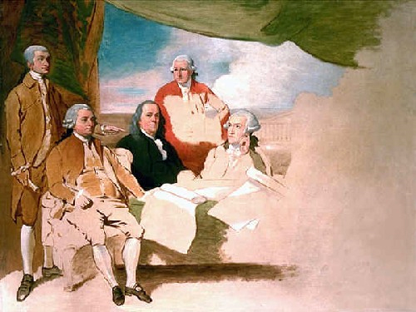
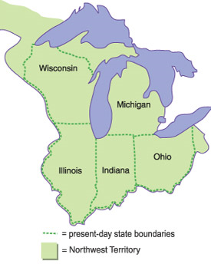
The “Articles’” Achievements
Secured recognition of American Independence
Created executive departments and admiralty courts (developed into Cabinet & Federal Court System)
Northwest Ordinance (1787)
Created process for territory to become a state
Prohibited slavery in new territory
Guaranteed equality of new states

Slide 9
Weaknesses of Articles
No power to tax
Caused problems paying off war debts
No power to force states to recognize agreements with foreign nations
Damaged trade relations
No power to make laws regulating trade among states
No power to makes laws directly regulating behavior of citizens

Slide 10
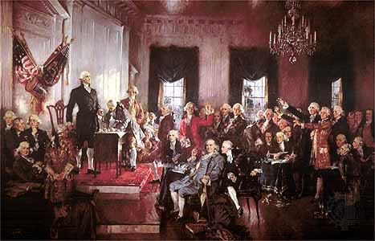
Attempts to Solve Problems
Amendments never passed since all 13 states needed to ratify
Many leaders proposed a meeting, or convention, to discuss changes
Delegates then met in
Philadelphia to propose
changes to the Articles

Slide 11
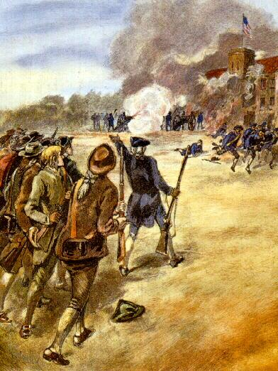
Shay’s Rebellion
100’s of farmers in MA gathered to prevent courts from selling their property
Many ex-soldiers were not paid their wages, therefore falling into debt and losing their farms
Shays and his men attempt to capture weapons arsenal
Governor calls militia to put down rebellion
Fears generated by this and similar conflicts convinced many that a stronger national government was needed

