Slide 1
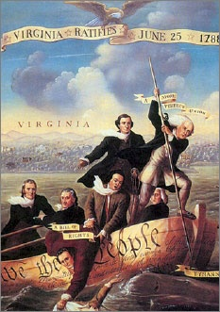
Lesson 7:
What Basic Ideas about Government and Rights Did the State Constitutions Include?

Slide 2
Lesson 7 Purpose
After declaring Independence, the Founders designed new state government to protect individual rights and promote the common good
This lesson shows how the Constitution of Massachusetts in particular was designed to achieve these ends.
It also shows how State constitutions served as a model and had great influence on the development of the U.S. Bill of Rights.

Slide 3
Lesson 7 Terms & Concepts
Checks & Balances
In American constitutional thought, distributing and balancing the powers of government among different branches so that no one branch or individual can completely dominate the others.
Legislative Supremacy
A system of government in which the legislative branch has ultimate power. Parliamentary government is such a system.
Veto
The right of a branch of government to reject a proposed law that has been passed by another branch in an effort to delay or prevent its enactment. Under the U.S. Constitution, it is the power of the president to refuse to sign a bill passed by Congress, thereby preventing it from becoming a law

Slide 4
Lesson 7 Objectives
Explain the basic ideas about government and rights that are included in state constitutions.
Explain how the experiences of the states in developing their constitutions and bill of rights influenced the framing of the US Constitution and Bill of Rights.
Evaluate, take, and defend positions on
The theory of legislative supremacy.
The importance of the Virginian Declaration of Rights, and the role of declaration of rights in early state constitutions.

Slide 5
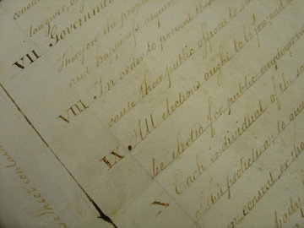
The Colonies’ Status Following the Declaration
States were not yet a “country,” only united by fight against Great Britain
Between ‘76 – ’80, each stated adopted a new constitution
All based upon natural
rights, rule of law,
republicanism, and
constitutional gov’t

Slide 6
Basic Ideas of State Constitutions
Higher Law and Natural Rights
Constitutions limit governmental power
Purpose of gov’t is to protect natural rights
Social Contract
Each constitution created through an agreement w/ the people
Popular Sovereignty
Ultimate governing authority rests with the people
Representative Government
All legislature composed of representative elected by voters

Slide 7
Basic Ideas of State Constitutions
Legislative Supremacy
Legislatures (makes laws) most powerful branch
Leg. Most capable of reflecting will of the people
Executive (enforces laws) is less accountable to people and should not be trusted with too much power
Judiciary (judges) should not be trusted w/ too much power either
Checks & Balances
Parts of each legislature checked (limited) power of other
Usually done through multiple houses (House of Reps & Senate)

Slide 8
How Did Massachusetts Differ?
Strong Executive
Governor popularly elected
Governor’s salary was fixed (could not be changed by Leg.)
Governor could revise laws, appoint Leg. officials and judges
Representation of Various Economic Classes (Classical Republicanism)
Large Property Owners = Can elect governor (Executive)
Mid-level “ “ = Can elect upper house members (Legislative)
Low-level “ “ = Can elect lower “ “ “ “ “ “

Slide 9
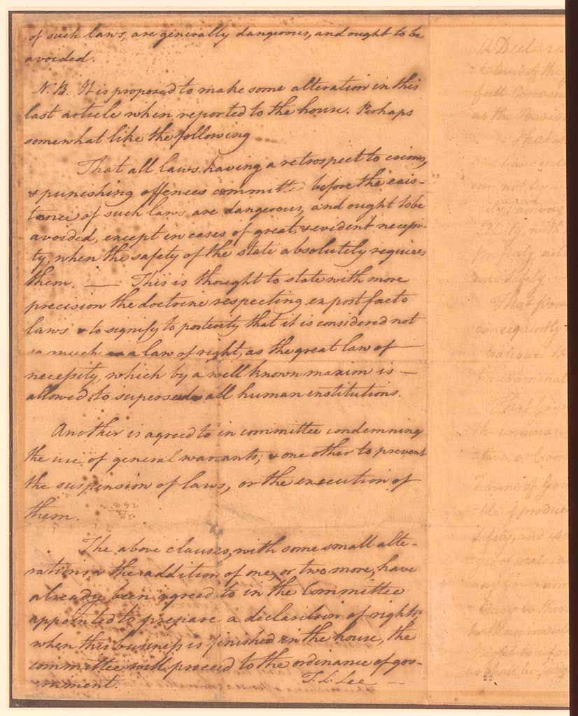
The Virginia Declaration of Rights
Listed specific rights of the people, including:
Freedom of the press
Rights of criminal defendants
Gov’t cannot deprive natural rights
All power is derived & kept by the people
Gov’t is instituted for common benefit, protections, and security. If not, it can be abolished. (Class. Repub., Social Contract)
Freedom of religion

