Slide 1
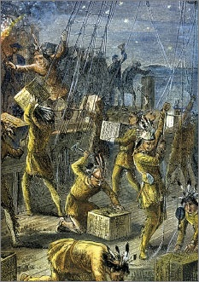
Lesson 6:
Why Did American Colonists Want to Free Themselves from Great Britain?

Slide 2
Lesson 6 Purpose
The growth of the American colonies raised issues with Great Britain that were difficult to resolve peacefully.
This lesson describes the circumstances that produced the Declaration of Independence and the major ideas about government and natural rights included in that document.

Slide 3
Lesson 6 Objectives
Describe the British policies that some American colonists believed violated basic principles of constitutional government and their rights as Englishmen.
Explain why Americans resisted those policies and how that resistance led to the Declaration of Independence.
Evaluate the arguments that the colonists made to justify separation from Great Britain.
Evaluate, take, and defend positions on
Violations of colonists’ rights before the Revolution.
Important questions about the meaning and implications of the Declaration of Independence.

Slide 4
Lesson 6 Terms & Concepts
Compact
A formal contract or agreement between or among two or more parties or states. (ex. The Mayflower Compact of 1620)
Law of Nature
In natural rights philosophy, moral rules found out by correctly applied reason or right reason, telling persons what they may and may not do in various circumstances. In philosophy, laws of nature have often referred to the rules that would prevail in the absence of man–made law. Natural law is conceived to contain standards of justice that apply to all people.
Sovereignty
The ultimate, supreme power in a state. Democratic theory states that the people as a whole are sovereign; the citizens of the United States constitute the sovereign people.
Writ of Assistance
A document giving a governmental authority the power to search and seize property without restrictions. Abolished in American law, the use of such writs by the British government was a major issue during some phases of the American Revolution.

Slide 5
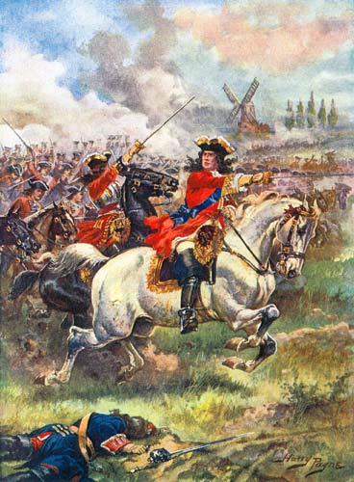
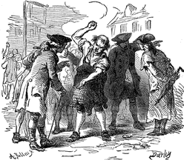
A Change in British Policy
Generations of colonists had little interference from British government in their daily affairs.
However, in 1763
Britain wants colonists to help pay for war w/ French (7 Years War, 1756-1763)
Proclamation Act ‘63– Bans colonial settlements west of Appalachians
Stamp Act ’65 – New taxes on colonists to raise revenue
Quartering Act ‘65 – Required colonists to shelter British troops in their homes

Slide 6
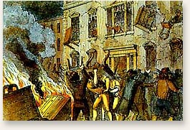
Colonial Resistance
New restrictions & taxes caused some economic hardship & challenged colonists’ understanding of representative government.
“No taxation w/o representation.”
Sons of Liberty help organize popular resistance.
Rarely used violence, but political agitation precipitated crowd action.

Slide 7
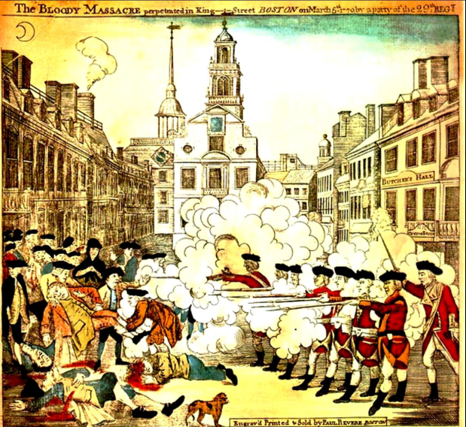
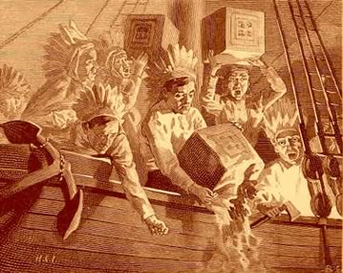
Colonial Resistance (Continued)
’66 – Parliament repeals Stamp Act, but passes Declaratory Act, which asserts Britain's full power & authority over colonies.
Parliament offers Writs of Assistance to officials to search & seize colonial property.
‘70 – Clash between British Troops and colonists, 5 colonists killed (Boston Massacre)
’73 – Colonists protest Tea Act by dumping 45 tons of tea into Harbor (Boston Tea Party)
British Respond with “Intolerable Acts”
Closed Boston Harbor, granted more power to Royal Governors, limited town meetings, authorized British troop occupation

Slide 8
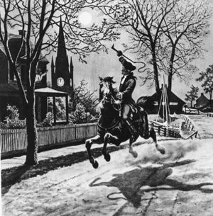
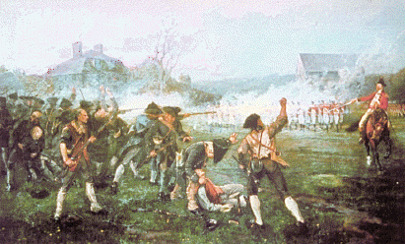
Organized Resistance
‘74 – Colonial representatives meet in Philadelphia , vote to ban trade w/ Britain (1st Continental Congress)
Radical colonists plan to overthrow gov’t since it no longer protected colonists’ rights. (Minutemen)
‘75 – British march to Concord, MA to seize hidden arms & ammunition & arrest Patriot leaders
Revere rides through countryside
warning that …
“Shot heard round the world…”
REVOLUTION BEGINS!

Slide 9
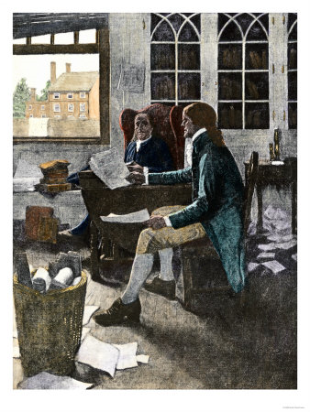
Purpose of the Declaration
Continental Congress appoints committee to prepare a declaration of independence from Britain
Jefferson’s draft rejects the British government’s sovereignty over the colonies
The Founders knew it was important to justify this action to other nations and to identify the basic principles of a legitimate government

Slide 10
The Declaration’s Main Arguments & Ideas
The Declaration renounces the monarchy and appeals to natural rights common to all
Asserts ideal of popular sovereignty
Natural Rights
Constitutions & governments cannot violate them
Social Contract
Human Equality
Humans are politically equal, neither God nor nature appointed some at birth to rule over others
Government by Consent
People grant consent to gov’t to protect natural rights

Slide 11
The Declaration’s Main Arguments & Ideas
“A Long Train of Abuses”
Destroying colonial legislatures
Limiting role of colonial judges
Keeping standing British armies in peacetime
Quartering soldiers among civilian population
Imposing taxes without colonial consent
Depriving colonists trial by jury
Changing constitutions of colonial government
Right of Revolution
If British government has become corrupt and fails to perform its proper duties, colonist have right to establish their own free and independent nation

