Slide 1
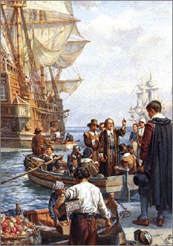
Lesson 5: What Basic Ideas about Rights and Constitutional Government Did Colonial Americans Hold?

Slide 2
Lesson 5 Purpose
This lesson describes how basic ideas of Constitutional government were developed and used in the American colonies before independence.
It also explains how social and economic conditions in America sometimes required old ideas about government to be adapted or discarded.
Occasionally the colonists needed to create entirely new institutions.

Slide 3
Lesson 5 Terms & Concepts
Charter
A written document from a government or ruler that grants certain rights to an individual, group, organization, or to people in general. In colonial times, a charter granted land to a person or company along with the right to found a colony on that land.
Constituent
A person represented by an elected official.
Covenant
A binding agreement made by two or more persons or parties. In Protestant churches during the Reformation, a covenant was an agreement made in the sight of God. The Mayflower Compact was such a covenant.
Indentured Servant
A person who voluntarily sold his or her labor for a set period of time in return for the cost of passage to the American colonies. Indentured servants provided the most important source of labor in the colonies in the seventeenth century and for a large part of the eighteenth century.

Slide 4
Lesson 5 Terms & Concepts (Continued)
Magistrate
A lower-level judicial officer, usually elected in urban areas, who handles traffic violations, minor criminal offenses, and civil suits involving small amounts of money. More generally, magistrate means public official.
Mayflower Compact
An agreement to form a political body signed on November 21, 1620, by all adult males aboard the Mayflower before the ship landed in Plymouth, Massachusetts. The signers agreed to submit to "just and equal Laws" put into effect under the compact "for the general good of the Colony."
Suffrage
The right to vote.

Slide 5
Lesson 5 Objectives
Describe the early development of America’s traditions of constitutional government.
Explain why American colonists attached special importance to such constitutional principles as written guarantees of basic rights and representative government.
Evaluate, take, and defend position on
The differences between life in colonial American and in England during the same period.
The relationship between natural rights theory and slavery in America
How natural rights philosophy and history help to explain the colonists’ views of the proper role of government.

Slide 6
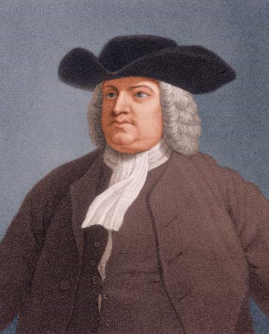
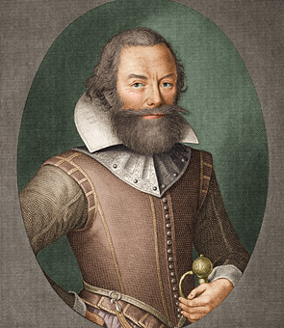
Colonial Settlements = Constitutional Experiments
England provided two incentive plans for settlers
Royal Proprietorship (11 of 13 colonies)
Land given to friends of the king
Proprietors then found ways to lure settlers to their colony
Joint-Stock Company (Virginia)
Land given to companies in order to generate profits (business)
Mayflower Compact
Pilgrims lay foundation for Massachusetts gov’t
Early example of social contract theory

Slide 7
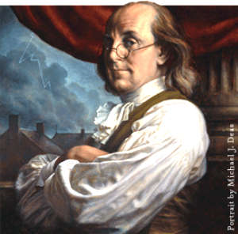
The Unique American Experience
Higher wages and more land available
Colonists ignore many English land customs (primogeniture: land passed down to eldest son)
Wealth & family name did not mean automatic success / Ambition & hard work as, if not more, important for success
The chance to improve one’s life became a fundamental ideal of America

Slide 8
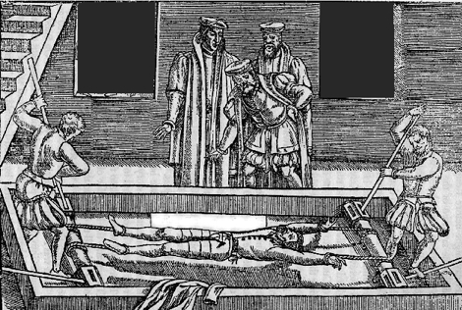
The Rights of Colonial Charters
Many royal charters (written documents that granted rights) echo ideals of Magna Carta
Tradition of expressing rights in writing became an essential part of American constitutions
Examples of rights granted
Habeas Corpus
Trial by Jury
Right to own property
Avoid self-incrimination
Free from cruel & unusual
punishment

Slide 9
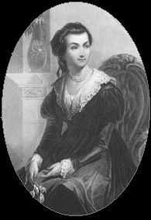
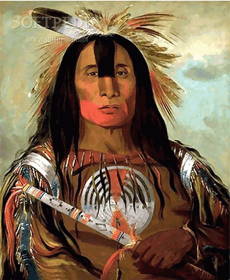
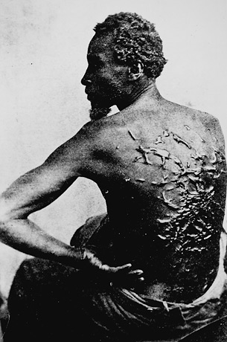
Whose Rights Were Excluded?
In some colonies the following rights were restricted
Only Protestant White Men could vote
Women not granted political rights
½ to 2/3 immigrants were indentured servants (similar to slavery until period of indenture ended)
Native Americans treated as foreigners, often removed from land
African slavery
1760 - 20% of population
Treated as property, denied basic human rights

Slide 10
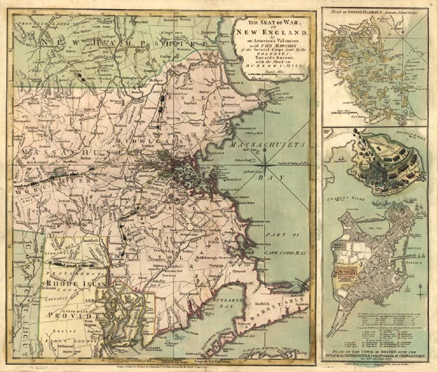
Colonial Ideas of Constitutional Gov’t
Fundamental Rights
Started as fundamental rights of Englishmen
Developed into protections under natural rights philosophy
Rule of Law
Government official must obey the laws and could not exercise power arbitrarily
Separation of Powers
Legislatures – Make laws
Governors - Enforce laws
Courts – Interpret laws

Slide 11
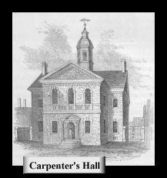
Colonial Governments: More Representative Than Britain?
Property requirements for voting
Land in American relatively easily to obtain, so % of eligible voters larger than in England
Colonial legislatures served shorter terms, meaning more voter choice
Members of colonial legislatures needed to live in the district they represented, unlike England

