Slide 1
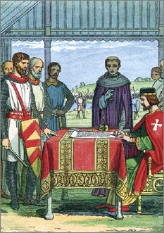
Lesson 4:
What Were the British Origins of American Constitutionalism?

Slide 2
Lesson 4 Purpose
This lesson describes the evolution of British constitutional government.
It examines the early stages of English government in the feudal period.
It also traces the development of representative institutions in England, English common law, the relationship between legal and constitutional structures, and the difference between British and American constitutionalism.

Slide 3
Lesson 4 Objectives
Explain how rights and representative government evolved in England and how this evolution influenced the Founders.
Identify the origins of some of Americans’ most important constitutional rights.
Evaluate, take, and defend positions on
The influence of the Magna Carta on the development of rights.
The importance of habeas corpus and trial by jury.

Slide 4
Lesson 4 Term & Concepts
Common Law
The body of unwritten law developed in England from judicial decisions based on custom and earlier judicial decisions. Constitutes the basis of the English legal system and became part of American law, except in Louisiana, which inherited its civil law system from France.
Magna Carta
King John of England agreed to this document in 1215… The Magna Carta granted certain civil rights and liberties to English nobles and to all "freemen," such as the right to a jury of one's peers and the guarantee against loss of life, liberty, or property except in accordance with law. Some rights were guaranteed for all the king's subjects, free or not free. In doing so, the Magna Carta limited the power of the king, who agreed that his will could be bounded by law, and became a landmark in the history of constitutional government
Precedent
Previous court decisions upon which legal issues are decided.
Redress of Grievances
The correction of complaints. The First Amendment protects the right of the people to petition government to obtain remedies for claimed wrongs.

Slide 5
Lesson 4 Terms & Concepts (Continued)
Rights of Englishmen
Refers to certain historically established rights, beginning with the rights of the Magna Carta, that all English subjects were understood to have. These included the right not to be kept in prison without a trial, the right to trial by jury, security in one's home from unlawful entry, and no taxation without consent, among others.
Rule of Law
The principle that both those who govern and those who are governed must obey the law and are subject to the same laws. This principle is contrasted to the "rule of men," in which those in power make up the rules as they please. The rule of law requires an independent judiciary that is immune from political or other manipulation.
Stare Decisis
Latin: "Let the precedent (decision) stand." The doctrine that a court should follow the previous decisions of other courts on cases in which the facts are substantially the same. This principle plays a key role in common law systems such as those of Britain and the United States.
Writ of Habeas Corpus
Latin: "You shall/should have the body." A court order directing that a prisoner be brought to court before a judge to determine whether that prisoner's detention is lawful.

Slide 6
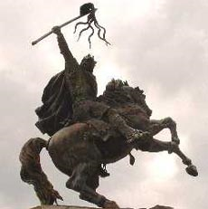
Roots of English Government
After fall of the Roman Empire, England divided into tribes
1066 – William the Conquer unites tribes into a single Kingdom. (Establishes Feudalism)
English monarch
Made laws
Supervised law enforcement
Heard court cases
Defended the kingdom
The kings advisers evolved into
Parliament & the Royal Court

Slide 7
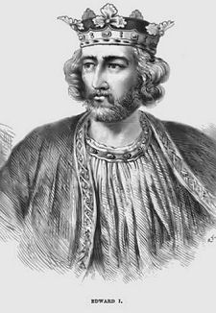
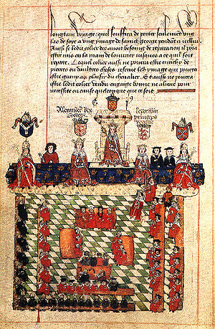
Parliamentary Government Begins
1295 - Edward I summons “Model Parliament”
2 Representative Parts (Houses)
House of Lords: Nobility & Church officials
House of Commons: Citizens & Knights (w/ wealth & status)
For monarchs, Parliament was a convenient way to negotiate with all of the country’s interests at once
English subjects found it to be an effective way to voice grievances & limit monarchs power

Slide 8
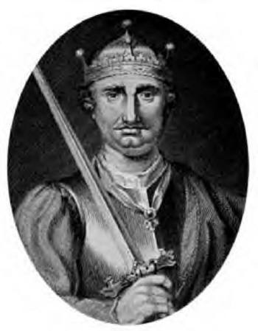
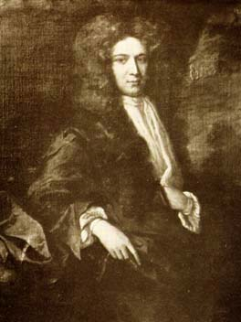
The Development of “Common Law”
To simplify complicated web of local legal systems, William the Conqueror creates a common law for entire kingdom
Judges required to publish decisions (creates precedents used to decide future cases)
This system establishes predictability and stability to laws

Slide 9
The “Rights of Englishmen”
Rights of Englishmen
Over time, monarchs and judges came to recognize certain personal rights (trial by jury of one’s peers)
Magna Carta (1215) – King John forced to sign a charter confirming certain traditional rights
Rule of Law
Every member of society (even Monarch) must obey laws
Outlaws arbitrary government
Basic Rights
Establishes redress of grievances (compensation for loss or wrong done to those if the Crown infringes on their common law rights)
Government by Contract
Established principle of drawing up agreements between parties as a basis for legitimate government

Slide 10
The British Constitution
Not a single document, instead consists of common law, important acts of Parliament, and tradition.
Important documents include Magna Carta (1215), Petition of Right (1628), English Bill of Rights (1689).
Habeas Corpus Established
Government must justify why a person is held in custody.
Limits government from jailing persons arbitrarily or indefinitely

Slide 11
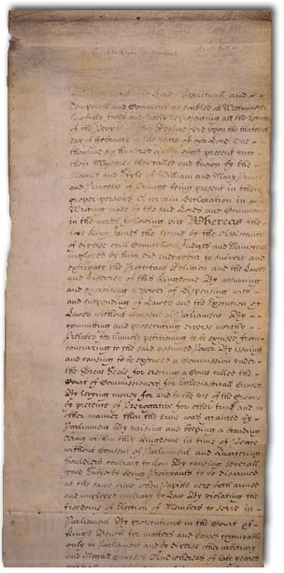
English Bill of Rights
Influences on Founders
Rule of Law
Restated idea in Magna Carta that rule of law is the foundation of limited government
Representative Government
Only representative government is legitimate
Americans reject representation by social classes, instead favoring the idea of social equality

