Slide 1
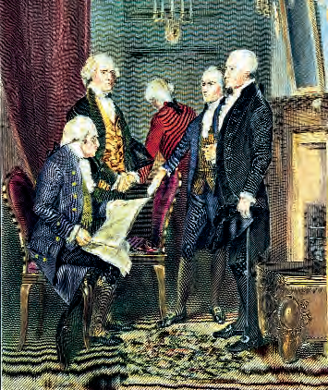
Lesson 39: What Does Returning to Fundamental Principles Mean?

Slide 2
Lesson 39 Purpose
This lesson is different from the others in that it consists mainly of Critical Thinking Exercises that represent great ideas and principles that have shaped our constitutional heritage.
It also asks you to use the skills of citizenship—observation, analysis, debate, and value judgments—to reach, express, and defend an opinion.

Slide 3
Lesson 39 Objectives
You are to practice for the responsibilities you will encounter in the years ahead
You will work through issues and reach your own conclusions.

Slide 4
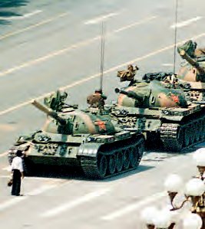
Why are Fundamental Principles Important?
The US began as a test to see if certain ideas about government would work
Keynes said “…in the long run, it is ideas and not men who rule the world.”
Tiananmen Square
Solidarity
Stalin
Victor Hugo: “An invasion of armies can be resisted, but not an idea whose time has come.”

Slide 5
What did the Founders Mean by Returning to First Principles?
1788: “What is the usefulness of a truth in theory unless it exists constantly in the minds of the people and has their assent?”
It is doubtful … an uncritical acceptance of the “wisdom of the past” is good nor what the Founders expected
In revisiting these principals, each generation
Must examine and evaluate them anew!
The Founders were
vigorous critics of inherited wisdom and their principles
Articulate, opinionated individuals who loved to examine ideas
We need to make principled arguments and ground our opinions in ideas of enduring value.

