Slide 1
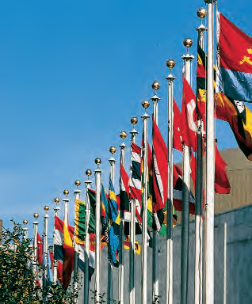
Lesson 38:
What are the Challenges of the Participation of the United States in World Affairs?

Slide 2
Lesson 38 Purpose
This lesson highlights some aspects of America’s participation in the international arena

Slide 3
Lesson 38 Objectives
Identify the constitutional responsibilities of the three branches of the national government in shaping the involvement of the US in world affairs
Describe globalization and identify some of the challenges that globalization poses for citizenship and participation in world affairs
Evaluate, take, and defend positions on issues involving globalization and improving the image of the US abroad

Slide 4
Lesson 38 Terms & Concepts
Collective security
A system formed to maintain peace among nations in which participant members agree that a military attack on one is an attack on all and will result in a united response from all members.
Globalization
Process of interconnectedness and closer integration of world markets and businesses as a result of advances in transportation, communications, and information technologies.
International law
Rules that regulate how countries are to behave toward one another.
Isolationism
Foreign policy of a nation that wishes to be inward-looking rather than involved with other countries.
Letter of marque and reprisal
A grant of authority from Congress to private citizens, not the president, to expressly authorize seizure and forfeiture of goods by such citizens in the context of undeclared hostilities with another country or countries. Without such authority, citizens seizing such goods would be pirates in the eyes of international law.

Slide 5
Lesson 38 Terms & Concepts
Multinational corporation
An enterprise that operates in more than one country
Treaty
An agreement under international law between countries or international organizations
United Nations
International organization created in 1945 to maintain peace through the collective security of its members

Slide 6
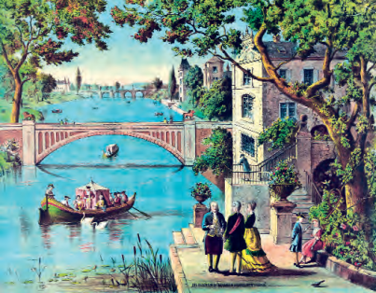
Why is International Engagement Inevitable?
Thucydides (c 460-400 BCE)
“The powerful exact what they can, and the weak yield what they must”
Even from founding, US needed others
World trade and scarce natural resources
Desire to export founding ideas to oppressed
Isolationism is not realistic in a world with fanatical terrorists, predatory states, nuclear and other weapons

Slide 7
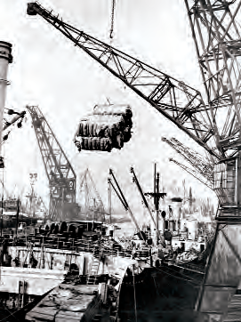
How Does the Constitution Provide for the United States’ Role in the World?
Congress
Regulate commerce among foreign nations and with Indian tribes
Declare war, issue letters of marque and reprisal, and make rules for captures on land and water
Raise and support armies, provide and maintain a navy, and regulate land and naval forces
Define and punish piracies and felonies on the high seas and offenses against the law of nations
Ratify treaties

Slide 8
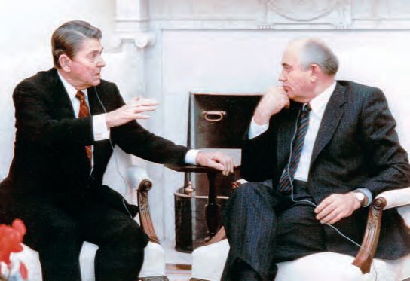
How does the Constitution Provide for the United States’ Role in the World?
President
Negotiate treaties
Act as commander in chief of the army and navy
Appoint ambassadors, other public ministers, and consuls
Receive ambassadors and other public ministers

Slide 9
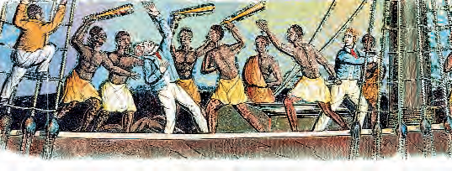
How does the Constitution Provide for the United States’ Role in the World?
Supreme Court
Exercise original jurisdiction over cases affecting ambassadors, other public ministers, and consuls
Exercise appellate jurisdiction over admiralty and maritime cases

Slide 10
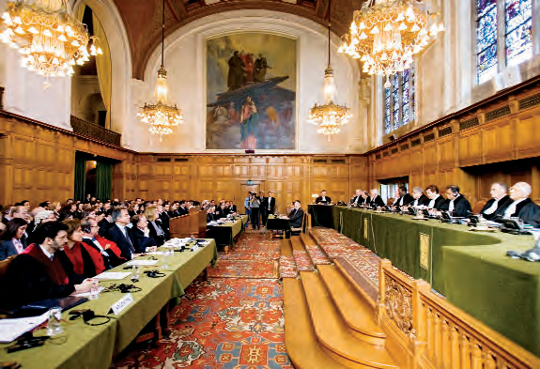
What is International Law?
Body of rules of conduct accepted as legally binding by countries in their relations with each other
Purpose: create and maintain international order
Four overarching ideals:
Equality of sovereign nation-states
Noninterference in the affairs of other nations
No use of force or threat of force
Respect for human rights

Slide 11
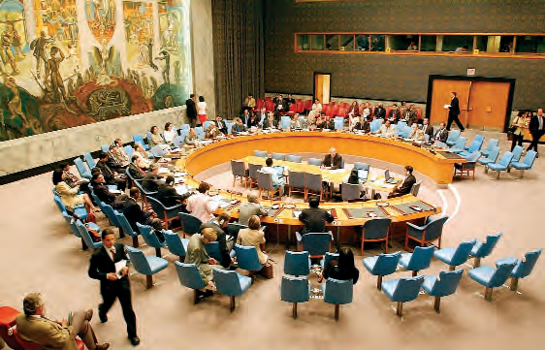
How do International Organizations Help to Maintain International Order
League of Nations after WW I, first attempt through collective security
United Nations, 1945
Goal: maintain peace through collective security; promote friendly relations, international cooperation to solve problems; encourage respect for human rights and fundamental freedoms for everyone
Many administrative bodies
All member countries are expected to provide financial support
5 permanent members: US, Britain, China, France, Russia
Other international organizations since WW II:
NATO
International Monetary Fund
World Trade Organization
World Bank

Slide 12
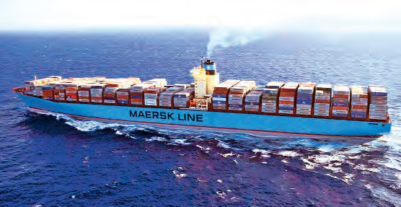
How can Americans Influence International Relations?
Voting, lobbying and contacting national officiate
Joining nongovernmental organizations
Traveling, exercising citizen diplomacy, participating in international education
Making informed consumer decisions

Slide 13
What is Globalization?
Global economy and effects of worldwide economic interdependence on cultures, social relations, and politics
Central features are
Trade and commerce: multinational corps, massive exports of manufactured goods
Worker migration: seek better jobs, leads to immigration policy issues, outsourcing jobs to cheaper labor pools/less regulation
Capital: investment patterns change with new markets/products; creditor nations gain leverage over debtor nation’s policy decisions; volatile markets with news events, stock markets
Information: technology changes with information available to consumers, investors, businesses; influences public opinion, affects political decision, virtual instant access to important info for decisions; fast capital transfers

