Slide 1
Lesson 37:
What Key Challenges Does the United States Face in the Future?

Slide 2
Lesson 37 Purpose
This lesson examines some of the challenges that might affect Americans in coming years.
It also explores issues that might lead to future possible changes to the United States Constitution.

Slide 3
Lesson 37 Objectives
Discuss the effects of diversity and technology on the lives of Americans
Explain the importance of civil discourse in debating divisive issues
Evaluate, take, and defend positions on the changing expectations of America’s government and potential constitutional amendments

Slide 4
Lesson 37 Terms & Concepts
Eminent domain
Inherent power of the state to seize a citizen’s private property or to expropriate property or rights in property without the owner’s consent. The Fifth Amendment provides for “just compensation” for private property taken for public use, known as the “takings clause”
Immigration
Movement of people from one place to another

Slide 5
How Might the United States Look in the Future?
US Census Bureau predicts by 2050:
US population will exceed 400,000,000
Most increase will be from immigration
US will be more racially and ethnically diverse than ever
Racial lines will blur with intermarriage
Medical advances will help Americans live longer
Typical American neighborhood will be in the West or the South
Cost of water, oil, natural gas will soar
Communications and info tech will bring new information and communication methods/vehicles

Slide 6
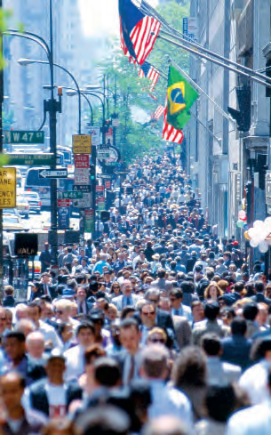
How does Diversity Create New Challenges?
E pluribus unum “has usually been achieved by balancing benefits of a diverse society with unifying influence of common civic culture and constitutional ideals.”
This is a major challenge to sustain.
Opinions vary:
not substantially different; enrich nation’s economy, culture, education or
How much can US absorb, especially those who do not learn to speak English and keep cultural practices that conflict with fundamental American principles

Slide 7
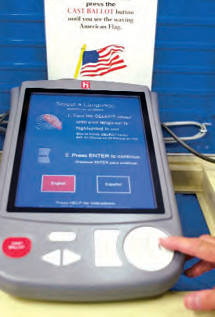
How is Modern Technology Affecting America’s Civic Life?
Improvements transform life
Internet, databases, email
Cable/satellite tv
Community-access tv
Events, proceedings happen electronically and in real time
Does not guarantee better informed populace
Difficult to determine reliability
Messages aimed at specialized audiences
Challenge includes devising ways to use technology to enhance knowledge and civic participation, not insulate from genuine interaction and political discourse

Slide 8
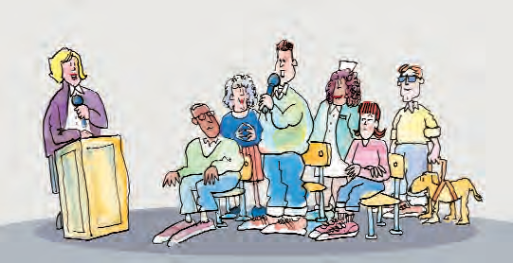
How Might Americans’ Expectations of their Governments Change?
Early America: rely on themselves and private associations to meet needs
20th century: increasingly look to gov’t for social safety net
Are Americans too dependent on gov’t to solve social problems?
Is gov’t growth a sign the private sector is not capable of providing what is required?

Slide 9
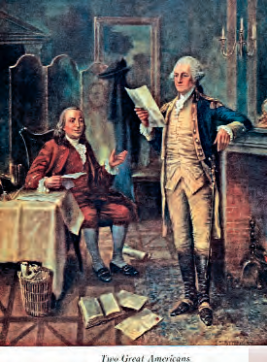
How can Civil Discourse Help to Address the Challenges Facing Americans?
Robust exchange of ideas and opinions by engaged citizenry is hallmark of vibrant democracy
Civil discourse is essential
Civil exchange of ideas and perspectives increases chances of finding mutually acceptable solutions to problems
Example: Constitutional Convention of 1787

Slide 10
What Additional Constitutional Changes Might Americans Debate?
Life and death:
When life begins/ends
Right to life/death
Term limits
Should 22nd Amendment be repealed?
Should limits apply to the House and Senate?
Should judges serve limited terms?
Property rights
“Takings clause”—eminent domain: should it be used by municipalities to sell to private entities?
Campaign finance
Should there be limits
Immigration
Illegals, legal visitors staying after visa expiration
Should clauses be amended to person from citizen or legal resident for equal protection and due process clauses?

