Slide 1
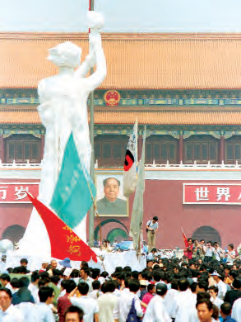
Lesson 36:
How Have American Political Ideas and the American Constitutional System Influenced Other Nations?

Slide 2
Lesson 36 Purpose
This lesson examines some of the challenges associated with using the American constitutional model in other parts of the world

Slide 3
Lesson 36 Objectives
Identify which aspects of the American constitutional system have been influential elsewhere.
Explain why some countries and international organizations have chosen to modify the American system or to use other types of democratic systems.
Explain how the US Bill of Rights influenced other countries and how some have adopted bills of rights considerably different from the US.
Evaluate, take, and defend positions on why some aspects of American constitutional democracy that have been effective in the US were not used in other countries.

Slide 4
Lesson 36 Term & Concepts
Human rights
Basic rights and freedoms said to belong to all people everywhere
Universal Declaration of Human Rights
An advisory declaration adopted by the United Nations General Assembly on December 16, 1948, consisting of thirty articles outlining the view of the General Assembly on those rights conceived as guaranteed to all people

Slide 5
How have American Ideas about Government and Human Rights Influenced Other Parts of the World?
Constitutional principals: popular sovereignty, individual rights, limited government, rule of law
Inspired French Revolution, 1789
1791 Constitutions: France, Poland
1800s: Latin American countries free from Spain, model for republic gov’t
1825: Russia, unsuccessful but inspired
20th century:
German constitution 1949—freedoms: religion, assembly, speech, press, expression
Afghanistan, Bosnia, Herzegovina, East Timor, Eritrea, Iraq, Poland, South Africa, Venezuela
After Cold War: former communist states experiment with constitutionalism of their own

Slide 6
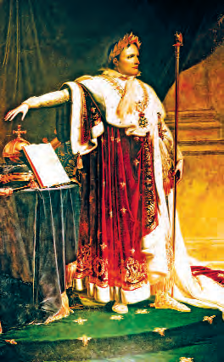
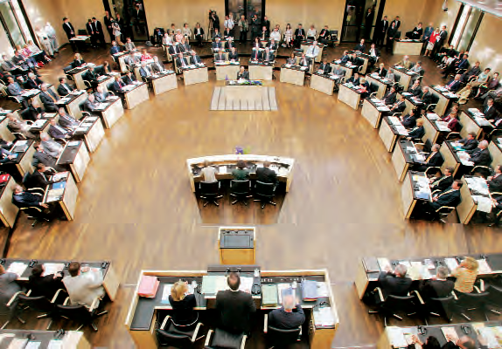
What Elements of American Constitutionalism have Influenced other Countries?
World’s first written framework for national government: US Constitution
Set standard for using convention to draft constitutions, then submit to people for ratification
Presidential government—head of state, elected, cannot be removed by vote of no confidence
Federalism—separate and overlapping powers
Judicial power & human rights—judicial review is an enforcement mechanism; need independent judiciary

Slide 7
How do Other Guarantees of Rights Differ from the Bill of Rights?
Bill of Rights: individual personal, economic, political rights; includes “negative” rights—gov’t “shall not”…
Contemporary charters of human rights assert positive rights—health care, education, equal pay for equal work, fair and just working conditions

Slide 8
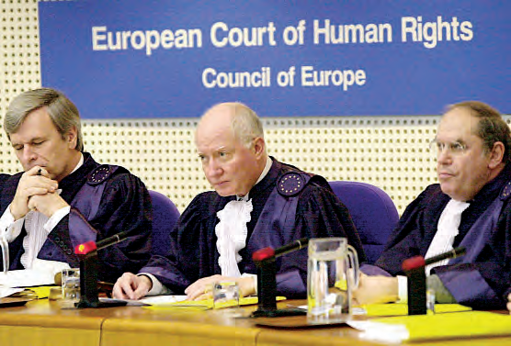
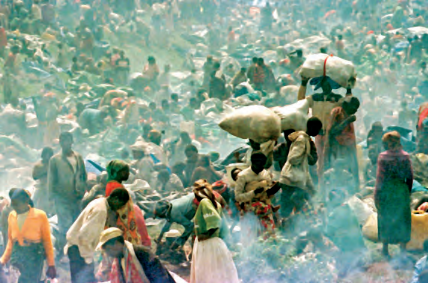
How is the United Nations’ Universal Declaration of Human Rights Similar to and Different from the Bill of Rights?
FDR asked Congress to adopt laws that would become a 2nd Bill of Rights; didn't happen
His widow used this to help the UN craft the Universal Declaration of Human Rights
30 articles; US agreed in 1948
Personal liberty outlawed coerced or arranged marriages, slavery
Habeas corpus and equal protection
Prohibition of ex post facto laws
Freedom of assembly, religion, speech, association, property rights, sanctity of home and correspondence
Prohibition of torture
Duty to community
Right to work, join unions, equal pay
Rest and leisure, reasonable work hours, periodic paid holidays
Adequate standard of living for health and well-being
Education
To seek, receive, and impart information and ideas via media
Regional agreements expanded it with European Court of Human Rights
Protection of rights is now important diplomatically

