Slide 1
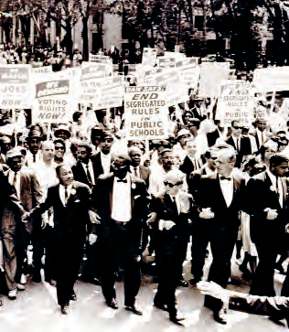
Lesson 35:
How Have Civil Rights Movements Resulted in Fundamental Political and Social Change in the United States?

Slide 2
Lesson 35 Purpose
The Declaration of Independence is celebrated for its commitment to the principles of human liberty and equality.
This lesson examines why African Americans, women, and other groups found it necessary to take concerted action to ensure recognition of their civil rights.

Slide 3
Lesson 35 Objectives
Explain the importance of the
Civil Rights Act of 1964
Voting Rights Act of 1965
Discuss the role of civil disobedience in America’s constitutional democracy.

Slide 4
Lesson 35 Terms & Concepts
Civil disobedience
Nonviolent refusal to obey laws that citizens regard as unjust or in protest of specific public policy
Civil rights
Rights belonging to an individual by virtue of citizenship
De facto segregation
Racial segregation not mandated by law
De jure segregation
Racial segregation mandated by law

Slide 5
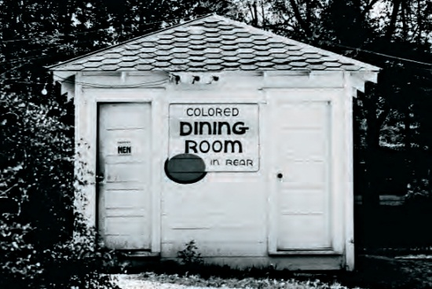
What was the Status of Civil Rights in Mid-Twentieth Century America
De jure segregation:
Separation required by law
De facto segregation:
Racial separation caused by actions of private individuals and groups
Brown: implied all laws compelling racial separation violate guarantee of equal protection of the laws
Racial segregation and discrimination was deeply entrenched: slavery almost 250 years, Jim Crow after the Civil War, US Army desegregated in 1948
National government usually deferred to state

Slide 6
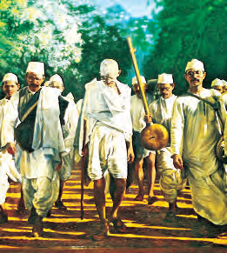
What were the Origins of the Modern Civil Rights Movement for African Americans and What were Its goals?
KKK and Jim Crow
Religious, social, political associations nurtured networks of communication and resistance
NAACP, 1909 founded
Influenced by Gandhi
Civil disobedience is usually nonviolent direct action
Preparation and education was key; political organization, social nonviolent action—sit ins, protests, marches, boycotts, demonstrations
Goal: overturn laws, protect right to vote

Slide 7
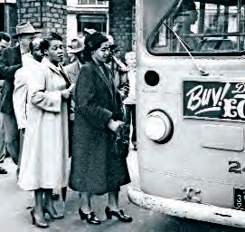
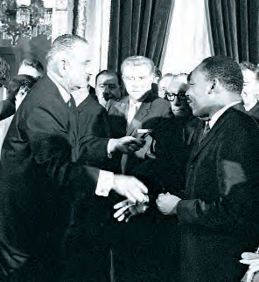
What is the Civil Rights Act?
1963: demonstrations throughout the South, some met with violence
Kennedy announced he would ask Congress for civil rights legislation; killed 3 months later
Johnson signed Civil Rights Act 1964
Most far-reaching civil rights law in US history,
outlawed de jure and de facto segregation
Discrimination in hotels, restaurants, theaters, gas stations, airline terminals, public accommodation sites
Prohibit job discrimination by businesses and labor unions
More national government authority to end school segregation
US Justice Dept. to file lawsuits against states discriminating against women and minorities

Slide 8
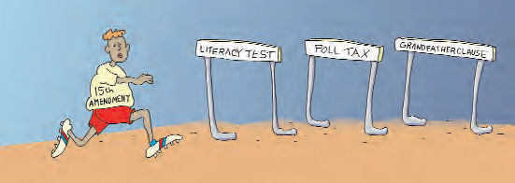
What is the Voting Rights Act?
1965 march: Selma to Montgomery
Alabama gov. sent troops: clubbed and beat marchers, killed one
Prohibits discrimination by race
Eliminates literacy tests, poll taxes, discriminatory registration practices
Requires state and local to provide voting materials and assistance in appropriate language based on # voters
2006--extended

Slide 9
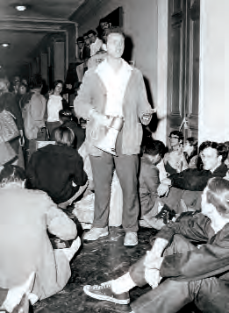
What is the Role of Civil Disobedience as a Form of Political Participation?
Used against slavery, in woman suffrage & civil rights movements
King and Thoreau: individuals should obey their conscience. “When conscience and law conflict, individuals have moral responsibility to promote justice by disobeying law”
Critics: never justified, weakens respect for law, makes individual “final” judge—not the law
Defenders: can be no other final judge than individual conscience; laws are not necessarily just; there are higher moral laws which shape moral consciousness; unjust breeds disorder, seeking more just society may promote order rather than undermine it

Slide 10
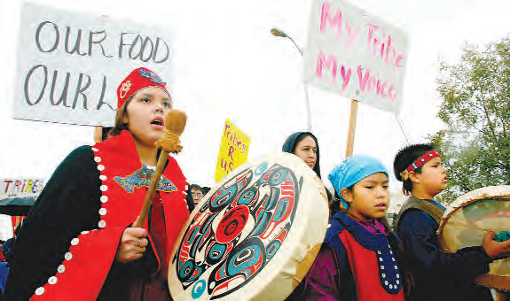
How has the Movement for Civil Rights Changed since the Mid-Twentieth Century?
Focus changed from race-centric
Voter registration
Increase minimum wage
Better health care for HIV/AIDS
High-quality public education for minority children
Farm workers
Chavez & Huerta
Better work conditions
Pesticides
Boycotts, strikes, protests
UFW
Native Americans
Substandard housing
Unemployment
Police brutality
Discrimination
AIM

