Slide 1
Lesson 34: What is the Importance of Civic Engagement to American Constitutional Democracy?

Slide 2
Lesson 34 Purpose
Popular sovereignty means people have ultimate governing authority, which carries the responsibility to exercise that authority knowledgeably to balance individual interests and the common good.
This lesson describes ways Americans can participate in civic life to help achieve ideals set for themselves and their nation.
It explains how civic engagement can advance both self-interest and common good.
It also discusses issues related to voting and voting turnout.

Slide 3
Lesson 34 Objectives
Describe needed reforms to
Education system
Political process
The Constitution
Explain opportunities for participation in civil life afforded by
Voluntary associations
NGOs
Service and business organizations
Voting
Evaluate, take and defend positions on
Whether voting should be mandatory
How voting could be easier/more convenient

Slide 4
Lesson 34 Terms & Concepts
Nongovernmental organization
An autonomous organization independent of direct governmental control that exists to perform any of a large number of purposes, including humanitarian, educational, or public policy problems and issues
Voluntary associations
Autonomous organizations founded and administered by private citizens, not elected officials, devotes to one or more purposes. They form an essential element of the social basis of democracy
Voter registration
Requirement in some democracies for citizens to enroll in voting rolls before being allowed to participate in elections

Slide 5
Why Should Americans Participate in the Civic Life of the Country?
It helps individuals become attached to their community, region, state, country
They become more likely to vote
They are more likely to be well informed

Slide 6
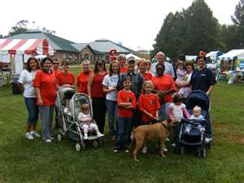
How do Voluntary Associations Contribute to Civic Engagement?
Become engaged in civic projects
Commit to making things better
Work toward a common goal
Types:
Religious
Social: book clubs, sports, women’s, athletics, school, scholarship
Service: Kiwanis, Lions, Jaycees, Rotary
Business: medical/disease, profession, industry
Nongovernmental organizations—NGOs: usually classified by focus i.e. disaster relief, health care, economic development, environmental protection; service or social groups
Carter Center, League of Women Voters,
Actively lobby for causes and do public education

Slide 7
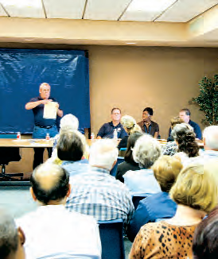
How can Americans Participate in Local and State Governments?
Elect, oversee representatives
Local: councils, commissions, school districts, advisory boards, review boards
State: inform one’s self about issues and candidates, elect judges, boards to study and make recommendations regarding matters such as
Child welfare
Drug and alcohol programs
Environmental protection

Slide 8
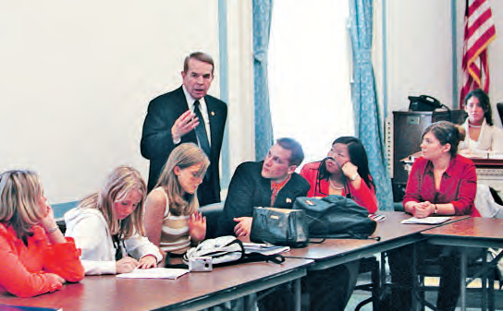
How Can Americans Participate in the National Government?
More limited than state/local
Political parties
Get involved in campaigns
Get voters out to vote
Have a voice in shaping policy, platforms, and goals
Advisory groups of constituents to representatives
Communicate with representatives

Slide 9
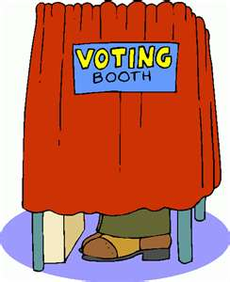
What Needs to be Done to Encourage Voter Turnout?
Elections are administered at the state and local level with help from the Federal Election Commission
Voter registration is done by local and state officials
Absentee/early voting is more popular now
Should presidential election days be national holidays?
Should polling places be open 24 hours or multiple days?

Slide 10
How is Civic Participation Connected to Self-Interest?
Personal interest—economic, quality of life
Acquiring skills
Learn how to affect decisions
Become more self confident
Develop contacts
Build a reputation as important member of community
Make new friends
Self-interest can be “enlightened” or narrow

Slide 11
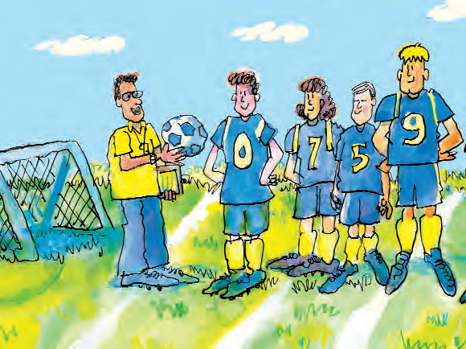
How is Civic Participation Related to Advancing the Common Good?
Makes people aware of other perspectives
Leads to concerns for the common good
Individuals see themselves related to the larger whole
Modify behavior to serve the needs of the whole
Strengthens network of interdependence

