Slide 1
Lesson 33: What Does it Mean to Be a Citizen?

Slide 2
Lesson 33 Purpose
This lesson discusses citizenship, how ideas about it have changed in the US, naturalization, dual citizenship and responsibilities of citizens and resident aliens.
Participation in government through the electoral process tacitly gives agreement to be governed by the Constitution. Most people at some point take an oath to support and defend the Constitution—in the military, as a juror, lawyer, teacher, or other way. This lesson discusses these ways.

Slide 3
Lesson 33 Objectives
Explain some of the most important legal rights and obligations of citizens.
Explain some of the most important moral rights and obligations of citizens.
Explain the different ways one may become an American citizen.
Evaluate, take, and defend positions on
How American citizenship was defined before the 14th and later amendments.
How the rights and responsibilities of citizens differ from those of naturalized aliens

Slide 4
Lesson 33 Terms & Concepts
Alien
A person not living in the country of his/her citizenship; foreign-born resident
Citizen
Legal member of a nation, country, or other organized, self-governing political community, such as a state
Denaturalization
To lose or renounce one’s citizenship; a legal process
Dual national citizenship
To be a legal citizen of two or more countries at the same time

Slide 5
Lesson 33 Terms & Concepts
Enlightened self-interest
Philosophy of ethics stating people who act to further interests of others ultimately serve their own self-interest
E pluribus unum
Latin: Out of many, one
Jus sanguinis
Right by which nationality or citizenship can be recognized to any individual born to a parent who is a national or citizen of that state
Jus soli
Right by which nationality or citizenship can be recognized to any individual born in the territory of the related state
Naturalization
To be come a citizen of a country not of one’s birth, legal process
Resident Alien
A noncitizen who lives in a country legally not of one’s birth

Slide 6
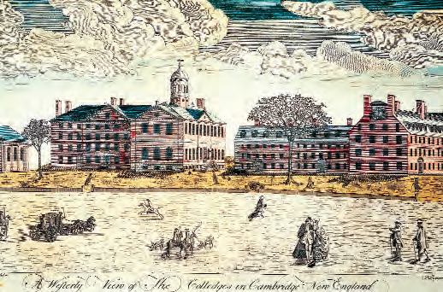
How have Americans Thought of Citizenship?
Commonwealths: a self-governing community in which members are expected to serve the good of all.
The Founders counted on citizens as self-sufficient individuals capable of meeting most of their own needs and would thrive in a system of limited government

Slide 7
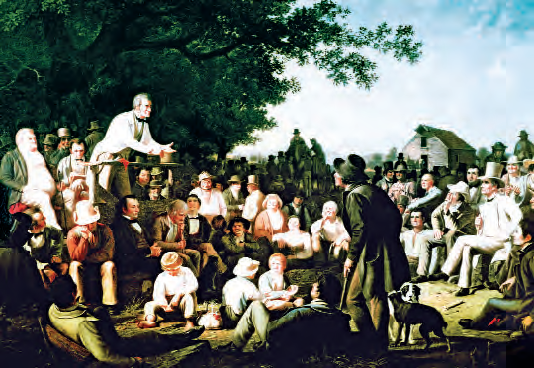
How did deTocqueville Connect Good Citizenship with Self-Interest in the United States?
Democracy in America
While impressed with equality of opportunity in American society
Wondered how a society so devoted to materialism and pursuit of individual self-interest could produce civic spirit needed for self-government
He argued they found a way to bridge the gap between classical republican virtue and natural rights self-interest
Quote on 245

Slide 8
How Have Ideas about Citizenship Changed in the United States?
From British subjects to colonial citizens
To a particular state and eventually to the “united” states
Philadelphia Convention delegates left citizenship issue to the states; 1787 Constitution, then the Articles of Confederation 1781-1788 continued to do so

Slide 9
Who are Naturalized Citizens and What Should be the Criteria for Naturalization?
Naturalization is a legal process to become a US citizen.
It can be granted to individuals or entire populations by statute or treaty.
It is tied to immigration policy
Only lawfully admitted aliens can become citizens
At least 18 years old
Resided in US continuously for at least five years
Good moral character
Can read, write, speak, and understand English
Demonstrate a belief in and commitment to the US Constitution principles
Take the Oath of Allegiance

Slide 10
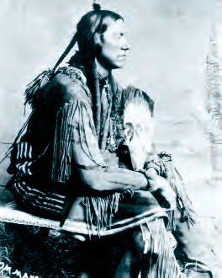
How has Citizenship Status of Native Americans Evolved?
Constitution Article I suggests they are separate, sovereign nations
1831, Supreme Court changed the interpretation saying they are “domestic dependent nations”
1924, Indian Citizenship Act made them citizens of the US and states where they reside.
Indian Civil Rights Act of 1968 includes protecting the “sovereignty of each tribal government.”

Slide 11
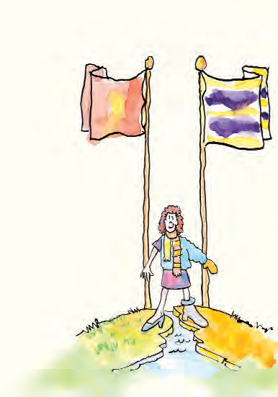
What is Dual National Citizenship?
Being a citizen of two countries
Children of American citizens who are born abroad are American
Dual citizenship for Americans is not currently addressed by law.

Slide 12
How May US Citizenship be Lost?
Supreme Court held that stripping natural-born citizens of their citizenship is cruel and unusual punishment, therefore illegal to do
Giving up US citizenship is a “natural and inherent right of the people”
US citizenship may be revoked for:
Becoming a naturalized citizen elsewhere
Swearing an oath of allegiance to another country
Renouncing citizenship formally
Being convicted of the crime of treason

Slide 13
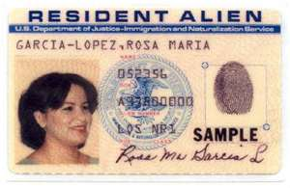
What are the Rights of Citizens and Permanent Residents?
Usually, only citizens can hold public office
Residency requirements usually accompany citizenship requirements for holding office
Only the president must be a natural born citizen of the US
Only citizens can vote
Territories such as Puerto Rico do not vote in national elections in their territorial homes
Many states revoke voting rights of convicted felons.
Most other rights are the same for both

Slide 14
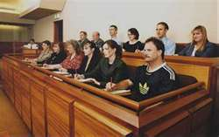
What are the Responsibilities of Citizens and Resident Aliens?
Everyone has a duty to obey the laws and pay taxes
Citizens have additional responsibilities:
Voting
Serving on juries

