Slide 1
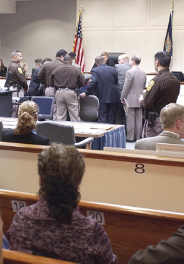
Lesson 32:
How Do the Fifth, Sixth, and Eighth Amendments Protect Rights Within the Judicial System?

Slide 2
Purpose
This lesson explores how the 5th, 6th, and 8th Amendments protect the rights of accused criminals before and during trial.
This lesson also explores the rights of those who have been convicted of crimes.

Slide 3
Objectives
Explain the 5th and 6th Amendment guarantees regarding indictments, double jeopardy, and due process.
Identify the rights protected by the 6th Amendment, particularly the right to counsel.
Describe the 8th Amendment provisions about bail and punishment.
Evaluate, take, and defend positions on the death penalty.

Slide 4
Terms to Know
bail Money or other security given to obtain an arrested person's release from legal custody, which is forfeited if the individual subsequently fails to appear before the court for trial. capital punishment The use of the death penalty by a judicial system. cruel and unusual punishment A criminal sanction or penalty that is not in accord with the moral standards of a humane and compassionate society. The Eighth Amendment prohibits such punishments. double jeopardy The provision in the Fifth Amendment to the U.S. Constitution that a person may not be tried twice for the same crime.

Slide 5
Terms to Know
grand jury A panel of jurors designated to inquire into alleged violations of the law in order to ascertain whether the evidence is sufficient to warrant trial. Contrasted with the "petite jury," usually composed of twelve people, of an ordinary trial. indictment A formal charge by a grand jury accusing a person of having committed a crime. plea agreement Pleading guilty to a lesser crime than that charged by a prosecutor. right to counsel Part of the right to a fair trial, allowing for the defendant to be assisted by an attorney, and if the defendant cannot afford counsel, requiring that the state appoint an attorney or pay the defendant's legal fees.

Slide 6
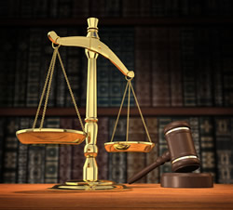
Importance of Procedural Justice
A Fundamental Premise
Person accused of a crime is innocent until government proves guilt beyond a reasonable doubt.
Procedural rules designed to protect the innocent.
Although some guilty remain free, it is considered a small price to pay to avoid mistakenly convicting the innocent.
Procedural right important because criminal law pits the power of the government against the individual.

Slide 7
5th, 6th, and 8th Amendment Protection of Rights Before Trial
Pretrial Protections
Indictment
Formal statement of charges requires so defendant knows how to prepare a defense (unless reach plea agreement)
Grand jury decides whether gov’t has strong enough case to proceed with trial. (applies only to cases in federal court)
Most states rely on preliminary hearings where judge decides
Bail
Release before trial helps them prepare for defense and avoids punishing innocent suspects. (not all suspects granted bail)
8th Amendment prohibits “excessive bail”

Slide 8
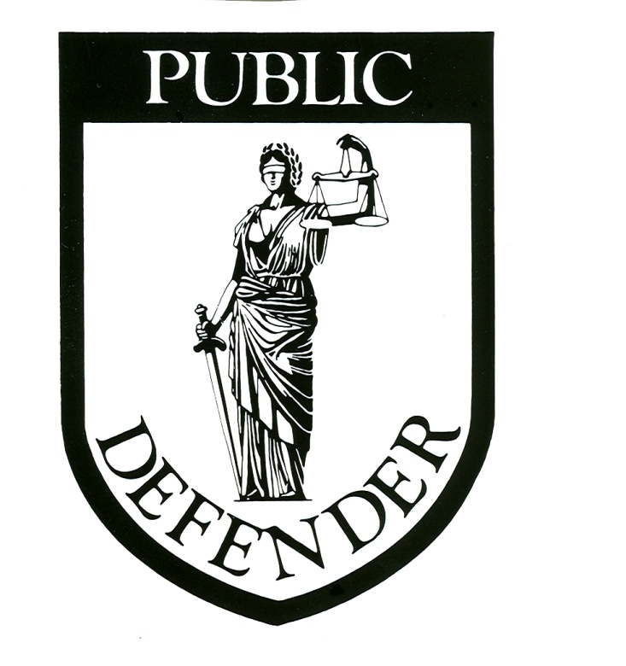
5th, 6th, and 8th Amendment Protection of Rights Before Trial
Counsel
6th Amendment guarantees right to counsel during questioning, while preparing for trial, and during trial.
Gideon v. Wainwright, 1963
Counsel provided if suspect cannot afford to pay
Complexity of adversarial system requires use of lawyers
Extending the Right to Counsel
Every person accused of a felony
Those too poor to afford them

Slide 9
5th and 6th Amendment Protections During Trial
A Speedy, Public Trial
Diminishes the possibility that evidence will disappear or witnesses memories will fade
Safeguards against courts being used as instruments of persecution
Grants opportunity for public to become more informed
However, judge can order some proceedings closed if it makes it impossible for defendant to receive a fair trial.
Right to Counsel
Although, defendant can waive right to counsel

Slide 10
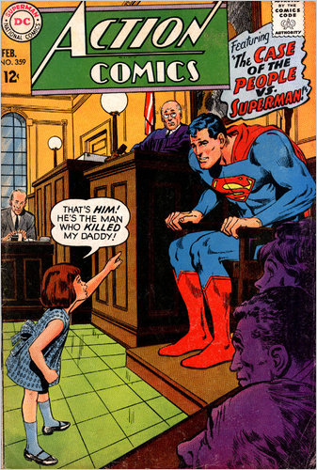
5th and 6th Amendment Protections During Trial
Compulsory Process and Confrontation
Defendants can require accusers to appear in court and be questioned. Cross-examining witnesses tests the truth of their written statements.
Impartial Jury in State & District Where Crime Was Committed
Jury trial protects against unfounded charges and biased/complacent/eccentric judges.

Slide 11
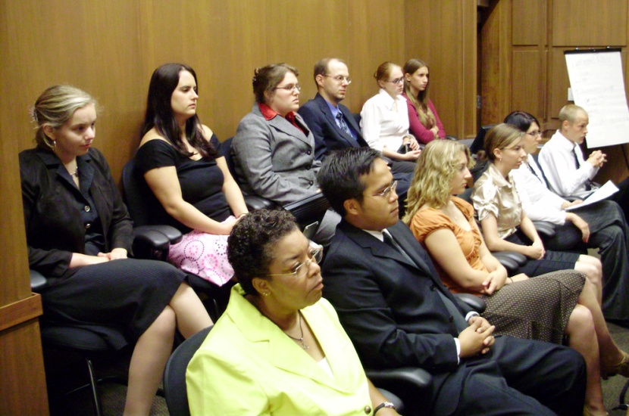
Jury Trials
Jury trials not required for petty offenses.
Historically 12 members, but Court has permitted juries as small as 6 in cases not involving death penalty.
Court has upheld state laws that require less-than-unanimous (12-member) verdicts if no death penalty involved.
Court has struck down laws
discriminating against prospective
jurors on basis of gender, race,
and religion.

Slide 12
5th and 8th Amendment Protections After Trial
No Double Jeopardy
If acquitted, gov’t cannot prosecute again for the same crime. However, can be tried in both Fed & State court if conduct violates laws of both.
No Excessive Fines
Fines must be reasonable in relation to crime and must not deprive defendant of equal protection of the laws. (14th)
No Cruel & Unusual Punishment
Prohibits tortuous punishments of 18th c.
Trop v. Dulles (1958) – cannot strip citizenship from natural born citizens.

Slide 13
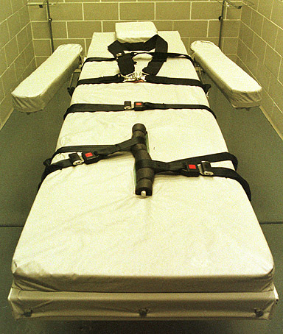
The Capital Punishment Controversy
Court has ruled that death penalty is constitutionally acceptable.
Cases of interest…
Furman v. Georgia (1972)
Standards needed for jury
Coker v. Georgia (1977)
Death penalty for rape unconstitutional
Roper v. Simmons (2005)
Death penalty for those under 18
(when crime committed) is
unconstitutional

Slide 14
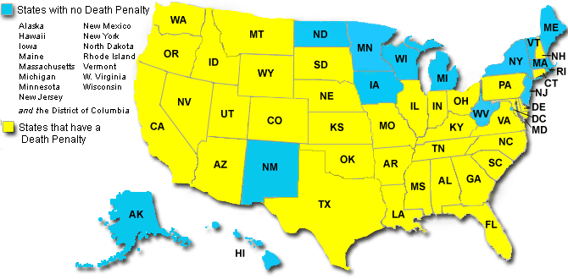
The Capital Punishment Controversy
http://www.amnestyusa.org/death-penalty/death-penalty-in-states/page.do?id=1101153

