Slide 1
Lesson 31:
How Do the Fourth and Fifth Amendments Protect Against Unreasonable Law Enforcement Procedures?

Slide 2
Purpose
The 4th Amendment limits the powers of government officials to search and seize individuals, their homes, their papers, and other property.
The 5th Amendment contains protections for criminal defendants, including protection from self-incrimination.
This lesson focuses on these protections and examines how and why they were important to the Framers.

Slide 3
Objectives
Explain the purpose and history of the 4th Amendment and issues raised by its interpretation.
Explain the importance of the 5th Amendment provision against self-incrimination.
Evaluate, take, and defend positions on contemporary issues involving the 4th Amendment and self-incrimination.

Slide 4
Terms to Know
affidavit A formally sworn statement. exclusionary rule The rule established by the U.S. Supreme Court that evidence unconstitutionally gathered by law enforcement officers may not be used against a defendant in a trial. probable cause Reasonable grounds for presuming that a crime has been or is in the process of being committed. Provided for in the Fourth Amendment. reasonableness Quality of what a rational and fair-minded person might say. right against self-incrimination A guarantee found in the Fifth Amendment against being compelled in any criminal case to be a witness against oneself.

Slide 5
Terms to Know
search In the context of American constitutional law, intrusion into someone's privacy. seizure In the context of U.S. constitutional law, interference with a person's property or freedom of movement. use immunity A guarantee government prosecutors give to a witness to not use the witness's self-incriminating compelled testimony as evidence against the witness in a subsequent criminal prosecution. A witness who receives use immunity may still be prosecuted, but based only on evidence not gathered from the protected testimony. warrant An order by a judge authorizing a police officer to make an arrest or search or perform some other designated act.

Slide 6
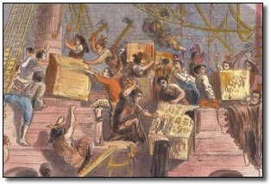
The 4th Amendment’s History
English Common Law
Americans inherit principle that a “man’s home is his castle.”
Common law prohibited open-ended general warrants known as “hunting licenses.”
Colonial Experience
Parliament issued general warrants to collect taxes, recover stolen goods, and persecute smugglers (Hancock)
Colonial objections helped spur Revolution
Anti-Federalists protest lack of protection
against such general warrants in body of
Constitution.

Slide 7
The 4th Amendment’s Purpose and Importance
Components
Prohibits general warrants
Probable cause necessary to obtain a warrant
Requires judge to determine whether probable cause exists
Requires applications for warrants to “particularly” describe the “place to be searched and persons or things to be seized.”
Importance
Prohibits the “most effective weapon in the arsenal of every arbitrary government.” - Justice Robert Jackson
Protects reasonable expectations of privacy

Slide 8
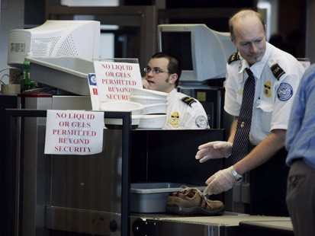
Interpreting and Applying the Fourth Amendment
An Ongoing Challenge
Striking a balance between society’s need for order/safety and the individual’s right to autonomy / privacy
Importance considerations:
When is a warrant required?
What is probable cause and when is it required?
How should 4th Amendment be enforced?

Slide 9
Warrants and Probable Cause
Protecting Individuals From Arbitrary Actions
Officials must submit a detailed affidavit to judge
Probable cause means enough evidence for a reasonable person to believe it is likely that an illegal act is being or has been committed.
But does not require absolute certainty
Examples of Exceptions to Warrant Requirements
Police are at the scene of a violent crime or robbery in progress (“In Hot Pursuit”)
If person consents to search or seizure
Evidence is “in plain sight” of official

Slide 10
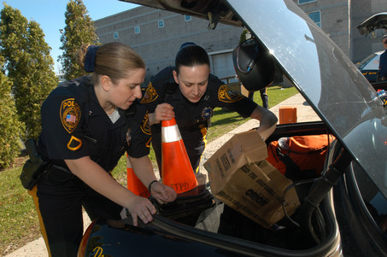
The Exclusionary Rule
What if Official Break the Law Regarding Warrants?
Weeks v. US (1914)
Prevents use of illegally obtains evidence during trial
Exclusionary rule discourages officers from breaking the law
Mapp v. Ohio (1961)
Exclusionary rule extended to criminal trials in state courts
Critics argue it ties the hands of police and is too high a price to pay for violations of 4th amendment.
Modifications since 1961
If officials relied in good faith upon
defective search warrant
“Inevitable discovery” rule

Slide 11
Alternatives to the Exclusionary Rule
Proposals To Replace Exclusionary Rule
Departmental Discipline
Independent boards investigate and impose discipline
Civilian Review Boards
Appointed by local gov’t, investigates, then recommends appropriate action to agency or suggests prosecution
Civil Suits
Individuals who feel rights have been violated can sue officers or agencies for money damages in civil court.

Slide 12
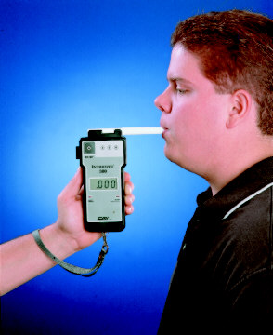
When Warrants and Probable Cause Are Not Required
Warrants “Unsuited to School Environment”
School officials are guardians of students, not law enforcement officers.
Searches in schools must be determined reasonable
Specific facts, together with rational inferences from those facts, justified the intrusion
Search was reasonably related in scope to circumstances justifying it (TLO v. New Jersey, 1985)
“Reasonableness” Standard in Other Settings
Random drug testing of public employees and
students participating in extracurricular sports.
Searches of homes of people on probation

Slide 13
The 5th Amendment’s Provisions Against Self-Incrimination
The Right Not To Incriminate Oneself
Defendant cannot be forced to testify at trial.
If they choose to, must answer all questions asked.
Other who testify do not have to answer questions that would incriminate themselves unless offered use immunity
Gov’t carries the burden of proof, so defendant should not be forced to reveal incriminating facts.
Protection applies in any public proceeding in which info obtained could tie a person to criminal activity.
Unless there is a privilege the law respects (doctor-patient), no one can refuse to testify on grounds that it might incriminate someone else.

Slide 14
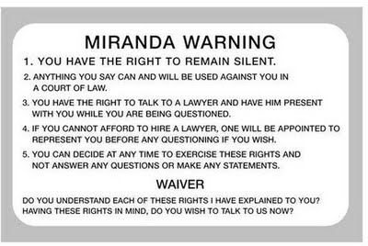
The Miranda Rule
Under Miranda, officers must warn suspects that
They have the right to remain silent
They have right to an attorney when being questioned
Anything they say may be used against them in court
If they can’t afford an attorney, one will be provided
If Miranda Rule is Violated, Evidence is Excluded
Dickerson v. US, 2000
Reaffirmed Miranda ruling,
could not be overruled by an act
of Congress

