Slide 1
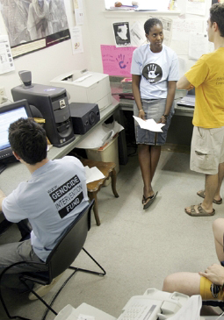
Lesson 30:
How Does the First Amendment Protect Freedom to Assemble, Petition, and Associate?

Slide 2
Purpose
This lesson focuses on the 1st Amendment rights to “peaceably assemble” and “petition the government for redress of grievances.”
It examines the importance and historical background of these rights, and discusses an important related right – the freedom to associate.

Slide 3
Objectives
Explain the importance of the rights to assemble, petition, and associate.
Describe the history of these rights and when they can be limited.
Evaluate, take, and defend positions relating to the exercise of these three rights.

Slide 4
Terms to Know
gag rule Any rule restricting open discussion or debate on a particular issue. public forum Geographical places in a community, such as streets, parks, or virtual reality sites, where people can express and exchange their views. right to assemble The right or legal claim provided for in the First Amendment that allows people to meet to discuss and express their beliefs, ideas, or feelings, especially in a political context. right to associate The freedom to meet with others for political or any other lawful purposes. right to petition The legal claim that allows citizens to urge their government to correct wrongs and injustices or to take some other action.

Slide 5
Importance of the Rights to Assemble, Petition, and Associate
Freedom to assemble and to petition the government enhances the First Amendment protection of political rights.
Right to Associate
Associations include political groups, church groups, professional organizations, social clubs, and community service organizations.

Slide 6
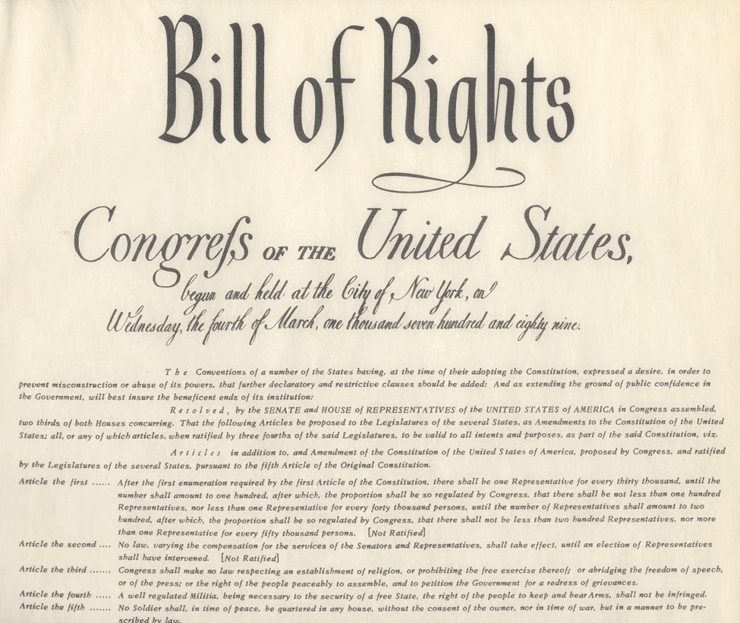
Founder’s Views
Common Law Tradition
Right to petition recognized in Magna Carta, as did the English Bill of Rights (1689)
Right to assemble and petition seen by Americans as a basic right of Englishmen and fundamental to a constitutional democracy
Since no representation in Parliament, colonial petitions were important means of
communication with British gov’t
Rights to assemble and petition
included in the state constitutions
and bills of rights.

Slide 7
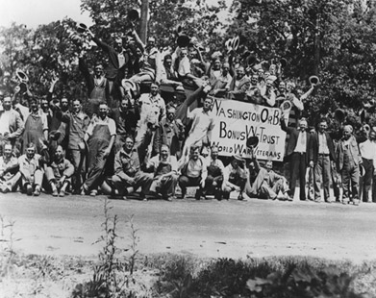
Rights to Assemble and Petition in Action
1790s
Petitions for pensions or back pay for Revolutionary War widows and orphans
1830s
Abolitionists and suffrage advocates petition Congress to the point that it issues a gag rule for certain topics, such as slavery. (finally lifted in 1844)
Great Depression
Military force used to disperse
veteran group demanding early
payments, killing 2 and injuring
many.

Slide 8
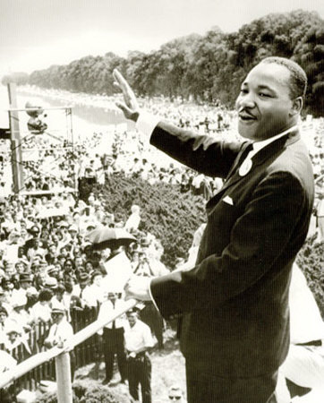
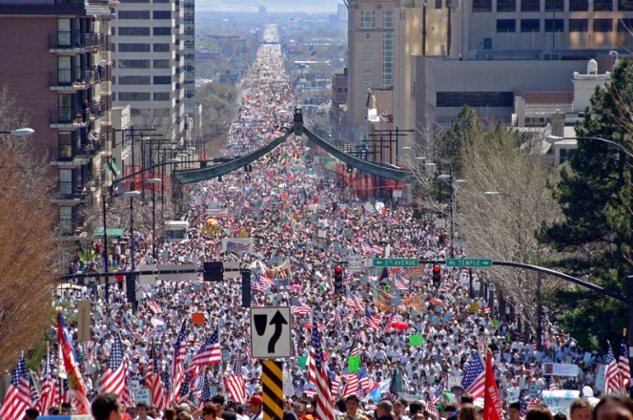
Rights to Assemble and Petition in Action
Women’s Rights
Early 1800s – group petitions MA legislature urging laws limiting work day and improving safety.
1865 – Petition with 400,000 signatures sent to Congress urging abolition of slavery. (13th Amendment)
Civil Rights Movement
1963 – Under Martin Luther King Jr.’s leadership, thousands participate in march on Washington for jobs and freedom.
Today
Many groups use right to assemble to attract news media
Faxes, emails, phone calls, letters, and the use of lobbyists are all modern forms of the right to
petition government.

Slide 9
Government Limitations on Right to Assemble
Hague v. Congress of Industrial Organizations (1939)
Ruled that people have right to assemble in public forum, but gov’t is responsible for ensuring safety and avoidance of unreasonable inconvenience to public.
Time, place, and manner restrictions permissible if:
Gov’t can prove legitimate reason for restriction and does not impose regulation with goal of suppressing speech or assembly
Ex) preventing riots, keep streets clear during rush hour
Restriction is precisely worded and applied in nondiscriminatory manner.

Slide 10
The Right to Associate
Implied Right
Not mentioned, but implied by other 1st Amendment rights and considered part of living in a free society.
Cases
NAACP v. Alabama (1958)
Barenblatt v. United States (1959)
The Right Not to Associate
Court has ruled that in situations that go beyond personal relationships and involve larger social purposes, gov’t may prevent private organizations from discriminatory practices based on race, gender, or ethnicity.

Slide 11
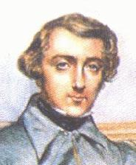
Tension Between Ideals
Eliminating Unfair Discrimination
vs.
Right of Each Individual to Live Their Life As Free As Possible From Government Interference
Toqueville – right to associate essential for preserving free government in the US. Americans did not need to rely on government to solve all their problems. (Help achieve the common good)

