Slide 1
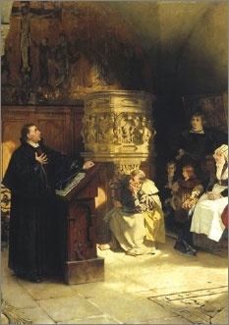
Lesson 3:
What Historical Developments Influenced Modern Ideas of Individual Rights?

Slide 2
Lesson 3 Purpose
The previous lessons explored philosophical ideas that shaped the Founders’ thinking about constitutional government and civic life.
This lesson examines important historical developments that also influenced their ideas.

Slide 3
Lesson 3 Objectives
Explain the differences between classical republican and Judeo-Christian ideas about the importance of the individual.
Explain how certain historical development influenced modern ideas about government, constitutionalism, and individual rights.
Evaluate, take, and defend positions on
Approaches to theories of morality
The importance of the rise of capitalism
How the enlightenment inspired the founders.

Slide 4
Lesson 3 Terms & Concepts
capitalism
An economic system in which the means of producing and distributing goods are privately owned and operated for profit in competitive markets.
city-state
A politically independent community consisting of a city and its surrounding territory.
feudalism
A system of social, economic, and political organization in Europe from the ninth to about the fifteenth century in which a politically weak monarch shared power with the nobility. The nobility required work and services from the common people, known as serfs, in return for allowing them to live on and make use of the noble's land and benefit from the noble's protection.
Judeo-Christian
Ideas, beliefs, and practices that have their historical roots in Judaism and Christianity.

Slide 5
Lesson 3 Terms & Concepts
nation-state
As currently used, a country; the standard unit of political organization in the world. The nation-state received its name from the idea of a people, or "nation," organizing itself politically for self-rule. Many countries today, however, are composed of two or more distinct peoples.
private morality
An individual's ideas about right and wrong to be practiced in one's personal life. These are derived from religious, philosophical, familial, and other sources, including individual conscience.
public morality
The values and principles of right and wrong pertaining to public policies and actions.

Slide 6
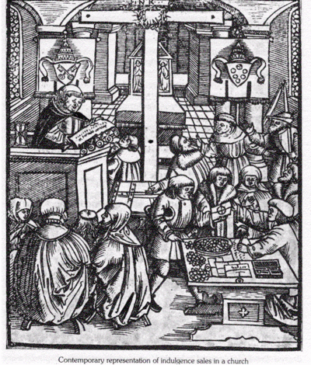
Judeo-Christian Heritage of Human Rights
Greek & Roman = Public Morality
Virtues important for acting in the community
Judeo-Christian = Private Morality
Virtues of inner faith & obedience to God
Christian teaching of individual dignity & worth contributed to Founders’ belief in individual rights
The church was a major unifying social institution during the Middle Ages, however…
Political loyalties remained local
No nations (in modern sense) to compete for loyalties

Slide 7
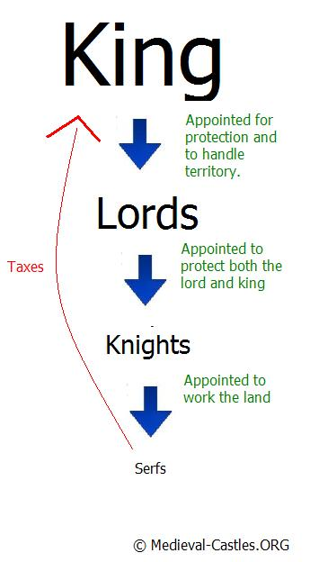
European Concepts of the Individual & Society (Middle Ages)
Feudal Society
Highly fragmented, isolated communities
“Land for service”
Class system with strict rights & responsibilities (Royalty, serf)
Hierarchical – no equality among groups and classes
Social relationships were permanent & hereditary
Property only gained or passed on through inheritance
No concept of natural rights belonging to individual

Slide 8
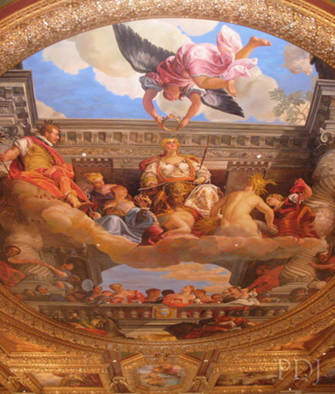
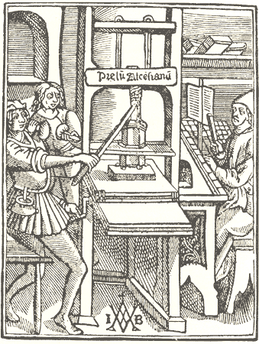
The Renaissance
“Rebirth” – period marked by revival of intellectual life in Europe (14th c.)
Educated people rediscover ancient Greek & Roman culture & teachings
Protestant Reformation & printing press encourage people to read and form opinions for themselves
This spirit developed into modern individualism
Many begin to challenge authority of the church and established institutions

Slide 9
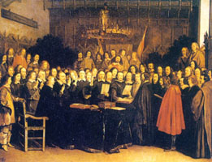
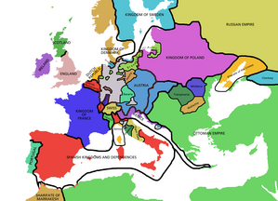
Rise of the Nation-State
1648 – Peace of Westphalia: national sovereignty was agreed upon among several nation-states
Each “nation-state” had a right to an independent existence with its own institutions (gov’t & religion)
People begin to think of themselves as members of a nation, with public rights and duties.
Political thought now shifted to what kind of gov’t would be best.

Slide 10
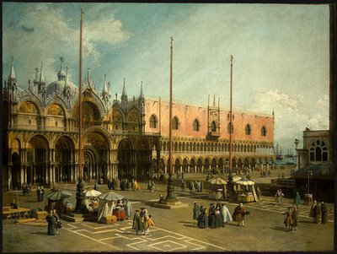
Capitalism – The New Economic System
The means of producing and distributing goods and services became privately owned and operated for profits in competitive markets
More choice of occupations, shifting attention to private interests (away from common good)
Many became wealthy through commerce, not just inherited land (a challenge to royalty)
Power begins to shift towards rising class of capitalists

Slide 11
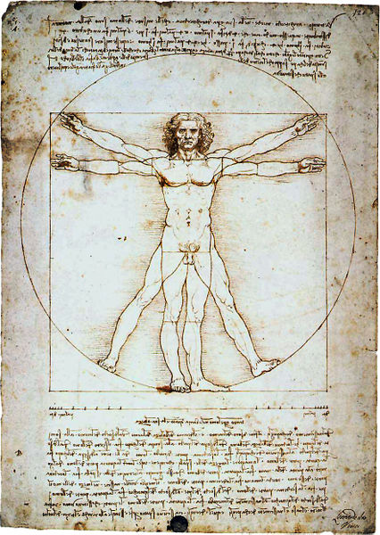
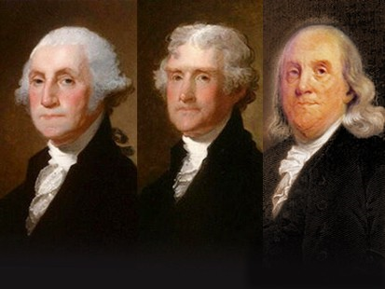
The Enlightenment
18th c. period of scientific & intellectual movement
Philosophers embrace scientific reasoning (Locke, Hobbes) in study of government
Ideas founded on notion that human behavior could be understood, predicted, and controlled
Founders believed that through reason, observation, and the study of philosophers’ writings, they could understand the workings of government and social institutions.

