Slide 1
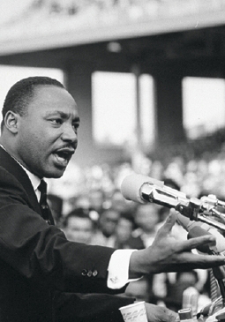
Lesson 29:
How Does the First Amendment Protect Free Expression?

Slide 2
Purpose
The 1st Amendment rights to speech, press, assembly, and petition are together considered the right to freedom of expression.
This lesson examines the benefits that freedom of speech and press offer to the individual and society, why they were important to the Founders, and the circumstances un which the government should be able to limit them.

Slide 3
Objectives
Explain the importance of freedom of expression to both the individual and society and its historical importance.
Explain the considerations useful in deciding when the government should be able to place limits on freedom of speech and the press.
Evaluate, take, and defend positions on issues involving the right to freedom of expression.

Slide 4
Terms to Know
libel Published words or pictures that falsely and maliciously defame a person. seditious libel Written language that seeks to convince others to engage in the overthrow of a government. time, place, and manner restrictions Government regulations that place restrictions on free speech. These regulations, specifying when, where, and in what way speech is allowed, are applied when unrestricted free speech will conflict with the rights of others.

Slide 5
Importance of “Free Expression”
Founders belief that freedom to express personal opinions is essential to free government.
Although pressure to suppress freedom of expression is widespread and powerful, freedom of expression…
Promotes Individual Growth & Human Dignity
Is Important for Advancement of Knowledge
Is a Necessary Part of Representative Government
Is Vital to Bringing About Peaceful Social Change
Is Essential for the Protection of All Individual Rights

Slide 6
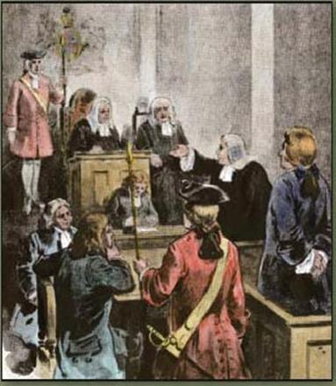
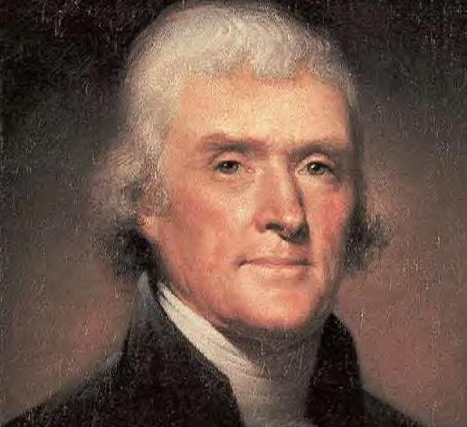
Protecting Expression in Early America
Common Law suggested that “Sedition Libel” mean defaming or ridiculing the government in a way that would jeopardize peace.
John Peter Zenger’s trial established
truth could be permitted as a defense
The importance of freedom of the press
Jury as a check on arbitrary power
Jefferson’s opposition to Adams’ Sedition
Act helped propel him to presidency
“Our liberty depends on freedom of the press,
and that cannot be limited without being lost.

Slide 7
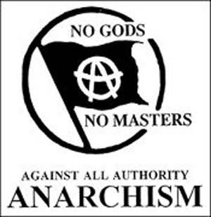
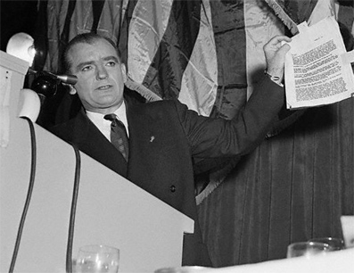
Suppressing Free Expression
Throughout many times in history, pressure has risen to suppress unpopular ideas.
Pre-Civil War ban on abolitionist literature
20th C. fears of labor movements, socialism, communism, anarchists. (McCarthy Era)
Since 1960s, fewer attempts have been made to prosecute those with different beliefs.

Slide 8
Government Limitations
The Court’s approach has been “dynamic” and “unpredictable,” but these general rules apply to laws restricting speech and press…
Laws may not discriminate unfairly on the basis of content of the expression or the speaker
However, no one has right to publish secret military info or names of US intelligence agents.
Time, place, and manner restrictions must be content-neutral and applied fairly
Regulations cannot affect content of expression or favor some individuals, groups, or opinions over others.

Slide 9
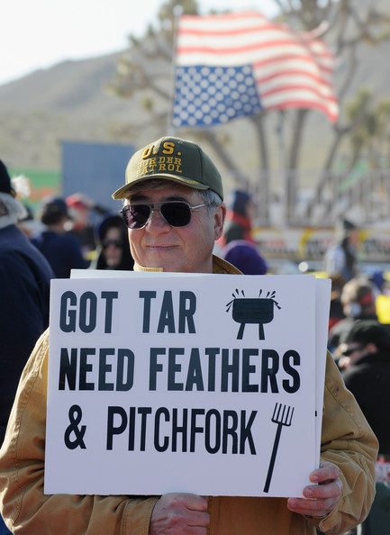
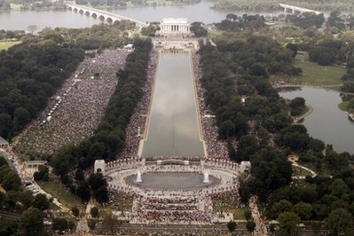
Government Limitations
Regulations on expression cannot be vague
Ex) rule prohibiting “disrespectful speech that interferes with the public good” is too vague
Regulations must not be overly broad and must be implemented by the “least restrictive means”
Regulations must solve a specific problem without limiting more expression than is necessary

Slide 10
Wars, Emergencies, and Freedom of Expression
Governments often limit free speech and press during wartime / emergencies in the name of defense
Alien & Sedition Act, Civil War restrictions, WWI through McCarthy era
The Bradenburg Test (Bradenberg v. Ohio, 1969)
Gov’t cannot forbid such expression unless “such advocacy is directed to inciting or producing imminent lawless action and is likely to incite or produce such action.”

