Slide 1
Lesson 28:
How Does the First Amendment Affect the Establishment and Free Exercise of Religion?

Slide 2
Purpose
The first two clauses of the 1st Amendment prohibit Congress from making laws regarding the establishment of religion or prohibiting the free exercise of religion.
The meaning of these clauses has been a topic of fierce debate.
As Jefferson asserted, should there be “a wall of separation between Church and State?” Or were the clauses created solely to prevent religious persecution and the establishment of one national religion?

Slide 3
Objectives
Explain the importance of religious freedom in the United States and to identify primary differences between the establishment and free exercise clauses.
Describe how the Supreme Court has interpreted the clauses, ongoing issues involving the clauses, and how conflicts can arise between them.
Evaluate, take, and defend positions on issues arising from guarantees relating to the establishment and free exercise of religion clauses of the Constitution.

Slide 4
Terms to Know
compelling state interest A public or common good claimed to take precedence over individual interests or, in some cases, rights.
established church An official, state-sponsored religion, such as those in dozens of countries that have official state religions, including Roman Catholicism, Anglicanism, Lutheranism, Eastern Orthodox... establishment clause The part of the 1st Amendment that prohibits the government from declaring an official religion. free exercise clause The part of the First Amendment stating that Congress shall make no laws that prevent people from holding whatever religious beliefs they choose or that unfairly or unreasonably limit the right to practice religious beliefs. separation of church and state A basic principle of American government that no single religion should be favored by government over other religions, nor should government interfere with the right to practice or not practice religious beliefs. This term was used in 1802 by President Thomas Jefferson to explain his understanding of the protection of religious freedom afforded by the Constitution.

Slide 5
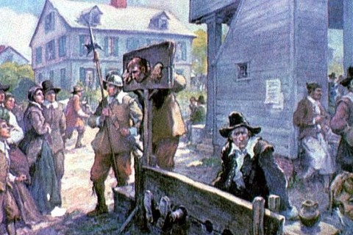
“Established” Religions
Reformation period in Europe characterized by bloody conflict between Catholics & Protestants over political power.
General belief held that established (official) religions formed necessary foundation for government.
Although many came fleeing religious persecution, most colonies established their own churches.
Ex) religious persecution commonplace in Anglican VA and Puritan MA

Slide 6
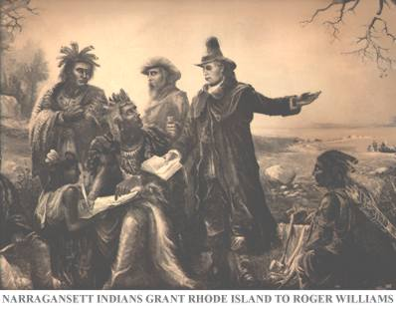
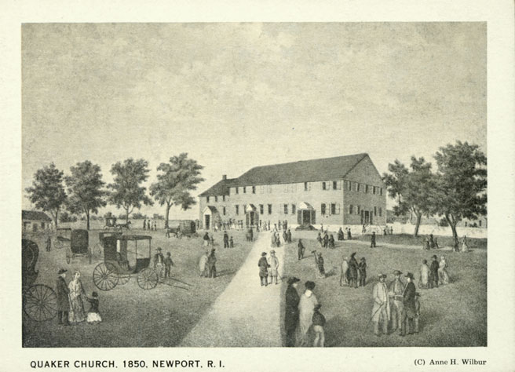
“Established” Religions
Religious Intolerance in America not Universal
Ex) Roger Williams founds RI based upon freedom of conscience, religious toleration, and separation of church and state.

Slide 7
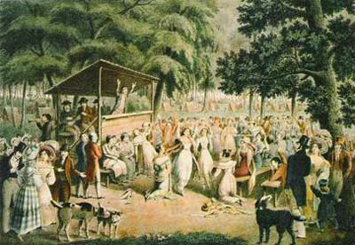
Prohibiting an Established Religion
Great Awakening (Mid 18th C.) drew many into new religious groups, making it increasingly difficult for one church to dominate.
By the time Constitution was written, general belief that freedom of belief was an essential right and actually strengthened both church and state.
Belief results in religion clauses of 1st Amendment
“Congress shall make no law respecting an establishment of religion, or prohibiting the free exercise thereof.”
- 1st Amendment

Slide 8
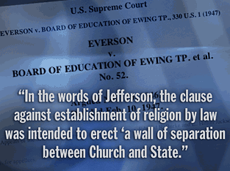
The Establishment Clause’s Affect on the States
Establishment clause prohibits Congress from establishing a national religion.
States eventually abandon practice of established religions. (MA last state, 1833)
Debate then shifted to constitutionality of laws providing state aid to religious organizations or requiring prayer in public schools.
Everson v. Board of Education (1947)

Slide 9
Interpreting the Establishment Clause
Broad Interpretation
1st Amendment prevents the gov’t from providing any aid to any religion.
Groups can receive same services everyone else receives, and government may provide assistance that makes it easier to exercise religion. (religious holidays)
Narrow Interpretation
Government is prohibited from giving one religious group preferential treatment.
Gov’t support ok, as long as it does so impartially.
Literal Interpretation
1st Amendment only prohibits establishment of an official religion, all else is fair game.

Slide 10
The “Free Exercise” Clause
Free exercise protects the absolute freedom of belief (conscience), but freedom to practice one’s religion is not absolute.
Religious beliefs can be limited to protect other important values and interests.

Slide 11
Balancing “Free Exercise” Against Other Interests of Society
Court creates and refines “tests…”
Ex)
When health of community is balanced against religious beliefs, public health more important.
When life, health or safety of individual is involved, mentally competent adults able to make own decisions.
The Court’s Current Test
Is the law “object neutral” and does it apply to everyone?
If is does not pass the first test, did the gov’t have a compelling interest for enacting it, and did the government adopt the least restrictive means for furthering that compelling interest.

Slide 12
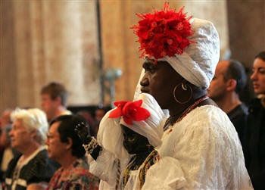
Balancing “Free Exercise” Against Other Interests of Society
If the Government can meet its burden of proof, then the law does not violate the free exercise clause.
Smith v. Oregon (1990)
Church of the Lukumi Bablu
Aye, Inc. v. City of Hialeah
(1993)

