Slide 1
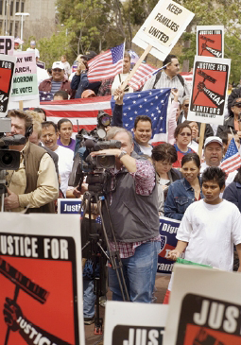
Lesson 27:
What Are Bills of Rights and What Kinds of Rights Does the US Bill of Rights Protect?

Slide 2
Purpose
This lesson provides a foundation for examining rights contained in the Constitution, Bill of Rights, and subsequent amendments.
It also examines four provisions that are sometimes overlooked: the Second, Third, Ninth, and 10th Amendment.

Slide 3
Objectives
Explain what bills of rights are and how they have evolved.
Examine the Constitution and its amendments and identify which of the rights they contain are
Held by individuals, classes, or categories of individuals, or institutions.
Personal, economic, or political rights.
Positive or negative rights.
Identify possible conflicts among these rights.
Describe various interpretations of the 2nd, 3rd, 9th, and 10th Amendment.
Evaluate, take, and defend positions about the kinds of rights protected by the Constitution and Bill of Rights

Slide 4
Terms to Know
autonomy Independence, freedom, or the right to self-governance. economic rights Those rights essential to citizens that allow them to earn a living, to acquire and transfer property, and to produce, buy, and sell goods and services in free markets. negative rights Those rights that prohibit government from acting in certain ways; rights that are not to be interfered with. personal rights Those rights of individuals in their private capacity, such as the rights to life and liberty, as distinguished from the political rights of citizens, such as the rights to vote and to hold public office.

Slide 5
Terms to Know
political rights All rights of a citizen in a free society that are clearly expressed and guaranteed by the Constitution and implied by natural laws. positive rights Those rights that require overt government action, as opposed to negative rights that require government not to act in specified ways. Examples of positive rights are those to public education and, in some cases, to medical care, old age pensions, food, or housing. rights Moral or legal claims justified in ways that are generally accepted within a society or the international community.

Slide 6
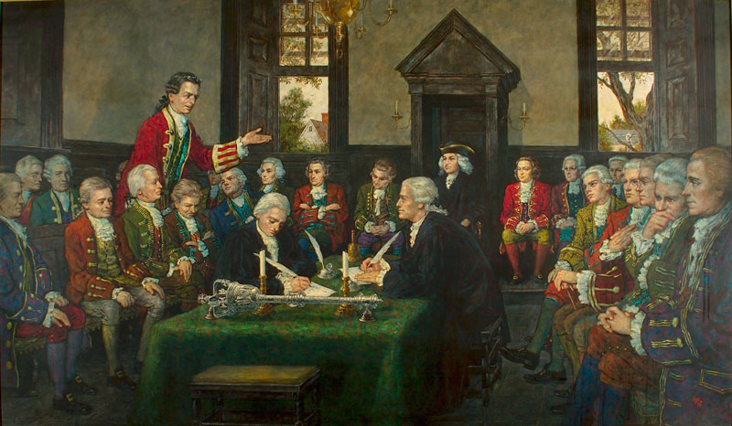
Bills of Rights & Their Evolution
A “Grand Theme of Human History”
Struggle between rights of people and the power of gov’t to interfere with or violate those rights
Magna Carta & English Bill of Rights
Listed rights such as free speech in Parliament and right to petition the government
American Bills of Rights
Instead of ordinary legislation, states included bills of rights directly into their
constitutions.
Ex) Virginia Declaration of Rights

Slide 7
Who May Hold Rights?
Individuals
Reflects natural rights philosophy that humans are autonomous and self-governing.
Ex) freedom of thought, privacy, and movement
Classes or Categories of Individuals
Most legal systems recognize groups such as children, veterans, disables, professional
(ex. doctors)
Institutions
Ex) schools, governmental institutions,
unions, universities, corporations

Slide 8
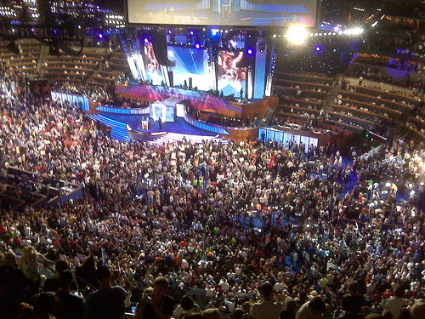
Common Categories of Rights
Personal Rights
Provide for individual autonomy. Rights to life, liberty, and property “God-given” or based on nature.
Purpose of government is to protect those rights.
Economic Rights
Rights include choosing a profession, acquiring and disposing of property, enter contracts, create copyrights or patents, and joining unions.
Political Rights
Rights that address political
participation such as the right to
vote and engage in political activity.

Slide 9
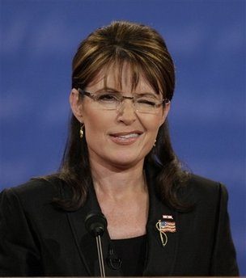
Government Action & Restraint
Positive Rights
Requires specific government action
Ex) protection from criminal acts, access to public education
In Bill of Rights
6th Amendment right of speedy and public trial
7th Amendment right to trial by jury
Negative Rights
Restricts government action
Ex) 1st Amendment restriction that
“Congress shall make no law” that violates
fundamental rights to freedom of speech,
religion, press, assembly, and petition

Slide 10
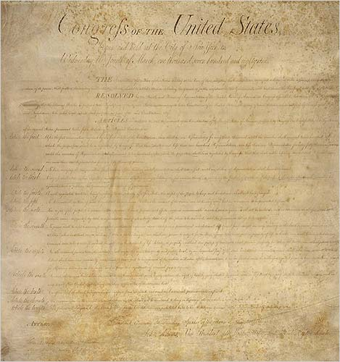
The U.S. Bill of Rights
Contains specific guarantees of various rights
Includes positive, negative, personal, economic, and political rights that protect individuals, classes, and institutions
Example
2nd – refrains gov’t from infringing upon the “right of the people to keep and bear arms”
Controversy remains over interpreting this phrase

Slide 11
The 9th & 10th Amendment
9th and 10th Amendments do not provide specific guarantees, creating ongoing debate
Theories regarding the 9th Amendment
Admission of impossible task of listing all rights
Bill of Rights does not increase national gov’t powers in area not mentioned in previous amendments
Commands judges and Congress to affirm rights not mentioned in Constitution
Views of the 10th Amendment
States nature of American federalism but adds nothing
Protects powers of the states against the national gov’t

Slide 12
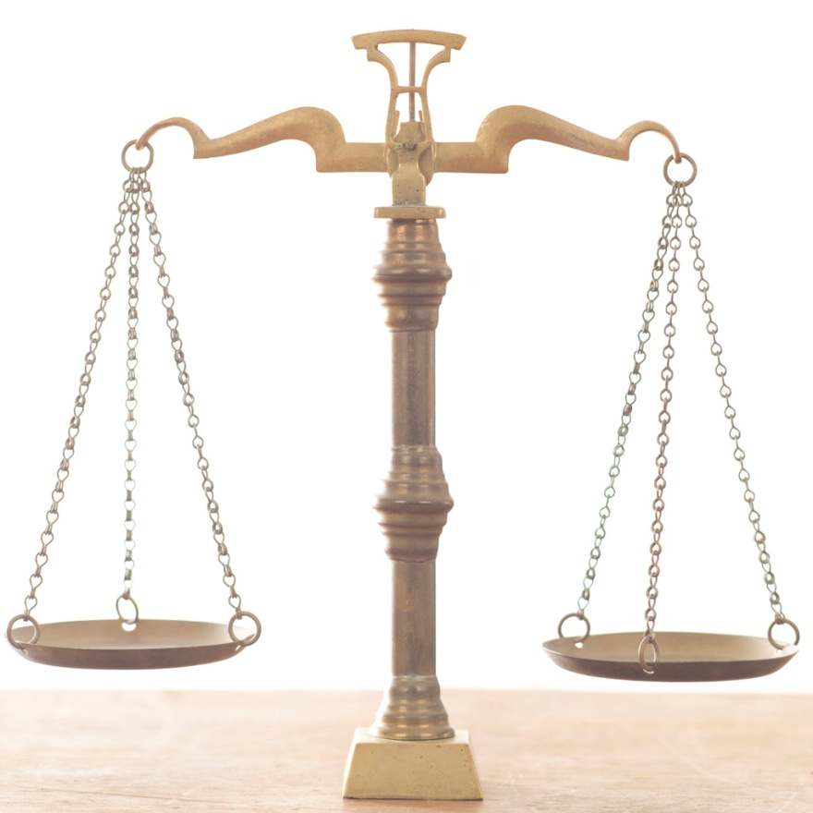
Rights Protected in the Constitution’s Body
Hamilton argued that Constitution itself is a bill of rights
Designed to prevent gov’t abuse of power and violation of rights
Examples (Art. I, Sec. 9)
Habeas Corpus rights guaranteed
Bills of Attainder Prohibited
Ex Post Facto Laws Prohibited

Slide 13
Changing Attitudes About the Bill of Rights
Initial Reaction
Luke warm response, little effect on average person who had closer ties to state governments
Baron v. Baltimore (1833) – court rules that Bill of Rights only applies to national government.
14th Amendment and Supreme Court decisions needed to incorporate limits on state governments as well
20th Century
Increasingly recognized throughout world as one of most important documents expressing fundamental rights
However, many Americans have little knowledge of the document and rights that it protects

