Slide 1
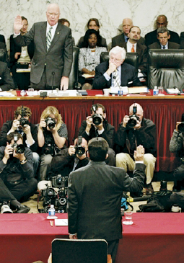
Lesson 26:
How Does American Federalism Work?

Slide 2
Purpose
The powers of and the boundaries between the national and state governments never have been clear.
This lesson examines constitutional provisions affecting the states in their relationship to the national government.
It also explains how state governments are organized, including their creation of units of local government.
Finally, it describes the role of states as “laboratories of democracy.”

Slide 3
Objectives
Explain how American federalism involves divided sovereignty and an ongoing effort to balance power.
Explain the function of three basic kinds of local government – counties, municipalities, and special districts.
Give examples of governmental innovations at the state and local levels.
Evaluate, take, and defend positions on continuing issues related to America’s unique system of federalism.

Slide 4
Terms to Know
initiative A proposed law placed on the ballots of some states for voter decision. Initiatives that pass immediately become law. local government Government of a specific local area, such as state subdivisions authorized by states or governments of cities, counties, and towns. Also includes special government units, such as water districts. police powers The inherent authority of a government to impose restrictions on private rights for the sake of public welfare, order, and security within the boundaries of constitutional law. recall A process of using special or general elections for removing elected officials from office. referendum Placing a measure approved by a legislature on a ballot for popular approval. reserved powers Those powers referred to in the 9th and 10th Amendments that are reserved to the states or to the people.

Slide 5
Constitutional Status of State Governments
States’ Role in National Government
9 of 13 states were needed to ratify Constitution (Art. VII)
Determine Voting Qualifications for House Members (Art. I)
Equal Representation in Senate
Vital Role in Electoral College System
Governing Power Left to the States
Art. I Sect 8 – 9 powers states do not have (no titles of nobility)
Prior list, enumerated powers for Congress, and 10th Amendment established that powers not granted to national government are reserved to state governments.

Slide 6
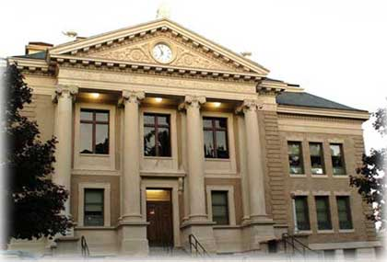
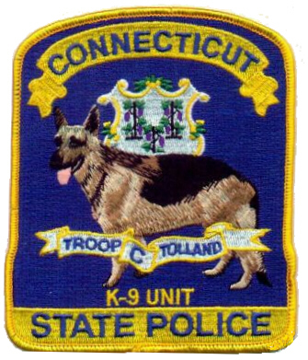
Constitutional Status of State Governments
Reserved (Police) Powers
State gov’ts power to enact legislation that protects the health, safety, welfare, and morals of those within this district
Ex) Schools, making / executing criminal and civil laws, zoning
Historic Tension
Disputes often arise over Supremacy Clause and ambiguities regarding which level of gov’t has which power

Slide 7
Common Features of State Government Organization
Bill of Rights
Most include same rights as US Constitution. Many also add rights such as right to work or right to education.
Legislative Branch
Most legislatures (assemblies) meet annually, are bicameral, with districts for both houses based upon population.
Executive Branch
Governor is chief executive, most serve 2 or 4 year terms. Lt. Governor role similar to “vp.”
2003: US gov’t employees = 3 million,
State / Local gov’t employees = 15 million

Slide 8
Common Features of State Government Organization
Judicial Systems
Trial and appellate courts. Judges elected in some states, appointed in others.
Municipal courts deal with local matters such as traffic offenses.
State Supreme Court has final say about meaning of state constitution.
Creation of Local Governments
State grants charters to carry out certain gov’t responsibilities. Local laws typically called ordinances.
Categories of local government includes: counties, municipalities (cities & townships), and special districts that provide specific services (school districts).

Slide 9
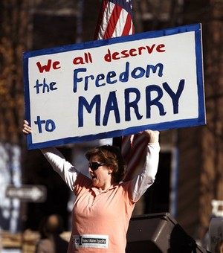
Changing State Constitutions
Since 1776, 144 New State Constitutions, Thousands of Amendments
Only 18 states have original constitution
Ballots usually contain proposals for constitutional amendments
Current policy debates in the states: same-sex marriage, gambling, marijuana decriminalization / legalization

Slide 10
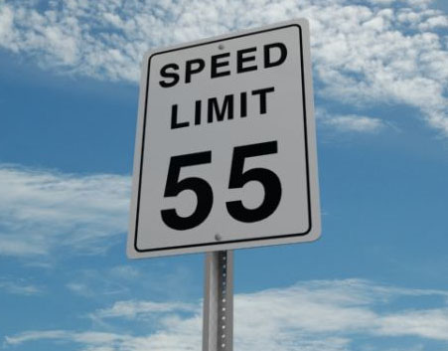
Federalism In Practice
Regulation of Commerce
States retain power to regulate commerce within its borders.
However, courts have asserted Congress’s power to regulate local activities if they “have a substantial effect on interstate commerce.”
Ex) Medical marijuana use laws. Gonzalez v. Raich
Grant-in-aid Programs
In return for money from national gov’t, states must comply with congressional policies
Ex) Federal highway funds require compliance
with “national” speed limit.
Ex) Race to the Top education funds

Slide 11
“Laboratories of Democracy”
Initiative, Referendum, Recall
Methods allow citizens to participate in direct democracy in their states.
Environmental Protection
Several states set emission standards set by Kyoto Accords, despite national governments choice not to.
Health Care
Several state-wide reforms have been
tried in the states and served as a model
for national legislation.

