Slide 1
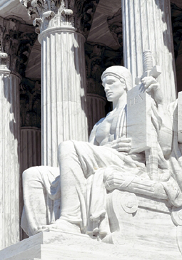
Lesson 25:
What Is the Role of the Supreme Court in the American Constitutional System?

Slide 2
Purpose
As opposed to English tradition, the Constitution provides for an independent judiciary.
Hamilton considered it “least dangerous branch” because it depends on other branches to enforce its decisions.
This lesson examines how the Supreme Court has become a coequal branch of the national government and describes some of the institutional checks on its power.

Slide 3
Objectives
Explain the difference between the Supreme Court’s original and appellate jurisdiction.
Explain the four methods of constitutional interpretation.
Explain how America’s system of checks and balances limits the power of the Supreme Court.
Evaluate, take, and defend positions on issues relating to the role of the Supreme Court in the constitutional system.

Slide 4
Terms to Know
advisory opinion In some judicial systems, a formal opinion on a point of law given by a judge or court when requested by a legislature or government official. appeal The bringing of a court case from a lower court to a higher court in an attempt to have the lower court's decision reversed. Grounds for appeal include errors of law, fact, or procedure. appellate jurisdiction The legal authority of a court to hear appeals from a lower court. jurisdiction The power or authority to hear cases and make decisions. landmark decision A legal decision that constitutes a turning point or stage. Brown v. Board of Education (1954) is an example of a landmark decision.

Slide 5
Terms to Know
litigant A party involved in a lawsuit. methods of constitutional interpretation Interpretive methods employed by U.S. Supreme Court justices when considering constitutional issues of some cases. See strict construction, original intent, fundamental principles, and instrumentalism
original jurisdiction In some cases, such as those in which a state is a party, the Supreme Court has the right to consider the facts and the law in a case without it having first been passed on by a lower court. writ of certiorari A type of writ seeking judicial review of a legal decision.

Slide 6
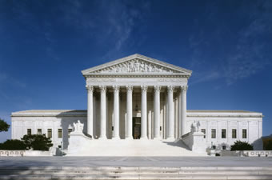
Constitutional Powers of the Supreme Court
Article III
Created Supreme Court, Congress has power to create inferior courts.
Life tenure for all Federal Judges
Jurisdiction over cases arising under national law and involving citizens from more than one state.
Trial by jury in all criminal cases except impeachment
Power of judicial review, deciding whether acts of Congress, executive, state laws, or state
constitutions violate US Constitution

Slide 7
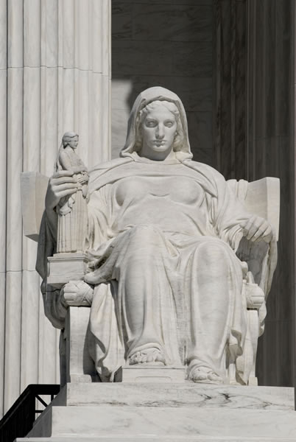
Constitutional Powers of the Supreme Court
Original Jurisdiction
Power of a court to pass judgment on both the facts of a case and the law.
Original Jurisdiction over
“cases affecting Ambassadors, other public Ministers and Consuls,… [and] … Controversies to which the United States shall be a Party.”
Original Jurisdiction - Supreme Court only one to hear case
Very few cases arise from original jurisdiction

Slide 8
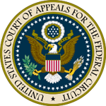
Constitutional Powers of the Supreme Court
Appellate Jurisdiction
Power of higher court to review and revise decision of inferior court
Supreme Court has appellate jurisdiction in all cases not in original jurisdiction unless restricted by Congress.
Congress Created 3 – Tiered system
Trial Courts (Federal District Courts) in each state
13 Courts of Appeal (Federal Circuit Courts)
Supreme Court

Slide 9
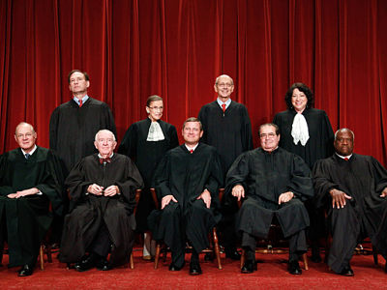
Constitutional Powers of the Supreme Court
Litigants who lose in lower federal court (or highest state court) can ask Supreme Court to review the case.
Supreme Court not require to issue writ of certiorari
Four justices need to approve
Of thousands of yearly petitions, number of cases decided by court on decline
1980 – 232 cases
2006 – 72 cases

Slide 10
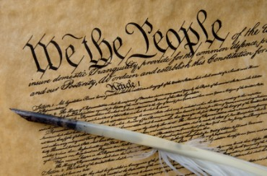
Methods of Constitutional Interpretation
Written Opinions
Courts issue majority, concurring, and dissenting opinions
Hold Supreme Court accountable by publicizing its rationale
Establishes a record that serves as precedent for future cases
Methods of Interpretation
Textualism, Literalism, or Strict Construction
Looking at literal / ordinary meaning of each word or phrase
“keeps Court neutral and helps justices avoid imposing their own values on the Constitution”

Slide 11
Methods of Constitutional Interpretation
Original Intent or Original History
Seek to understand what Founders originally meant
“helps maintain stability and neutrality in the law”
Fundamental Principles
Looks to principles – natural rights, republican gov’t – to interpret meaning of words, phrases, or clauses
“identifying fundamental principles is useful in determining what meaning of words actually are”
Modernism or Instrumentalism
Premise that Constitutional interpretation should adapt to changing circumstances and contemporary needs.
Argue that justices should not “hold back social progress by adhering to outmoded understandings of the Constitution”

Slide 12
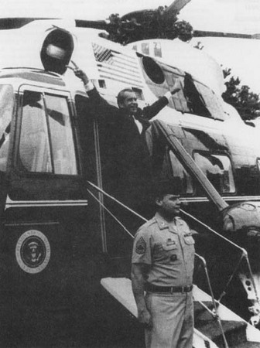
Checks on Supreme Court Power
Self-Imposed Limits
Attempt to avoid partisan politics by refusing “political questions”
Does not issue advisory opinions, only decides specific cases
Presidential Appointments
Nominees can change approaches to
constitutional interpretation and attitude
about role of the court
Executive Enforcement
President may threaten to refuse enforcement.
Ex) US v. Nixon

Slide 13
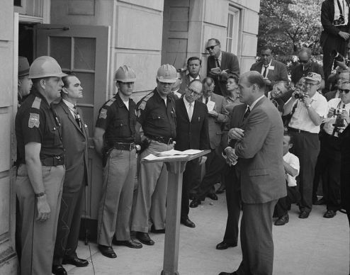
Checks on Supreme Court Power
Congressional Power
Congress determines appellate jurisdiction and controls budget
If statute declared unconstitutional, may pass it in another form
Can alter size of the court
Can propose amendments in response to unpopular decisions
Ex) 16th Amendment – Income Tax
Federalism
State enforcement may be lax.
Some states still evade entirely
desegregating schools

