Slide 1
Lesson 24:
How Are National Laws Administered in the American Constitutional System?

Slide 2
Purpose
Departments, agencies, and bureaus that administer laws (bureaucracy) touch every aspect of American life.
This lesson examines the role of administrative departments and agencies in America’s national government.

Slide 3
Objectives
Explain why Congress create administrative units, the circumstances that contribute to their creation, and the range of governmental functions that administrative perform.
Identify some of the checks on the exercise of administrative power.
Evaluate, take and defend positions on public administration in the United States.

Slide 4
Terms to Know
bureaucracy Governmental departments and agencies and their staffs, principally civil service members and political appointees. cabinet The group of advisors to the president composed of the heads of the departments of the executive branch and certain other officials. Cabinet advice to U.S. presidents is not binding, as opposed to parliamentary systems, where the consensus of cabinets is said to bind prime ministers. civil service Employment in federal, state or provincial, and local governmental agencies. The civil service was formed in an effort to reduce political patronage and promote professionalism in government. independent agencies Administrative organizations located outside the structure of executive departments.

Slide 5
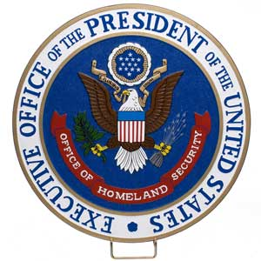
Kinds of Administrative Units
Executive Departments
Congress directs each to administer certain laws / President appoints each secretary, or “head” (Cabinet)
Currently 15 departments, each head in line of succession
Executive Office of the President (EOP)
Created in 1939 to help with budgeting, personnel management, and natural resources planning.
Includes: White House Office, Office of
Management & Budget, Council of
Economic Advisors, National Security
Council

Slide 6
Kinds of Administrative Units
Independent Agencies
Located outside structure of Executive Departments
Granted quasi-legislative regulatory powers
Ex) Environmental Protection Agency (EPA), Peace
Corps
Others
Federal Emergency Management Association (FEMA)
Was independent agency, now part of Dept. of Homeland Security
US Postal Service
Government corporation
Federal Communications Commission (FCC)
Designed to enforce regulations of the industry

Slide 7
Administrative Organizations
Quasi-legislative powers delegated to implement broad congressional mandates.
Rules published in Federal Register
Some units granted quasi-judicial powers
Hearings held to resolve disputes
Example: IRS
Makes & Enforces rules about tax collections. Also holds hearings for those accused of violations.
Administrative Procedure Act (1946)
Established rules to implement laws, requires public notice / hearings, permits judicial review of administrative decisions

Slide 8
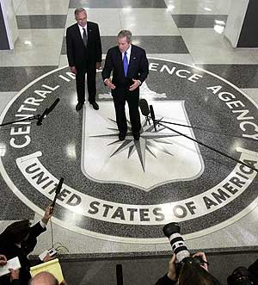
Contributing Factors
Growth in response to demands placed on gov’t
Ex) Industrial Revolution lead to Dept. of Commerce and Labor, Interstate Commerce Commission, and Federal Trade Commission
Great Depression / New Deal
FDR creates significant growth in federal bureaucracy in response to national crises
Cold War
Dept. of Defense, National Security Council,
CIA…

Slide 9
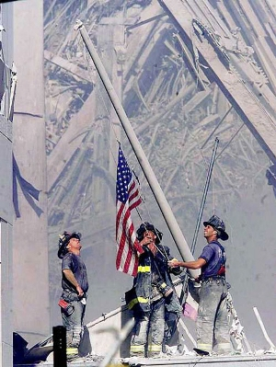
Contributing Factors
Reduction
Starting in 1970s, many commissions and boards abolished
Ex) Interstate Commerce Commission
9/11
Terrorist attacks result in creation of Department of Homeland Security

Slide 10
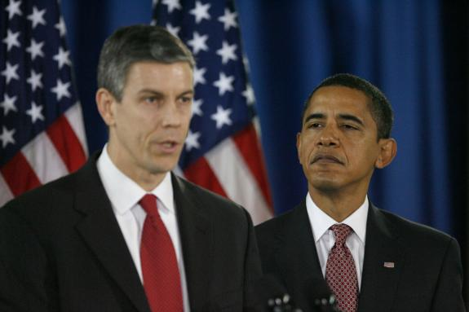
Staffing Administrative Agencies
Civil Service
1883 – Patronage substituted for merit-based system / administrative class insulated from politics
Congress sill establishes office requirements, performance standards, wages, benefits, & “whistle-blower” protections
Hatch Act (1939)
Parties prohibited from pressuring workers to contribute or work for candidates in exchange for job security
President makes appointments to
key leadership positions
Helps ensure bureaucracy enacts his
policy agenda
With new administration’s usually
complete change in leadership

Slide 11
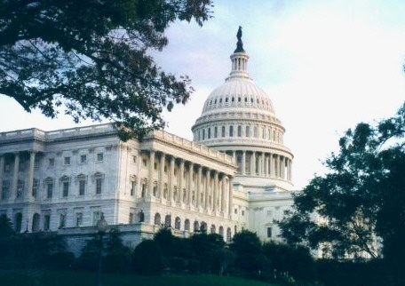
Checks & Balances
The President
Appointment power rewards loyalists / advances agenda
Executive Orders – directs agencies to take certain actions
Congress
Creates, consolidates, or eliminates agencies
Senate confirms high-level appointees
Statutes direct agency actions
Appropriates funding
Congressional Oversight
Ex) review budgets, investigate actions

Slide 12
Checks & Balances
Courts
Decide whether agencies violate 14th Amendment due process & equal protection requirements
Requires Congress to clearly define agency standards
Federalism
If state and national policies differ, states sometimes resist or refuse to comply with standards (ex. Education reform)
Citizens, Interest Groups, Media
Those directly affected by public policy ca monitor actions, report complaints, or investigate issues regarding problems and injustice in the bureaucracy

