Slide 1
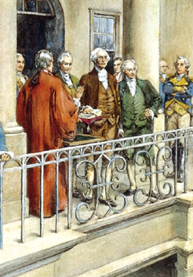
Lesson 23:
What Is the Role of the President in the American Constitutional System?

Slide 2
Purpose
The president is among the most powerful political figures in the world.
Internationally, the president speaks for the country and is the symbol of America.
Domestically, the president suggests policies to Congress and is the leader of their political party.
Americans look to the president for leadership, while also fearing concentration of executive power.
This lesson examines sources of presidential power and ways that checks and balances limit presidential power.

Slide 3
Objectives
Explain the president’s responsibilities and how the office has evolved.
Identify various constitutional and political checks on the president’s power.
Explain fundamental differences between the parliamentary prime minister and the American presidency.
Evaluate, take, and defend positions on issues involving the exercise of presidential power and the relationship between the president and other branches of gov’t.

Slide 4
Terms to Know
commander in chief Highest ranked person of the military forces. According to the U.S. Constitution, the president is commander in chief of the nation's armed forces. executive orders Directives issued by the president, including Presidential Directives, National Security Directives, and Homeland Security Presidential Directives. Presidents have issued such orders since 1789. Such orders are open to the public, except for National Security Directives. executive power The authority to carry out and enforce the law.

Slide 5
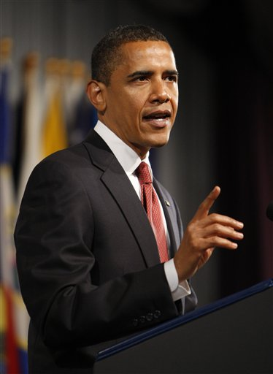
The President’s Responsibilities
Executive Power not specifically defined in Constitution, but following powers are listed (Art. II)
Commander in Chief of army and navy
Heads executive department
Granting reprieves and pardons
Making treaties (subject to Senate’s
consent)
Nominating ambassadors, consuls, judges
Recommend legislation
Veto bills
Receive ambassadors (chief diplomat)

Slide 6
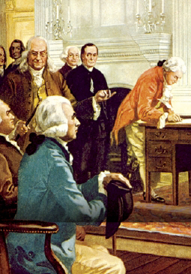
The Framers’ Vision of the Presidency
Official above partisan politics
Electoral College would identify people with character “preeminent for ability and virtue”
No expectation of campaigns
Wanted “energetic” president as opposed to legislature’s “deliberative” nature
Hamilton: “Bad execution… must be… a bad government.”

Slide 7
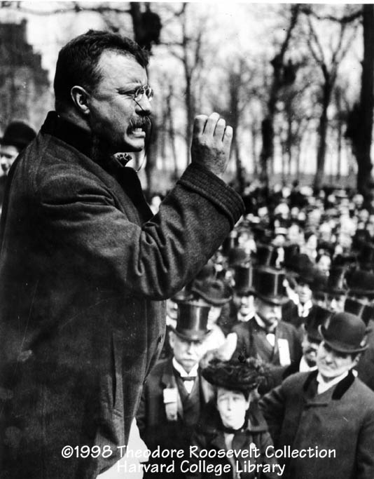
The Presidency Evolves
Andrew Jackson
Unprecedented use of veto (national bank)
Abraham Lincoln
Expansion of wartime powers (suspension of habeas corpus)
Teddy Roosevelt
“Bully Pulpit” – used visibility and influence of presidency to advocate his political agenda

Slide 8
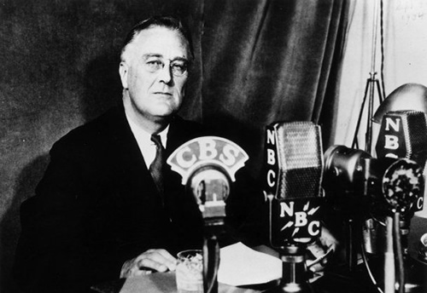
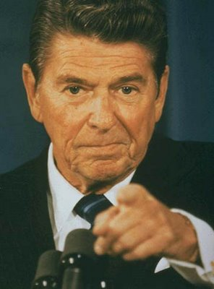
The Presidency Evolves
FDR
Took control of policy process through New Deal programs.
Social Security, employment programs, executive agency reform
Exerted unprecedented military power during WWII
Employed “fireside chats” to establish trust and confidence
Since FDR
Effective presidents have used FDR’s strategies to bolster power
Reagan – “The Great Communicator”
JFK & Clinton – Used charisma to win political allies and persuade public to support policy proposals

Slide 9
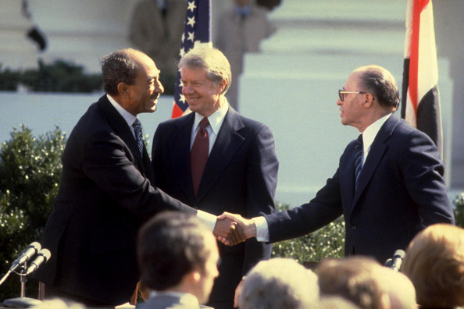
Foreign Policy
Congress’s role (declare war, fund armed forces…) largely reactionary to president
The President foreign relations powers…
Commanding Armed Forces
Military power used to defend nation and as a threat to persuade
Each president since FDR has sent troops abroad w/o declaration of war.
Making Treaties
Sole authority to negotiate
on behalf of US, pending
Senate approval

Slide 10
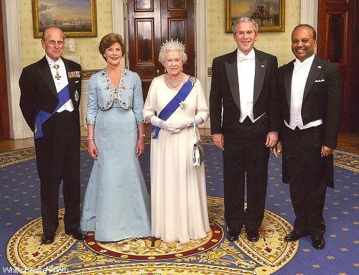
Foreign Policy
Appointing Ambassadors & Public Ministers
President decides who represents US abroad.
Ambassadors help shape US image and advise on foreign policy
Receiving Ambassadors and Other Public Ministers
President sole channel of international communications
Assumes right not to recognize them

Slide 11
Expansion of War Powers
During wars and emergencies, presidents often exercise power not granted in Constitution
Grover Cleveland – sent unauthorized troops to put down Pullman train car strike
FDR – sent war ships to Britain before entered WWII
Attempts at restraint
1952 – Supreme Court rules against Truman (seizing steel mills during Korean War)
2006 – Bush’s “special military commissions” violated US law and Geneva Convention
However, Congress & Court tend to defer to president

Slide 12
Expansion of Presidential Power
Over time, power has flowed from one branch to the other.
19th C. – Congress dominated
20th C. – As role of US in world grew, so did Executive power
Why growth of presidential power?
Over past century, polls show public demand for strong president
However, polls also show public distrust of strong executives
Broad constitutional powers
Role in recommending legislation
Increasingly active role in development of federal regulations
Regulations elaborate on general laws passed by Congress

Slide 13
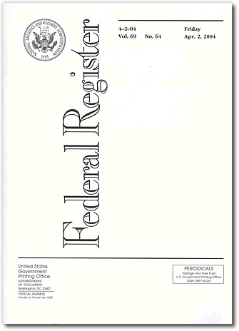
Expansion of Presidential Power
Executive Orders
Rule or regulation issued by the president.
Must be published in Federal Register
Assumption of new responsibilities
Issues involving education, health care, transportation, product safety, etc. have shifted from purely state / local control to national as well.

Slide 14
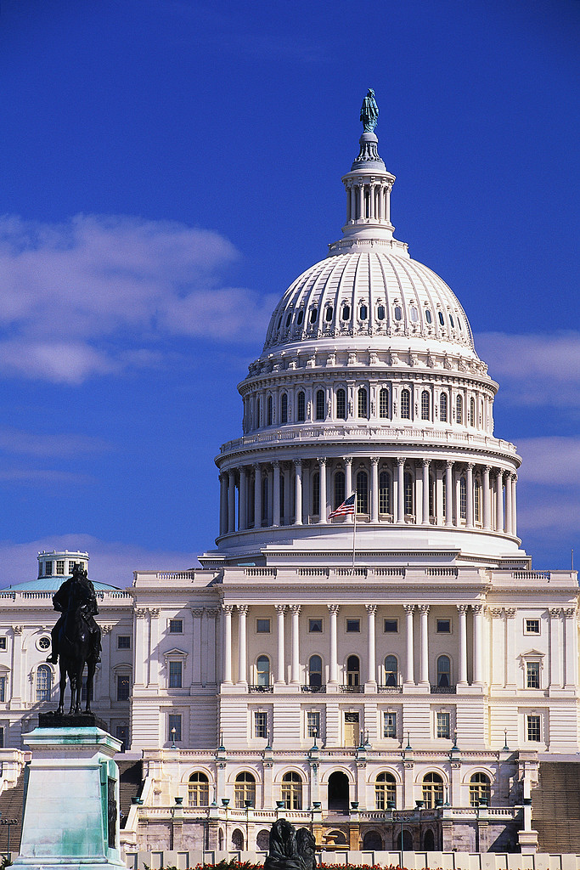
Limitations on Power
Congress
Rejecting or modifying president’s legislative agenda
Asserting its constitutional authority
(war powers)
Refusing to ratify treaties
Refusing to confirm nominees
Refusing to fund programs
Removing president from office

Slide 15
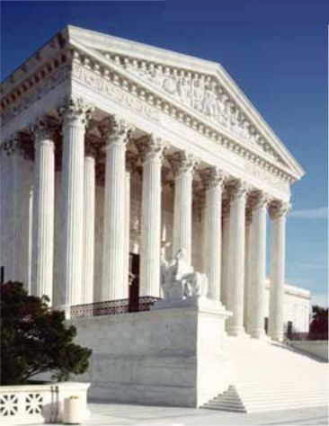
Limitations on Power
Supreme Court
Humphrey’s Executor v. US (1935)
Congress must approve president’s removal of official from independent regulatory agencies
US v. Nixon (1974)
President not entitled to automatic immunity from legal process
Train v. City of NY (1975)
President cannot refuse to spend money appropriated by Congress
Executive Agencies
Public Opinion

Slide 16
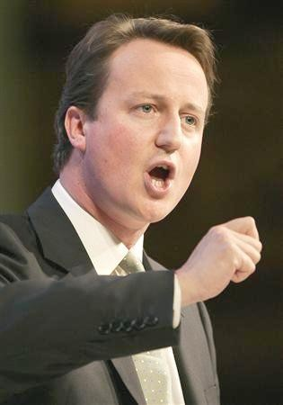
Differences Between American Presidency & British Prime Minister
Prime Minister
Chief Executive
Appointed by majority party or coalition
Must have served in Parliament
Passage of legislation more efficient, but PM can be quickly replaced once they lose confidence of Parliament

Slide 17
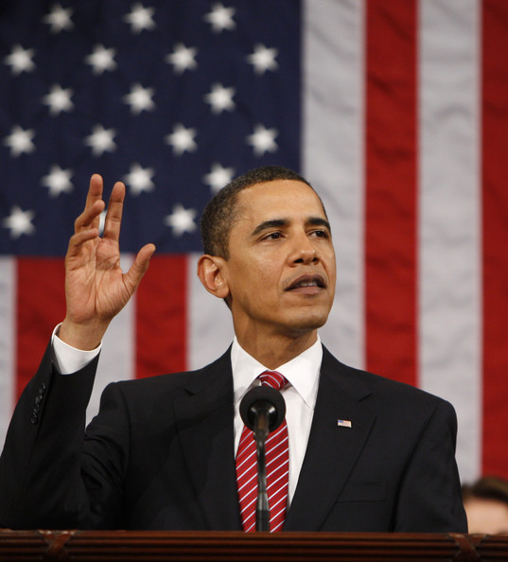
Differences Between American Presidency & British Prime Minister
Presidency
Not appointed, elected. No experience required.
Fixed 4-yr term, regardless of public opinion
Many more checks on power than in Parliamentary system
Power depends on ability to persuade
President’s standing in eyes of world can enhance or detract from international reputation of nation.

