Slide 1
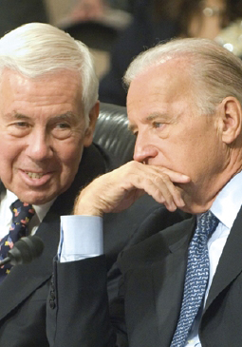
Lesson 22:
How Does Congress Perform Its Functions in the American Constitutional System?

Slide 2
Purpose
Congress is one of few national assemblies with the power to initiate legislation, not simply vote on executive’s proposals.
Congress also conducts investigations that lead to important changes in policy and removal of officials.
Despite its rules and leadership structures, the 535 member Congress faces challenges representing their growing and diverse constituencies.

Slide 3
Objectives
Describe the role of rules, committees, and political parties in Congress.
Describe the lawmaking process.
Identify the primary sources members rely upon.
Explain the importance of Congress’ power to investigate.
Explain why compromise is required in the deliberative process.
Evaluate, take, and defend positions on how Congress functions and whether it should streamline its procedures.

Slide 4
Terms to Know
bill A proposed law placed before a legislature for approval. cloture A rule of the U.S. Senate stipulating that debate on a legislative proposal be cut off and the proposal voted upon by the full Senate if sixty members agree. filibuster The practice of refusing to surrender the floor during a debate to prevent the Senate from voting on a proposal. impeachment Charging a public official with a crime while in office and bringing him or her to trial. Convicted officials are removed from office. lobbying The practice of attempting to affect legislation by influencing legislators.

Slide 5
Terms to Know
pocket veto A presidential practice that allows a bill to die if not signed within ten days and Congress is adjourned. The president is conceived as keeping the bill in his pocket rather than taking it out and signing it. power to investigate The power of Congress to undertake formal inquiries into matters of public business and public policy. resolution A formal statement of a decision or expression of opinion put before or adopted by an assembly such as the U.S. Congress. seniority Length of service. In the U.S. House of Representatives or the U.S. Senate, certain powers and responsibilities of congressional members, such as committee chairmanships, are granted on the basis of their time in office.

Slide 6
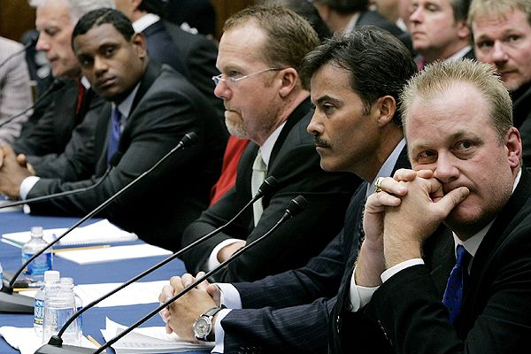
The Role of Rules & Committees
Rules and Committees not specified in Constitution, but instead created by each chamber (Art. 1 Sec. 5)
Committees
Standing (permanent) Committees have jurisdiction over particular subjects, appoint more specific subcommittees
Ex) http://www.govtrack.us/congress/committee.xpd
Hold hearings to hear public
testimony or conduct gov’t oversight
Select Committees (task forces)
exist for limit time for specific
purpose

Slide 7
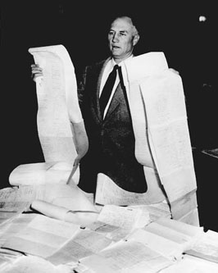
The Role of Rules & Committees
Rules
Examples
House rules specify size and jurisdiction of committees / govern form and structure of debate
Senate more informal, filibuster option remains open at all times.
However, 60 votes (cloture) brings proposal to a vote
Party Organization
Leaders encourage members to adhere to party platform
Committee chairs appointed by seniority and party loyalty

Slide 8
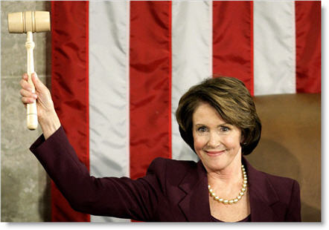
Congressional Leadership
House Leadership (3 models)
Strong Institutional Speaker
Speakers wield considerable power over organization and legislative agenda
Powers: controls committee appointments, chairs Rules Committee, “traffic cop” deciding which bills come to the floor and rules of debate.
Decentralized Committee Leadership
Some historical periods witnessed committee chairs rebelling against speaker
Party Control
Strong speaker who represents majority party
Committee chairs appointed based upon
party loyalty

Slide 9
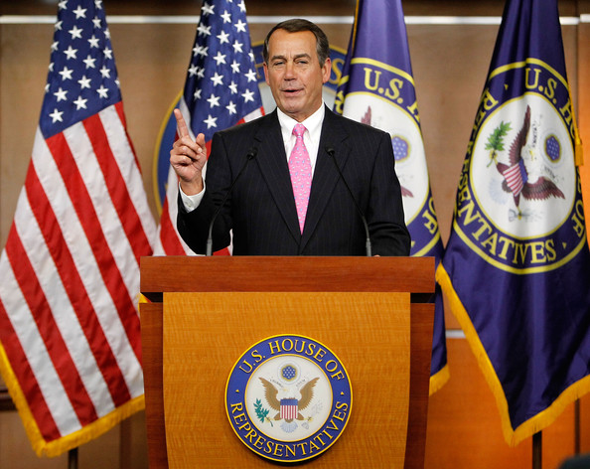
Congressional Leadership
Senate Leadership
VP is president of Senate, but only power is to cast tie-breaking vote.
Majority and Minority Leaders chosen by each party to guide operations.

Slide 10
Majority Rule and Compromise in Congressional Deliberation
Bill vs. Resolution
Simple resolutions address rules or express sentiments of Congress
Joint Resolutions device for proposing Amendments or other matters. If signed (or over-ride), has force of law
Most proposals take form of a bill
Bills introduced in either House (except revenue bills= H)
Numbers with prefix S or H
The process is as follows…

Slide 11
Majority Rule and Compromise in Congressional Deliberation
Committee Assignments
Bills assigned to at least 1 committee / usually referred to subcommittees for rigorous scrutiny and amendments
Hearings
Representatives of government agencies, interest groups or outside experts present testimony
Deliberations
At “Mark Up” sessions, members can review, modify, approve final version, and recommend to full House or Senate
Report
If bill wins favorable committee vote, reported to full chamber
Committee report justifies its actions

Slide 12
Majority Rule and Compromise in Congressional Deliberation
Floor Vote
Places on calendar for consideration and a vote
Referral to the Other Chamber
If passed, sent to other chamber where process begins again
Conference Committee
When versions of bill differ (most do), conference committee (members of both house) try to reach compromise.
If agreement reached, conference report submitted for vote (cannot be amended, can be filibustered)
Referral to President
If president signs, becomes law
If vetoed, 2/3 vote needed in each chamber to over-ride
If not signed, but Congress adjourns within 10 days, bill is dead
(pocket veto)

Slide 13
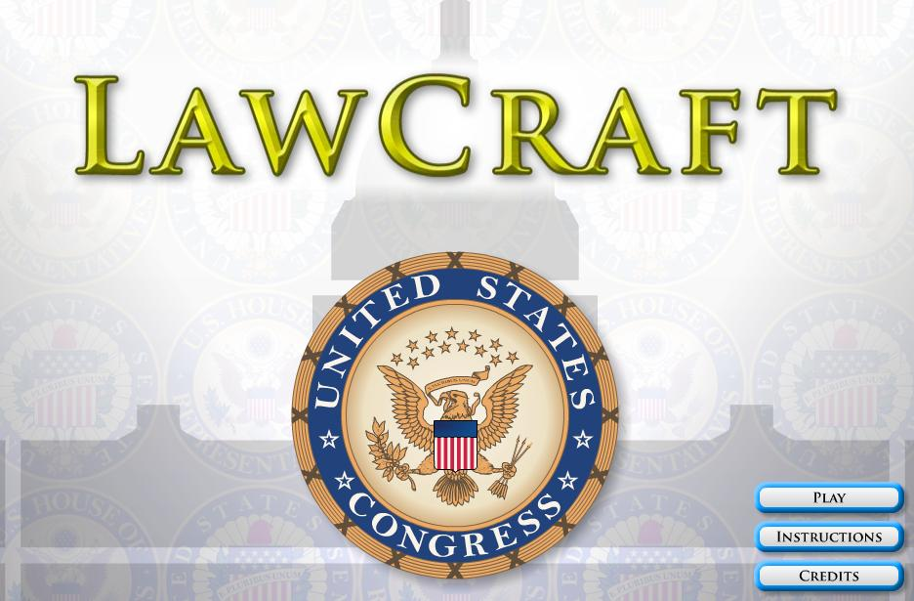
Majority Rule and Compromise in Congressional Deliberation
Bill must win majority support at each phase
Sponsors of bill must be persistent and willing to compromise
Lawmaking process demonstrates American system of representative gov’t, limited gov’t and checks and balances at work.
LawCraft
http://icivics.org/games/lawcraft

Slide 14
Ideas for Legislation & Deciding Which Bills to Support
Campaign Promises
Responses to Crisis
Legislation Introduced by Others
Library of Congress and Congressional Budget Office provide research, analysis, and projected costs.
Executive Branch
President outlines legislative agenda at State of the Union
Party members sponsor president’s legislation
Legislation also introduces by Executive departments / agencies

Slide 15
Ideas for Legislation & Deciding Which Bills to Support
Constituents
Constituents recommend enactment or repeal of laws through various forms of communication (letters, opinion polls, blogs)
Interest Groups
Organizations, industries, and interest groups employ lobbyists to help influence legislation
Reflects right to free speech, assembly, and petition
Effective Lobbyists are well-informed on issue, knowledgeable of process, well-organized, and cooperative.

Slide 16
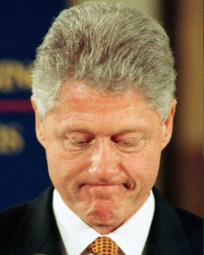
The Power to Investigate
Purpose
Finding facts on which to base legislation
Discover or influence public opinion
Oversee administrative agencies
Probe activities of public officials
Secure partisan political gain
Power to investigate also used to impeach federal officials
Initiated in House. If vote on impeachement, sent to Senate
Conviction in Senate requires 2/3 majority

