Slide 1
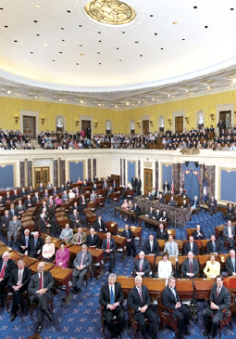
Lesson 21:
What Is the Role of Congress in American Constitutional Democracy?

Slide 2
Purpose
Congress is often called America’s first branch because of its lawmaking powers and control over the nation’s purse.
Congress is also considered the “People’s Branch” since it is directly accountable to the electorate.
This lesson examines Congress’s constitutional powers and how it represents both the people and the states.

Slide 3
Objectives
Explain basic differences between Congress and the British Parliament and how Congress reflects America’s commitment to representative government and federalism.
Identify several constitutional sources of power and some of the challenges members face in representing and serving constituents.
Evaluate, take and defend positions on contemporary issues about congressional representation and organization.

Slide 4
Terms to Know
delegate theory The idea that a legislative representative should exactly mirror his or her constituents' views in deciding on public policy. enforcement powers The power of Congress to enforce laws. enumerated powers Those rights and responsibilities of the U.S. government specifically provided for and listed in the Constitution. federalism A form of government in which power is divided and shared between a central government and state and local governments.

Slide 5
Terms to Know
gerrymandering Drawing the boundaries of an electoral district to favor a political party. implied powers Those powers authorized by a legal document that are not expressly stated but can be inferred from expressly stated powers. The power of Congress to do all things "necessary and proper" to carry out the powers delegated to it by Article I, Section 8, Clause 18 of the U.S. Constitution. The "necessary and proper" clause is also known as the "elastic clause," because it greatly expands the Constitution's enumeration of the powers of Congress. Implied powers can be distinguished from "inherent powers," those that are expressly provided for in the Constitution. inherent powers Those powers ingrained so deeply in an institution that they need not be stated. For example, what the "inherent powers of the presidency" might be is a hotly contested subject in American national politics. trustee theory of representation The idea that a legislative representative should use his or her best judgment in making decisions on public policy, regardless of constituent opinion.

Slide 6
Differences Between Congress and the British Parliament
Although British Parliament served as a model for our 2-house legislature, there are 4 major differences.
1) Representation
British Parliament
Designed to represent specific order in society.
House of Lords - traditionally an inherited seat. Today hold honorary lifetime appointments. (1200 members)
House of Commons – elected, represent geographic regions
Congress
House of Reps – represent viewpoints of district / frequent turnover (2 yr. terms)
Senate – represent whole state / longer terms ( 6 yrs.)

Slide 7
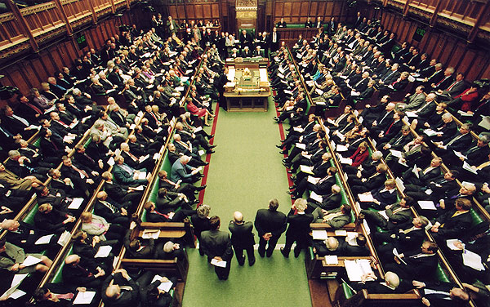
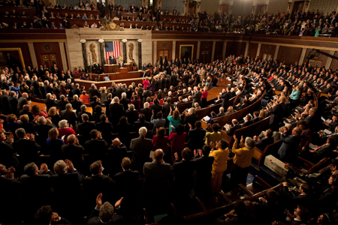
Differences Between Congress and the British Parliament
2) Separation of Powers
British Parliament
Leader of majority party appoints prime minister (chief executive and chief legislator)
Members of Parliament hold Cabinet positions as well
House of Commons is much more powerful house
http://www.youtube.com/watch?v=TsAa9VmwOaI
Congress
Article 1 Sec 6 prohibits mingling of executive and legislative powers
House & Senate both powerful, frequently limit each others’ power

Slide 8
Differences Between Congress and the British Parliament
3) Term Lengths
British Parliament
No fixed election schedule, but at least every 5 yrs. depending on “confidence” in prime minister and party in power
Congress
Reps (2 yr terms) / Senate (6 yrs., staggered)
4) Federalism
British Parliament
Local governments are primarily administrative units of central government. Most powers simply delegated from national level.
Congress
State legislatures wield considerable power, leading to dynamic system of federalism.

Slide 9
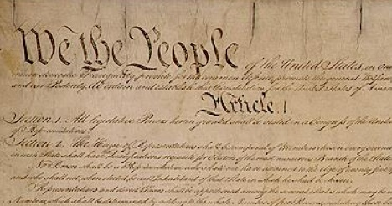
Congress’s Constitutional Powers
Limitations
Art. 1 Sec. 8 - limits powers to those “herein granted” /
18th power = “all laws… necessary and proper for carrying into execution the foregoing powers”
Art. 1 Sec. 9 – lists matters congress “shall not” legislate
Tax state exports, grant titles of nobility…
Bill of Rights – list of rights Congress “shall not” infringe
First – “Congress shall make no law” abridging free press

Slide 10
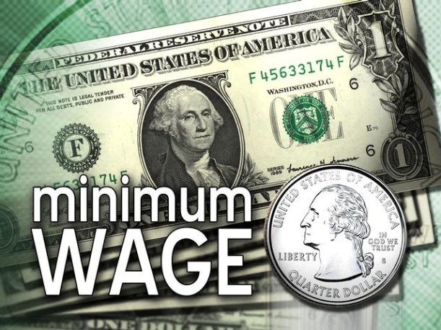
Congress’s Constitutional Powers
Enumerate Powers
Those powers listed in Constitution
Ex) “Regulate Commerce”
Congress now regulates manufacturing,
child labor, wages…
Implied Powers
Some expressed powers imply additional powers
Ex) “Necessary and Proper” Clause
Court Case: McCulloch v. Maryland (1819)
Decision = N & P clause and power to coin & borrow money implied power to create a national bank.
Congressional Oversight
Implied power to create, and monitor, executive agencies designed to implement policy mandates.

Slide 11
Representing the People & The States
No constitutional term limits
Since 1842, all members of House elected from single-member districts
Many states redistrict after each 10-yr. census
Drawn by state legislatures or independent commissions
Dissatisfied groups can challenge redistricting in court

Slide 12
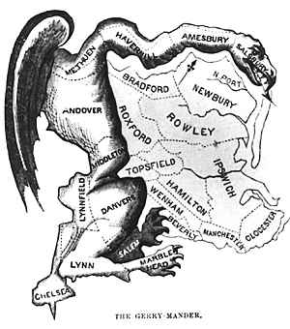
Controversy Over Districting
Court Case: Wesberry v. Sanders (1964)
Decision – adopted rule of “one person = one vote”
New requirements have not ended debate over Gerrymandering
Senate initially chosen by state legislatures, but 17th Amendment creates direct elections

Slide 13
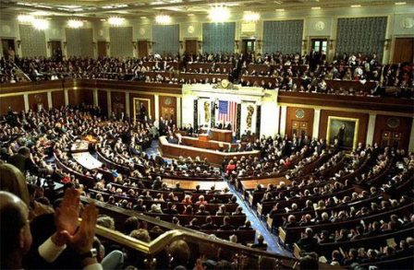
Controversy Over Districting
1913 – Congress fixes size of House at 435
By 2004, average House district population over 700,000
Surpassed worldwide only by India
District size creates challenges addressing needs and interests of such diverse constituencies

Slide 14
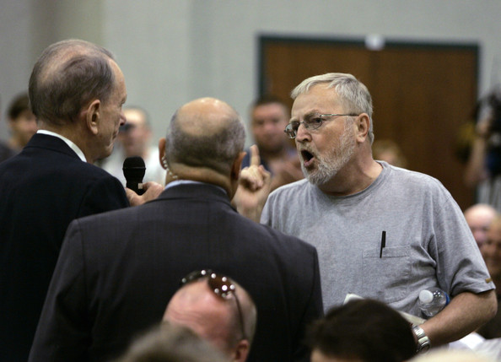
Theories of Representation
Delegate Theory or Trustee Theory?
Most representatives claim to practice both
Our vast and diverse nation make it challenging to both represent constituents while also finding common ground with legislators from other regions.
Congressman Specter dealing with “unhappy” constituent
http://www.youtube.com/watch?v=jV1jmvMHsS0

Slide 15
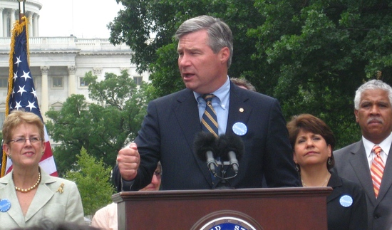
Serving Constituents
Communications
Media appearances, websites,
town hall meetings…
Case Work
Staffers help constituents solve problems involving national government.
Ex) Dealing with agencies (IRS, Social Security), asking for favors (tours, meetings w/ legislators)
Serving Constituents’ Interests and Concerns
Introducing / sponsoring legislation that serves constituents interests.
Working to have federal projects located in district (highways)

