Slide 1
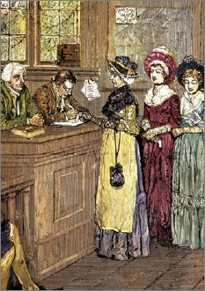
Lesson 20:
How Has the Right to Vote Been Expanded since the Adoption of the Constitution?

Slide 2
Purpose
During the early years of the nation, most white men met property requirements. However, many groups were historically denied the right to vote.
This lesson examines how the right to vote has been expanded since 1787 to now include almost all citizens 18 yrs. of age or older.

Slide 3
Objectives
Describe the extension of the franchise as a result of changes in voting laws, amendments to the Constitution, and Supreme Court decisions.
Evaluate, take and defend positions on how extending the right to vote is related to fundamental ideas and principles of American constitutional gov’t.

Slide 4
Terms to Know
enfranchisement
Giving the right to vote to a person or category of persons.
franchise
A right or privilege. In the context of American politics, it means the right to vote.

Slide 5
Importance of American Enfrachisement
Representative gov’t based upon principle that people have a say in determining who makes, executes, and judges the law.
Voting most basic means of participation.
Although colonial America had property requirements, franchise generous compared with Britain.
However, whole classes remained excluded.
Women, natives, religious minorities, slaves…

Slide 6
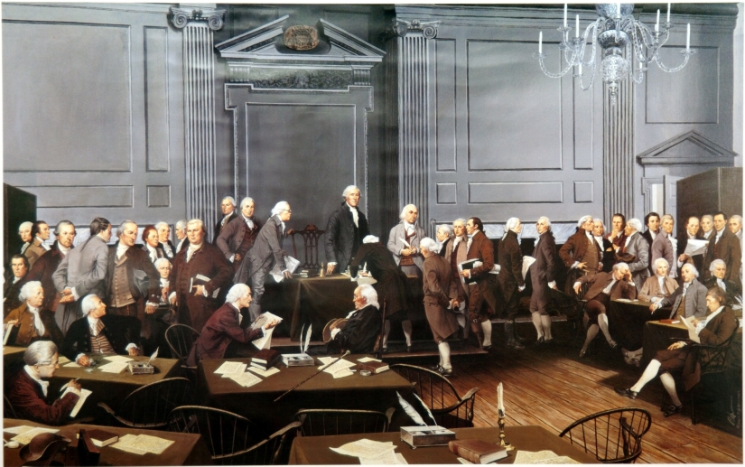
Early American Suffrage
Framers could not agree, so left power with the States.
NJ (1776)
All inhabitants who met property / residency (including women & African Americans)
However, those groups were later disenfranchised in 1800s.

Slide 7
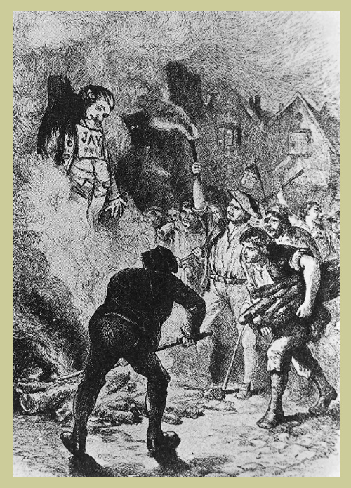
Expansion of Suffrage
White Men
Many leaders (J. Adams) feared mob rule would erupt w/o property rights.
Western states lead reform to abolish prop requirements in early 1800s (to attract settlers)
Following Mexican-American War and Texas Annexation, suffrage granted to free Mexicans. However, violence and fraud deny many their rights.

Slide 8
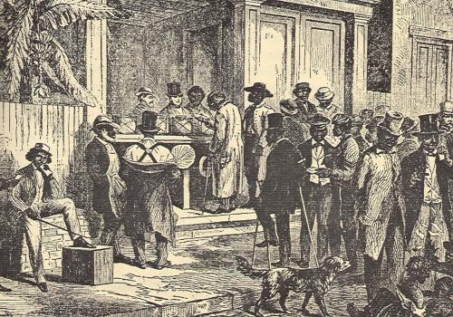
Expansion of Suffrage
African American Men
15th Amendment (1870) grants voting rights to African Americans, but literacy tests, poll taxes, and grandfather clause bar many from voting.
Almost a century passes until the civil rights movement galvanized national support to end voting discrimination.

Slide 9
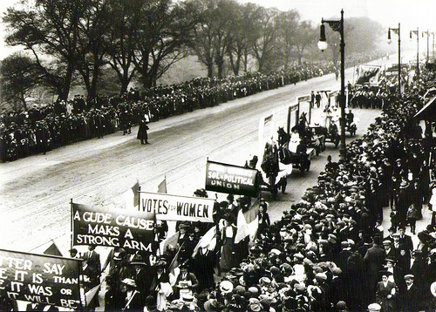
Expansion of Suffrage
Women
Mid 18th c. abolitionist and women suffrage movement closely links.
Stanton’s Seneca Falls Declaration of Sentiments echoes Jefferson’s Declaration (‘48)
Suzan B. Anthony & others point to section 1 of 14th claiming that as citizens they should have suffrage
Minor v. Happersett (‘75) Ruled that citizenship does not automatically grant suffrage.
WY leads western states
expansion of women’s suffrage
Following WWI and mass
demonstrations, 19th
Amendment guaranties
franchise for women

Slide 10
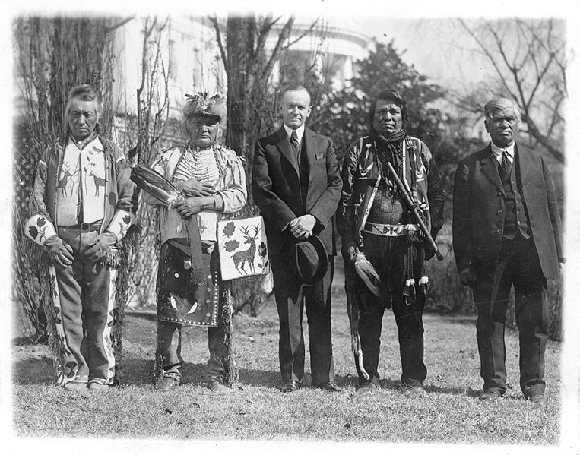
Expansion of Suffrage
Native Americans
Originally, Native Americans not considered citizens
Considered “foreigners” and often treated as enemies
Dawes Act (‘87) extends citizenship if give up tribal affiliations (attempt to undermine tribal culture)
Indian Citizenship Act (’24) extends franchise to all natives with expectation that tribal gov’ts would whither and natives would assimilate into “mainstream”
Enforcement lacking until
passage of 24th (bans poll taxes)
and Voting Rights Act (‘64)

Slide 11
Expansion of Suffrage
18 Year Olds
By ‘70, only 3 states granted suffrage to those under age 21
Facing protests over Vietnam, Congress amends Voting Rights Act to ensure suffrage for 18 yr olds
Oregon v. Mitchell (‘70) – rules that Congress could regulate voting age in national elections but not state elections.
In response, 26th Amendment passed prohibited all governments from denying voting rights of citizens age 18 or older.

