Slide 1
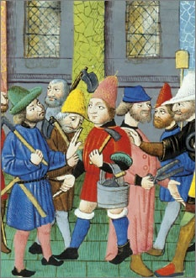
Lesson 2: What Ideas about Civic Life Informed the Founding Generation?

Slide 2
Lesson 2 Purpose
People’s judgment about government may reflect ideas about human nature, the proper function and scope of government, the rights of individuals, and other values.
Political philosophers have discussed these matters for thousands of years.
This lesson examines important concepts such as the common good, civic virtue, the state of nature, natural rights, consent, and the social contract.

Slide 3
Lesson 2 Objectives
Describe how and why natural rights philosophy differs from classical republicanism.
Describe how both systems of thought influenced the founding generation.
Explain challenges society faces when it strives to preserve the rights to life, liberty, property, and the “pursuit of happiness,” while also promoting the common good and civic virtue.
Evaluate, take and defend positions on
the importance of civic virtue today.
the role of political philosophy in thinking about government.

Slide 4
Lesson 2 Terms & Concepts
civic virtue
The dedication of citizens to the common welfare of their community or country, even at the cost of their individual interests. Traditionally considered most relevant to republics, since republican citizens are responsible for the well-being of their country.
classical republicanism
The ideals and practices of ancient Greek or Roman city-states that emphasized civic participation and the responsibility of citizens for the well-being of their polity, or country. Acts by citizens that placed the public good, or common welfare, above private interest were especially prized.
common good
The good of the community as a whole, as contrasted with private interests that may conflict with public interest. Also known as the public good.
consent of the governed
Agreement by citizens to obey the laws and the government they create. Consent is the foundation of government's legitimacy.

Slide 5
Lesson 2 Terms & Concepts
divine right
The idea prevalent in early modern Europe that monarchs derive their authority directly from God. Adherents to this doctrine claimed that to disobey such monarchs, to attempt to replace them, or to limit their powers is contrary to the will of God. Also known as the divine right of kings.
inalienable rights
Fundamental rights inherent to being human that every person therefore possesses that cannot be taken away by government or another entity. This phrase was used in the Virginia Declaration of Rights and the Declaration of Independence.
natural rights
The doctrine that people have basic rights, such as those to life, liberty, and property in a state of nature. Some writers, especially those influencing the American Founders, argued that certain of these rights are inalienable-inherent in being human-and that people create governments to protect those rights.
political legitimacy
Acceptance by the governed that the claim to authority by those who govern is justified. In democratic societies, legitimacy is achieved only when those who govern gain power through the free consent of the governed in free and fair elections.
popular sovereignty
The natural rights concept that ultimate political authority rests with the people.

Slide 6
Lesson 2 Terms & Concepts
pursuit of happiness
An "unalienable" right stated in the Declaration of Independence. It is the right of Americans to pursue personal fulfillment in their own way, so long as they do not infringe on the rights of others. Within certain limits, this right denies the legitimacy of government to decide what kind of happiness one ought to seek.
right to revolution
The right of the sovereign people of any democratic state or regime to depose a government after it has attacked citizens' basic rights for a significant period of time. This right, espoused by English philosopher John Locke, was asserted in the Declaration of Independence to justify separation from Britain and the overturning of the authority of King George III.
social contract theory
Presumption of an imaginary or actual agreement among people to set up a government and obey its laws. The theory was developed by the English natural rights philosopher John Locke, among others, to explain the origin of legitimate government.
state of nature
The condition of people living in a situation without government; anarchy. Natural rights philosophy inquired about what rights, moral rules, or laws applied in such circumstances and what rights, if any, people retained after agreeing to leave the state of nature to form a politically organized society or state.

Slide 7
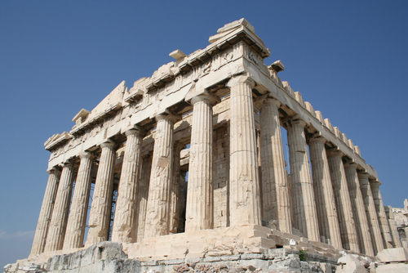
The Founding Generation’s Values
Classical Republicanism (Ancient Rome)
Place the needs of people as a community above individual liberty and self-determination (Promoting the common good)
Three Main Aspects of Classical
Republicanism
Small, uniform communities
Good gov’t is only possible in
small communities because people
are able to know and care for one other
and discern the common good.

Slide 8
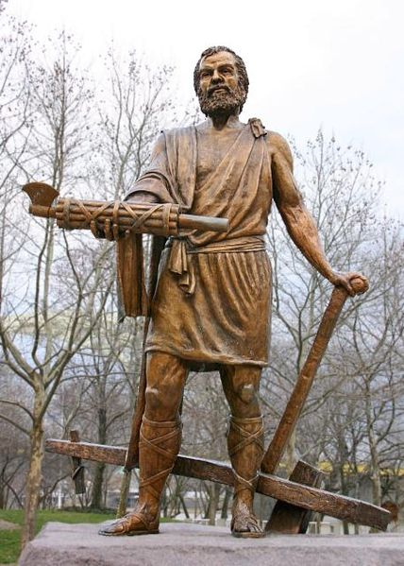
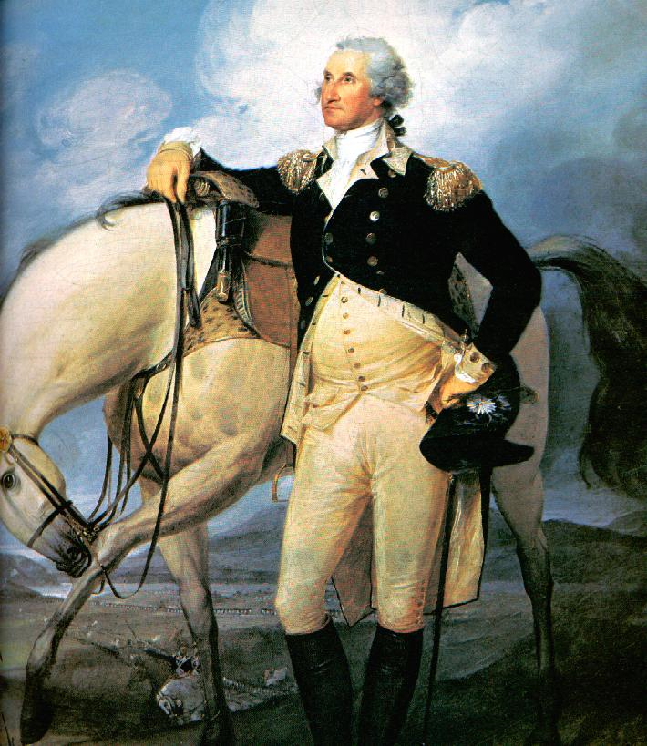
The Founding Generation’s Values (Cont…)
Citizenship & Civic Virtue
Citizens should set aside personal interests to promote common good. (ex. Cincinnatus / Washington)
Moral Education
Children must learn
rituals & values of society
skills to speak & reason well
Values of civic virtue
Skills to participate in political debate

Slide 9
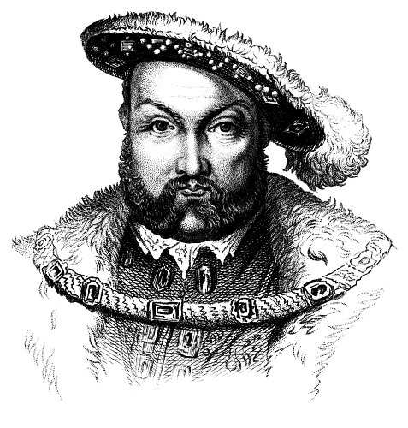
The Role of Philosophy in the Study of Gov’t
New philosophies challenges Divine Right of Kings in 1600s
Idea that monarchs derive their authority to rule from God
New thinkers suggested that self-government was required for social peace and a just society.
Natural Rights philosophy suggest what life would be like in a complete state of nature (no government)

Slide 10
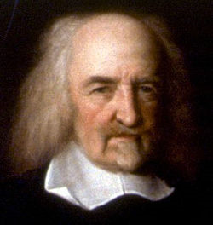
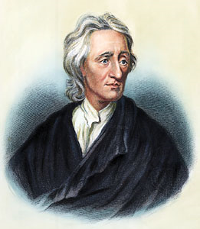
Natural Rights Philosophy
Social Contract Theory
17th c. - Thomas Hobbes proposes that people enter a contract with government to maintain stability & peace.
John Locke
People possess inalienable rights (life, liberty, property)
Government protects natural rights, but can be replaced if it fails to protect those rights

Slide 11
Natural Rights’ Influence on the Founders
Individual Rights
Inalienable rights exist regardless of wealth, social status, or birth.
Popular Sovereignty
The government derives its authority from the people. (social contract)
People have the right to create whatever government they feel is best.
Limited Government
Authority is limited by the purpose for which government is created.
Human Equality
All people are free from another’s control and are equal to another.
Colonial American enjoyed more social equality than Europe, but huge social inequalities remained. (SLAVERY)

