Slide 1
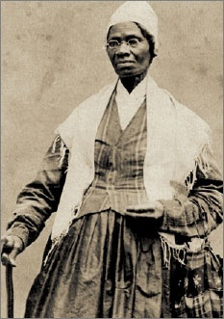
Lesson 19:
How Has the Equal Protection Clause of the Fourteenth Amendment Changed the Constitution?

Slide 2
Purpose
This lesson examines how the equal protection clause prohibits state governments from denying people “equal protection of the laws.”
Like the due process clause, the equal protection clause places limits on government, not private individuals.

Slide 3
Objectives
Define equal protection of the laws.
Explain why neither state nor the national gov’t can deprive people of equal protection of laws.
Explain the “separate but equal” doctrine and why it was abandoned.
Describe the categories used to decide cases challenging gov’t actions that treat some people differently.
Evaluate, take, and defend positions on how conflicts between or among rights should be resolved.

Slide 4
Terms to Know
equality of condition
Equality in all aspects of life, such as wealth, standards of living, medical care, and working conditions.
equality of opportunity
A right guaranteed by both federal and many state laws against discrimination in employment, education, housing, or credit rights due to a person's race, color, sex and sometimes sexual orientation, religion, national origin, age, or handicap.
intermediate scrutiny
In U.S. constitutional law, the middle level of scrutiny applied by courts deciding constitutional issues through judicial review.
rational basis
In U.S. constitutional law, the lowest level of scrutiny applied by courts deciding constitutional issues through judicial review.
separate but equal
The argument, upheld by the U.S. Supreme Court in Plessy v. Ferguson (1896) but later reversed, that racially segregated public facilities are constitutional if those facilities are of equal quality.
strict scrutiny
Under U.S. constitutional law, the second highest level of scrutiny used by courts reviewing federal law for constitutional legitimacy. "Super strict scrutiny" is the highest level.

Slide 5
“Equal Protection of the Laws”
Constitutional guarantee of fair treatment for all persons, regardless of sex, race, national origin, religion, or political views.
Every person entitled to equality of opportunity, not equality of condition
Early Cases:
Strauder v. WV (1880)
“All White” jury requirement prohibited
Yick Wo v. Hopkins (1886)
Ethnically discriminatory SF laws prohibited (citizens and aliens alike)

Slide 6
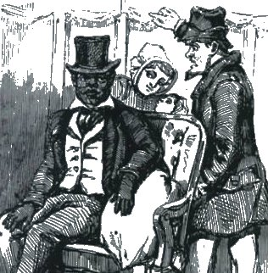
The “Separate But Equal” Doctrine
Following Reconstruction, Jim Crow laws designed to limit rights of African Americans and creates institutional segregation in South.
Plessy v. Fersguson (1896)
Racially separated rail cars constitutional as long as facilities were “equal”

Slide 7
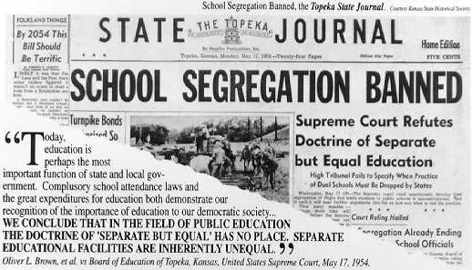
Abandoning “Separate But Equal”
Brown v. Board of Education (1952)
NAACP challenges Kansas BoE, emphasize damaging effects segregation has on children.
Court rules that “separate” is “inherently unequal”
Despite ruling, enforcement proved challenging…

Slide 8
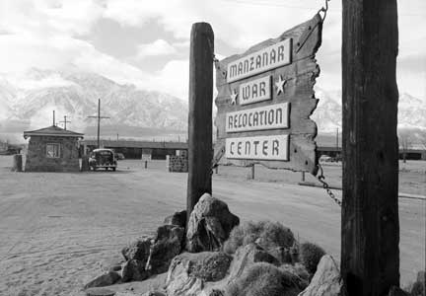
Interpreting the Equal Protection Clause
Supreme Court uses 3 basic levels of analysis to decide whether laws that create classifications violate “equal protection.”
Level 1: Strict Scrutiny
Race, national origin, religion, alien status, voting rights, interstate travel, access to courts.
Gov’t must prove a
“compelling state interest”
to justify such
classifications

Slide 9
Interpreting the Equal Protection Clause
Level 2: Intermediate Scrutiny
Gender, illegitimacy
Gov’t must prove laws “substantially related to important gov’t purpose”
Cases: Craig v. Boren (‘76), Rostker v. Goldberg (‘81)
Level 3: Rational Basis
Wealth, disability, age…
Laws must be rational/reasonable.
Cases: Stanton v. Stanton (‘75)
14th Only Applies To States.
In Hirabayashi v. US (‘43), court ruled 5th Amendment has equal protection component.

Slide 10
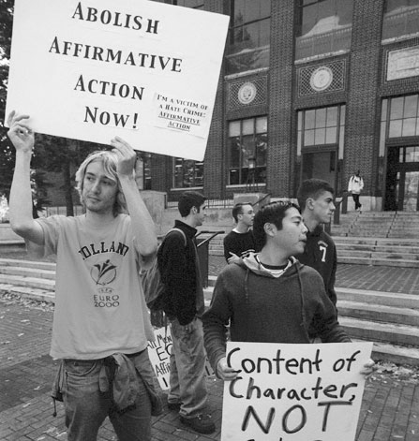
Controversies Remain
Is Affirmative Action Reverse Discrimination?
Is Intermediate Scrutiny Appropriate For Gender Classifications?
Should Mentally
Handicapped, Children of
Illegal Aliens, and Gays
and Lesbians Be Treated
As “Discrete and Insular
Minorities” Regarding
Issues of Prejudice?

