Slide 1
Lesson 18:
How Has the Due Process Clause of the Fourteenth Amendment Changed the Constitution?

Slide 2
Purpose
The 5th Amendment limits the national government, but the 14th guarantees that states cannot deprive rights without “Due Process.”
Due process is not defined, but has roots in English history and plays a central role in what government actions are considered valid.
This lesson explains how “due process” has changed since the 14th Amendment and how the requirement of due process has been used to protect individual rights from state government actions.

Slide 3
Objectives
Explain the historical origins of due process.
Explain the difference between procedural and substantive due process.
Define the concept of incorporation and describe its effects on the powers of the states.
Evaluate, take, and defend positions on historical and contemporary issues involving due process.

Slide 4
Terms to Know
adversary system
A system of justice in which court trials are essentially contests between accuser and accused that take place before an impartial judge or jury.
due process of law
A requirement stated in the Fifth and Fourteenth Amendments that treatment by state and federal governments in matters of life, liberty, or property of individuals be reasonable, fair, and follow known rules and procedures. See procedural due process and substantive due process
incorporation
The process through which the U.S. Supreme Court has applied the due process clause of the fourteenth Amendment to extend the reach of the Bill of Rights to include protection from interference by states.
inquisitorial system
A trial system in which a judicial official or set of officials acts as both prosecutor and judge, questioning witnesses, examining evidence, and reaching a verdict.
procedural due process
The principle that government must respect all, not some, of a person's legal rights. Government must not subject individuals to unreasonable, unfair, or arbitrary treatment.
substantive due process
Judicial interpretations of the due process clauses of the U.S. Constitution requiring the content of law to be fair and reasonable.

Slide 5
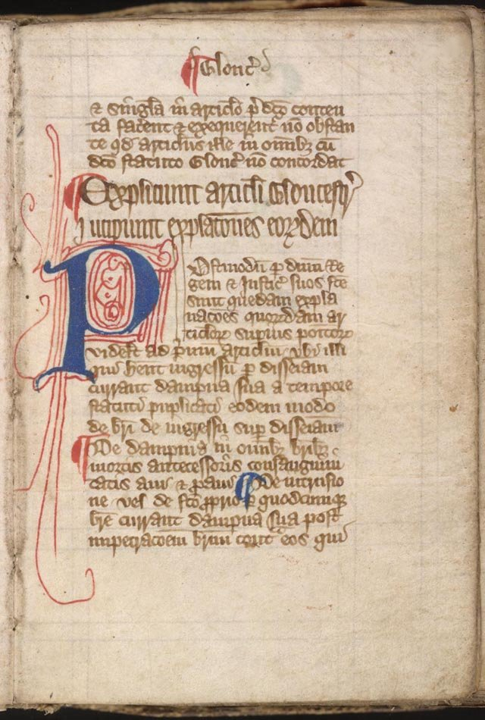
Due Process of the Law
Principle traced back to Magna Carta
Gov’t must follow established procedures and may not act arbitrarily in negatively altering or destroying life, liberty, or property.
Due process both an ancient and evolving concept (beliefs about natural rights evolve)

Slide 6
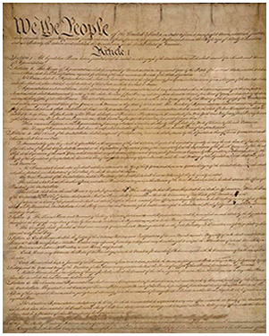
Due Process References in Constitution
5th Amendment
Limits national gov’t
Article 1
Prohibits ex post facto laws
14th Amendment
Imposes due process on states, grants Congress authority to enforce through legislation.
Courts then determine whether legislation satisfies due process requirements of 5th and 14th.

Slide 7
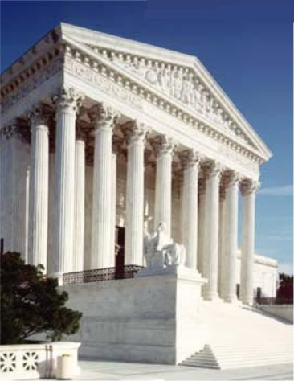
Procedural Due Process
Requires gov’t to act in certain ways before regulating life, liberty, and property issues.
Applies to both criminal & civil matters.
Examples
Requirement of notice
Opportunity of a fair hearing
Opportunity to present evidence
Opportunity to appeal initial decisions

Slide 8
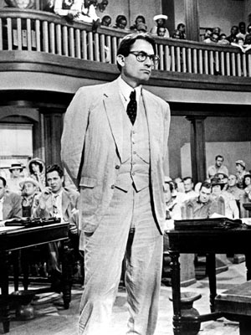
Procedural Rights in our Adversarial Legal System
US & England have adversarial legal systems
Assumes justice results from clash of positions between contesting parties.
Both sides try to persuade impartial judge / jury
In criminal cases, defendant innocent until proven guilty.
Prosecution must prove guilt beyond reasonable doubt.
Procedural justice ensures the “fight” is fair.

Slide 9
Inquisitorial System
Judges act as both investigators and decision-makers.
Argue that adversary system based upon unjustifiable assumptions
Adversaries are not of equal ability or resources
Neither side is concerned with truth emerging unless it helps their side of the case.
Critics of Inquisitorial system say it gives too much power to judges. Juries are more impartial than government officials.

Slide 10
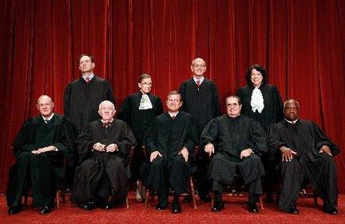
Substantive Due Process
Based upon idea that some rights are so fundamental that gov’t must have a “compelling” reason to regulate them.
Supreme Court must identify which rights are fundamental, and if gov’t has violated that particular right.

Slide 11
Indentifying Fundamental Rights
By 1937, court abandoned view that economic rights are fundamental.
The following are (controversially) considered fundamental
Right to marry and have children
Right to purchase and use birth control
Right to free speech
Right to interstate travel
Right of legal voters to vote
Right to religious freedom…

Slide 12
The Doctrine of Incorporation
By 1925, Supreme Court begins identifying rights in the bill of rights that the state must protect.
Gitlow v. New York – states cannot infringe upon free speech and press without compelling interest.
Selective incorporation means the court examines rights on case-by-case basis.
Justice Frankfurter’s “shock the conscience” test
Court more reluctant to incorporate criminal procedure rights, felt states have greater responsibility for prosecuting & punishing.

Slide 13
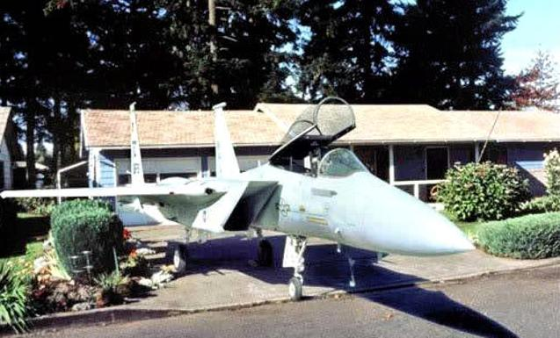
Rights Not Incorporated
2nd Amendment right to
bear arms
5th Amendment right to
an indictment by a grand
jury
7th Amendment right to a
jury trial in civil lawsuits
Implicit requirement in 6th amendment that the jury in a criminal case must have 12 members and must reach a unanimous verdict.

