Slide 1
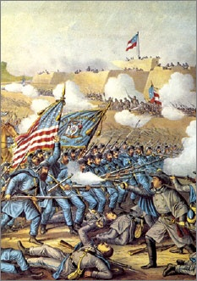
Lesson 17:
How Did the Civil War Test and Transform the American Constitutional System?

Slide 2
Purpose
Between 1860 and 1861, 11 Southern states seceded from the US, starting the Civil War.
The war raised several issues:
the right of states to secede
the president’s wartime powers
the balance between individual rights and national security
the constitutional status of slavery
Three amendments adopted after the war defined American citizenship and transformed the relationship between the national and state governments

Slide 3
Objectives
Describe several important constitutional issues raised by President Lincoln’s actions, including suspension of habeas corpus and the Emancipation Proclamation.
Explain the similarities and differences between the US and Confederate constitutions.
Explain how the Civil War led to the creation of the 13th, 14th, and 15th Amendments.
Evaluate, take, and defend positions on the conditions under which the writ of habeas corpus might be suspended and the constitutionality of secession.

Slide 4
Terms to Know
abolitionists
Opponents of slavery who wished to put an end to the institution.
grandfather clause
Provisions of laws passed in the South after the Civil War stating that citizens could vote only if their grandfathers had been allowed to vote. The law made it impossible for African Americans to vote because their grandfathers had been excluded from voting.
literacy test
A test to prove a person's abilities to read and write. Until 1964, such tests were used in various states to prevent minorities from voting.
poll tax
A tax that voters in many states were required to pay in order to exercise their right to vote. These barriers were used until 1964 to prevent African Americans from voting.
secession
In U.S. history, the act of states leaving the Union in 1861 following the election of President Abraham Lincoln; precipitated the Civil War.

Slide 5
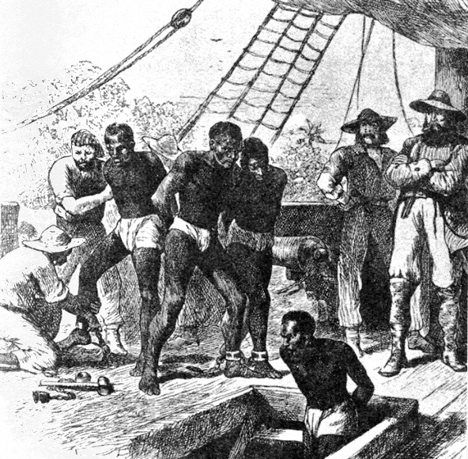
Constitutional Issues Lay Foundation for Civil War
The Constitution & Slavery
Constitution addressed slavery in following ways
3/5^{ths} Compromise (Art. I Sec. 2)
“Fugitive Slave Clause” (Art. IV Sec. 2)
Banned slave trade in 1808 (signed into law by Jeff.)
Pro-Slavery Advocates: slavery issue should be forever regulated by state gov’ts.
Abolitionists: no mention of “slavery” in Constitution / institution is at odds with American ideals / Founders sought end to slave trade

Slide 6
The Constitution & New Territories
Congress given power to approve new state constitutions
Missouri Compromise
Only new states south of MO’s southern border open to slavery.
Slave & non-slave states admitted in pairs to keep balance in Senate
Texas Annexation and Mexican War
Most newly acquired territory above “36’ 30’”
Compromise of 1850 – California = free state, tougher fugitive slave laws
By mid 1850’s, two sides emerge (both cite Dec.)
Free Soilers / Republicans (human liberty)
Popular Sovereignty Advocates - People of territory decide for themselves whether to allow slavery

Slide 7
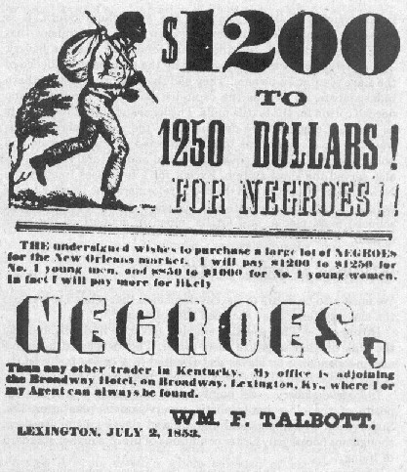
Fugitive Slave Law of 1850
This aspect of compromise infuriates abolitionists.
Leads to Northern “personal liberty laws” / refuse to enforce
Dred Scott v. Sanford (1857)
Scott sued master – claims when brought to Wisconsin, earned freedom.

Slide 8
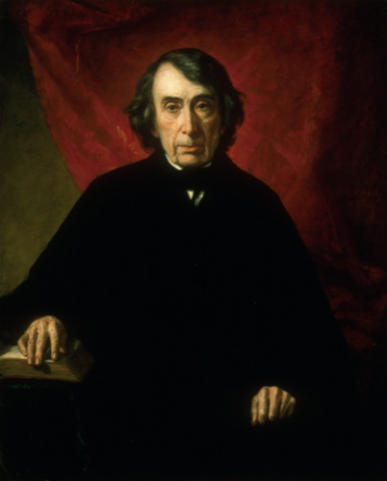
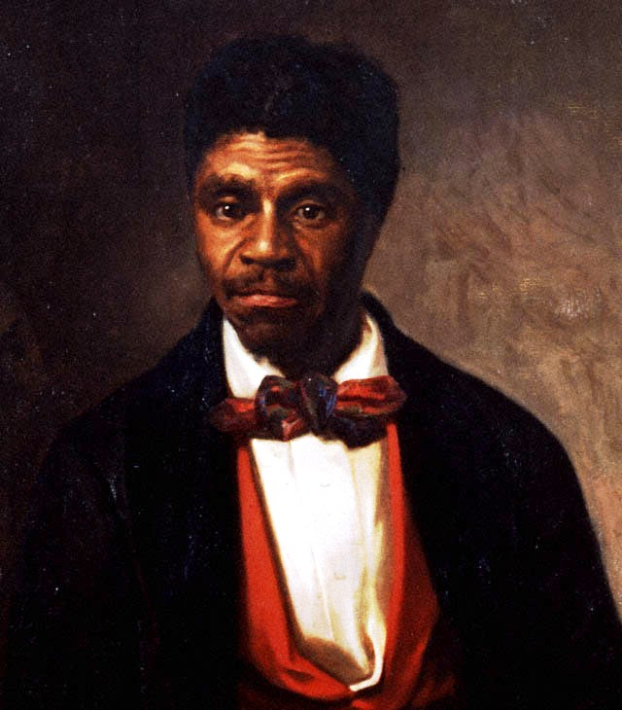
The Dred Scott Decision
African Americans could not be citizens
No protection under national law
(However, Constitution never defines citizenship)
National Gov’t has no right to exclude slavery (property) from new territories
Essentially nullifies MO Compromise
Due Process (5th Amendment) protects property rights (slaves)

Slide 9
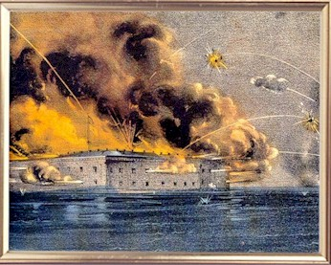
Secession & Its Constitutionality
Lincoln’ Election spurs Southern secession
South opposed Republican “free soil” principles
Form Confederate States of America, adopt own constitution
South argued that union was only a compact of states, none gave up sovereignty w/ ratification
Also claimed right to revolution if fundamental (property) rights were violated. Secession a 2nd American Revolution.

Slide 10
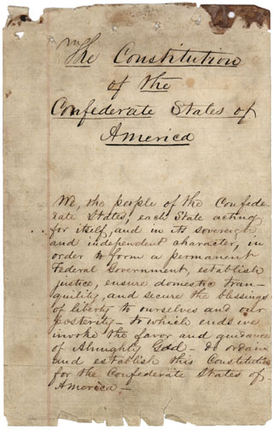
Lincoln & Northerners deny right to secede
Sovereignty granted to American people as a whole
No southern rights had been violated, just fear of losing of right to own slaves.
Secession considered act of rebellion.
Confederate Constitution
Key differences:
President = One 6-yr term
Restricts Congressional power over
tariffs and infrastructure
Explicitly protected slavery

Slide 11
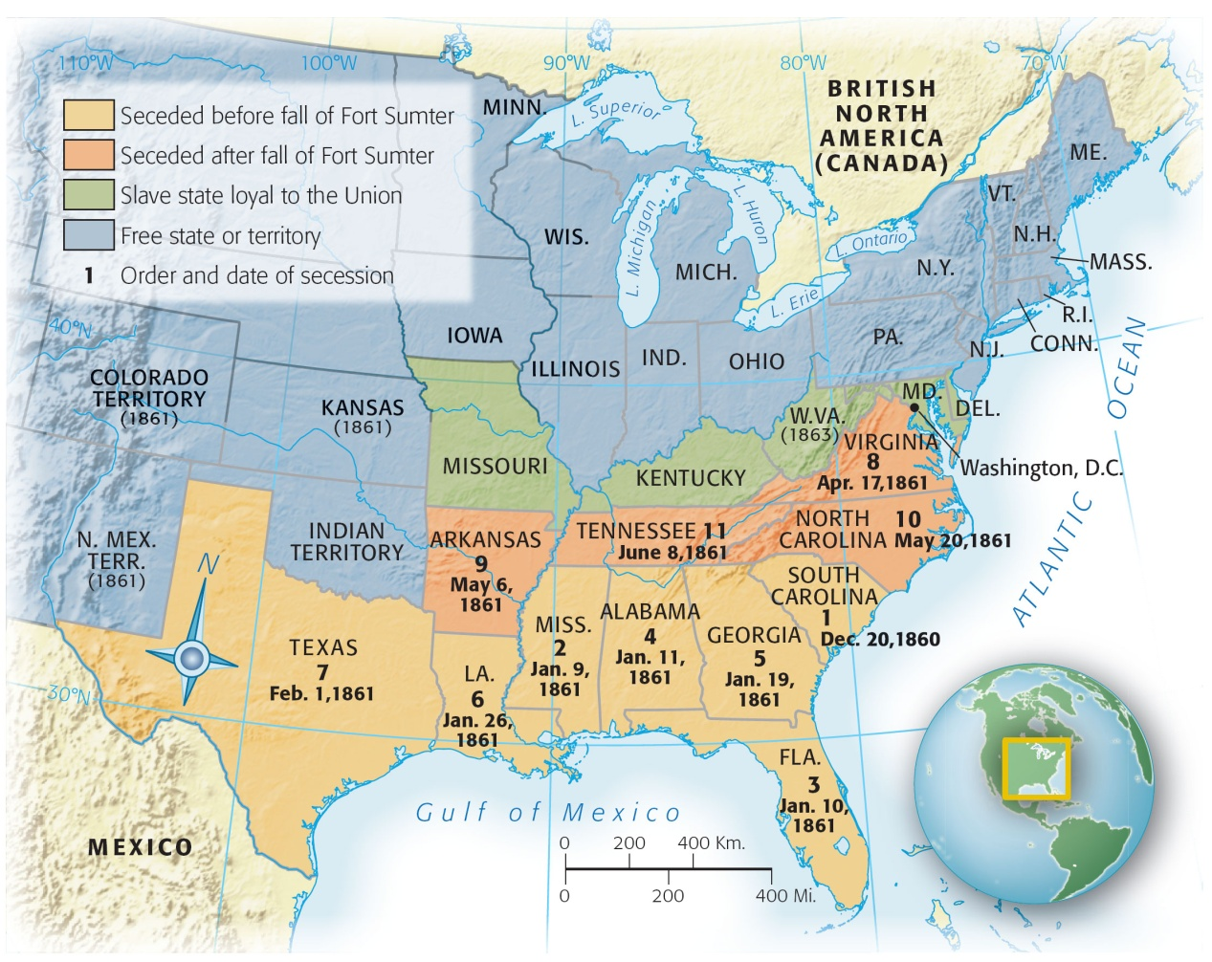

Slide 12
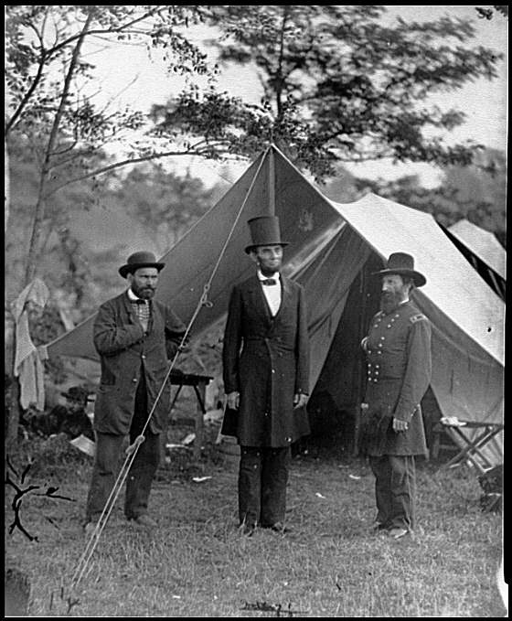
The Constitutional Issues that Provoked War
Slavery the main cause, but initially fought to preserve Union / defend Constitution
Unprecedented Presidential Powers
Expanded army w/o approval of
Congress
Suspended habeas corpus
(power of Congress)
Military trials / arrest for
“treasonable” speech

Slide 13
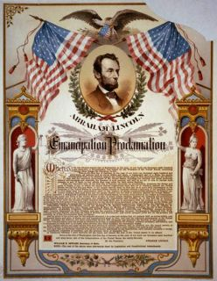
Emancipation Proclamation
Abolishing slavery considered a military necessity, would undercut South’s main labor source
Freed all slaves in rebellious
states
Profoundly symbolic
Union now committed to
principle of liberty

Slide 14
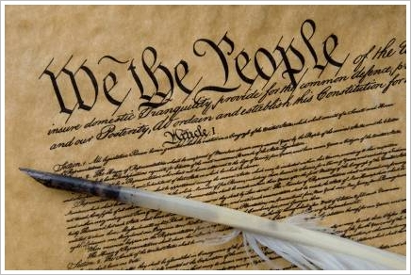
Constitutional Issues Resolved
Slavery
13th Amendment abolishes
slavery
Secession
Not a constitutional right /
established supremacy of
national government
Citizenship / Rights
South responds to 13th Amendment with Black codes / limit political power
Congress passes Civil Rights Act of 1866, but little change

Slide 15
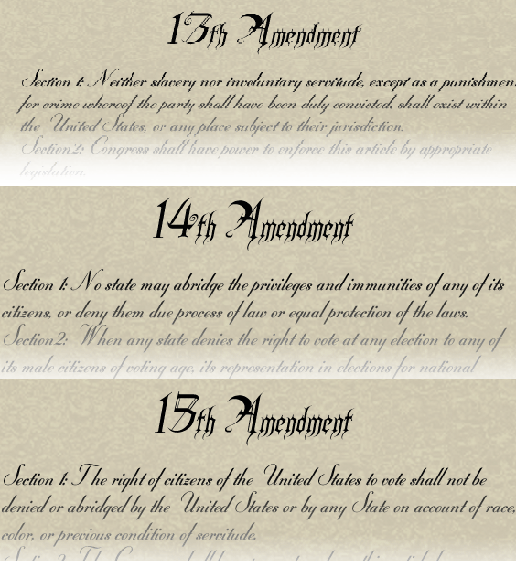
14th Amendment
Nullifies Dred Scott decision / grants citizenship to all born in US
States cannot abridge privileges or immunities of citizens
States cannot deny due process or equal protection of law
15th Amendment
Prohibits gov’t from denying right to vote based on race or status as former slave

Slide 16
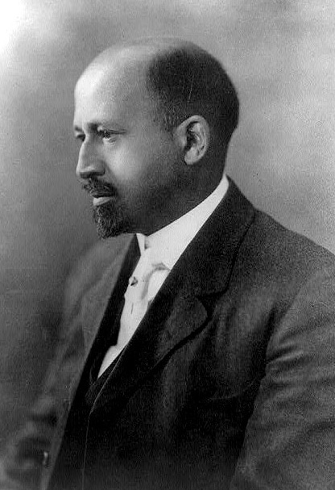
Weakening Public Support
Southern States pass laws destroying political power of African Americans
Poll Taxes
Literacy Tests
Grandfather Clauses
As gov’t failed to enforce 14th & 15th, community leaders become backbone of civil rights struggles.

