Slide 1
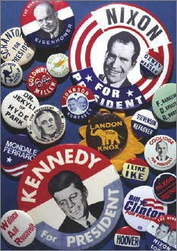
Lesson 16:
What Is the Role of Political Parties in the Constitutional System?

Slide 2
Purpose
Shortly after the government was established, to the Framers’ dismay, political parties formed.
This lesson describes the Framers’ views on political parties and how they first formed.
It also explains how parties became and essential component of the American political system by addressing challenges that the Constitution left unresolved.

Slide 3
Objectives
Explain why the Framers opposed the idea of political parties.
Describe the other ideas that helped political parties gain acceptance.
Explain the conflicting points of view that led to the development of parties and the roles they have played in history.
Evaluate, take, and defend positions on the importance of political parties today.

Slide 4
Terms to Know
delegated powers
According to the natural rights philosophy, people always retain their basic rights, but provisionally entrust or assign certain powers to their government for certain, limited purposes. The powers of government are therefore "delegated powers" in that they are granted by the people, and the people can take them back if government fails to fulfill its purposes.
party system
A concept in political science that political parties control government.
platform
List of the policies and priorities of a political party; also known as a manifesto.
political party
An organization seeking to achieve political power by electing members to public office so that its political philosophy is reflected in public policy.
sedition
Incitement to rebellion.
ticket
The choice of candidates of a political party for president and vice president.

Slide 5
The Framers’ Thoughts on Political Parties
Madison argues that Constitution would control “evil” effects of factions
Some (Burke) consider parties necessary to express open opposition to gov’t policies
Most American leaders oppose Burke, but many agree that they can “promote deliberation” and “check excesses in the majority”
Delegates had no true experience with an established party system.

Slide 6
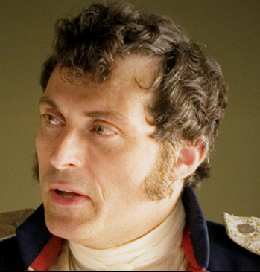
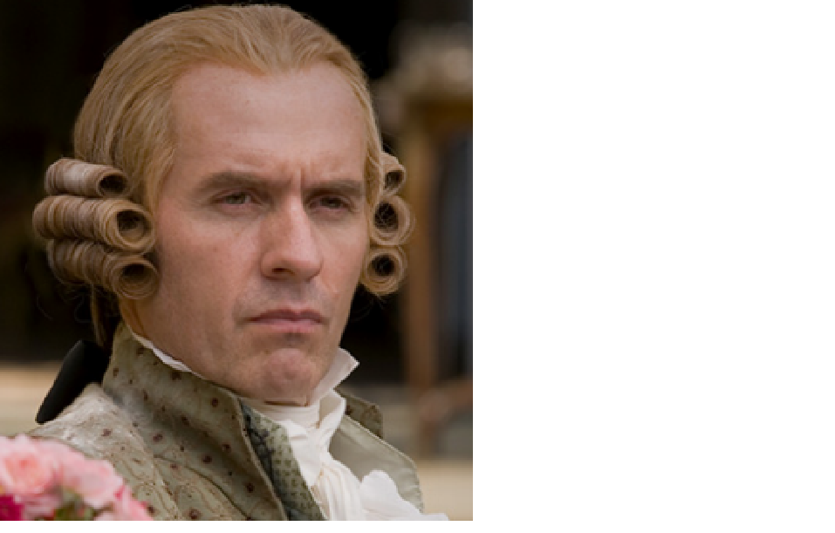
The Development of Political Parties
Ironically, Madison and Hamilton become opposing leaders of political parties w/in 10 yrs of ratification
Issue that led to party division:
1. Power of National Government
Hamilton – National Gov’t should address any national issue, mentioned in Constitution or not
Jefferson – Feared vague national powers and “energetic” use of authority

Slide 7
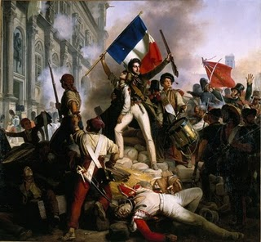
2. Economic Vision
Hamilton – National bank “necessary,” ex. Collect taxes, regulate trade
Jefferson – Believed in agrarian society, congress should only act if absolutely and indispensably necessary
3. Foreign Policy
Jefferson – supported France in Napoleonic wars, helped us during Rev. W/ Madison helps create Republican party.
Hamilton – supported GB, more
trade and cultural connection.
Develops into Federalist party.
Neither side accepted other as a
long-term, durable “loyal opposition”

Slide 8
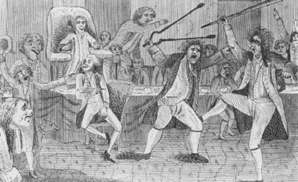
4. Alien & Sedition Acts
Adams signs acts that gave him power to deport “dangerous” foreigners and criminalize “seditious” language
Republicans (Jeff., Mad.) outraged at censorship, respond with KY and VA Resolutions (state need not comply w/ acts of Congress)
Mobilized Republicans for election of 1800.

Slide 9
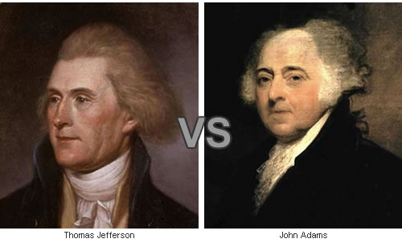
The Revolution of 1800 and its Aftermath
First election to feature candidates from political parties (Fed.–Adams, Repub.-Jeff)
Repub. victory symbolized first transfer of power through election rather than heredity / violence

Slide 10
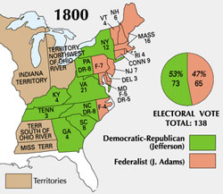
However, exposed problem in Constitution
Jeff & Burr tie, electors could not specify which would be president. House had to decide.
12th Amendment
Vote for Pres. & VP on same ballot
Jefferson opposed permanent political parties and thought Federalists ideals would fade away

Slide 11
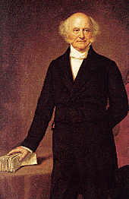
Political Party Growth and Functions
By 1820s, positive vision of parties emerged
Van Buren touts parties with clear principles and offer a clear choice
Parties are “glue” that holds federal system / checks and balances together.
Helped president work w/ Congress
Bridged great distances between Washington & people

Slide 12
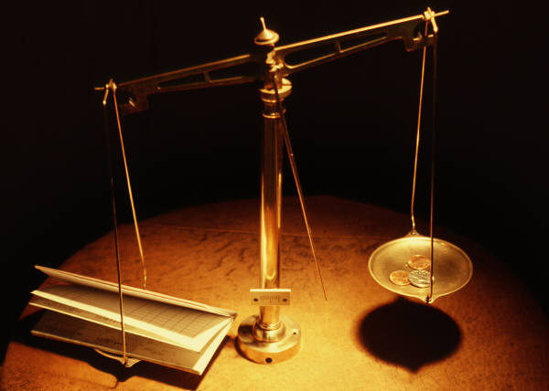
Patronage enabled president to build connections across levels of gov’t
Elaborate entertainments boost support and give members sense of belonging.
Unlike Jeff / Hamilton, Van Buren felt competing notions of common good could coexist.
Those out of power would hold them accountable / additional check and balance

Slide 13
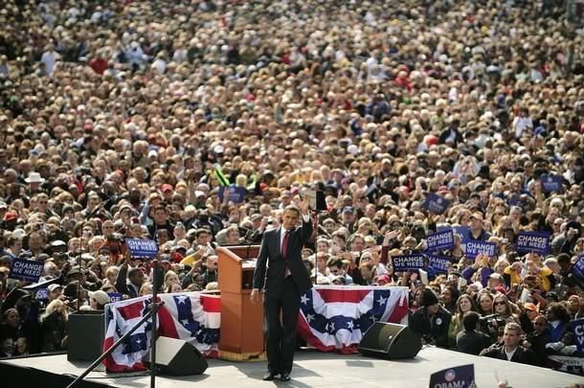
Political Parties Today
Democrats and Republicans have dominated since 1860s
Purposes of political parties today
Mobilize participation
Connect Executive and Legislative branches
Connect national & state governments
Creation and promotion of party platforms
Provide forums to deliberate about public policies / help organize & channel passions & interests
Provides stability
Ensures change in gov’t,
not Constitution

Slide 14
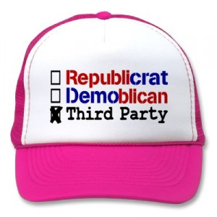
Less Favorable Aspects…
Mutes truly alternative views
Minor parties generally small, narrow interests. Little to no chance of competing nationally.
If single set of interest gains dominant power w/in a party, threat of majority tyranny.

