Slide 1
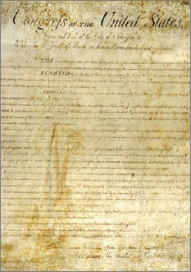
Lesson 15:
How Have Amendments and Judicial Review Changed the Constitution?

Slide 2
Purpose
This lesson describes the process devised for amending the Constitution and its first application, the Bill of Rights.
It also explains judicial review, and the arguments for and against this judicial power.

Slide 3
Objectives
Describe the two ways in which the Constitution can be amended.
Identify major categories of constitutional amendments.
Explain why Madison introduced the Bill of Rights.
Evaluate, take, and defend positions on the amendment process and judicial review.

Slide 4
Terms to Know
Amendment
A change in or addition to a legal document.
Judicial Review
The power of the courts to declare laws and actions of the local and state governments or the national government invalid if they are found to contradict the U.S. Constitution.

Slide 5
How and Why the Framers Devised an Amendment Process
Founders recognized that society & conditions would change over time.
The Constitution is difficult to amend
2/3 of Congress to Propose, ¾ of States to Amend
Over 10,000 have been introduced to Congress
Only 33 were officially proposed
Of 33, only 27 ratified

Slide 6
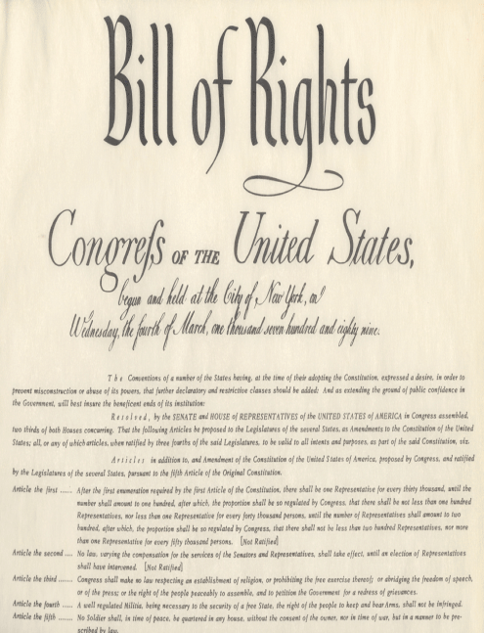
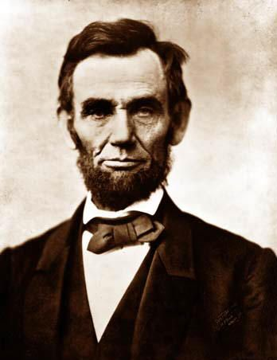
Types of Amendments
Bill of Rights (1791)
First 10 Amendments protect basic rights and liberties
Fundamental Changes
13th & 14th resulted from Civil War and resolved issues not settled at Constitutional Convention
Outlawed slavery
defined citizenship
imposed equal protection and due process requirements on states
gave Congress more enforcement power

Slide 7
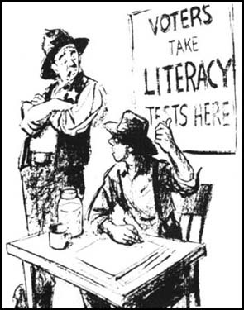
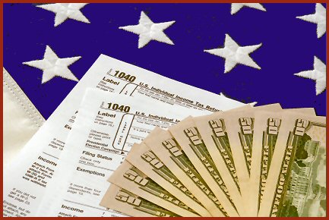
Expansion of Suffrage
15th, 19th, 24th, and 26th prohibit states from denying voting rights based on race, gender, age of persons of 18 or older, or failure to pay poll taxes
Overturning Supreme Court Decisions
11th overturned improper expansion of federal court power
16th overturned decision that prevented Congress from passing an income tax

Slide 8
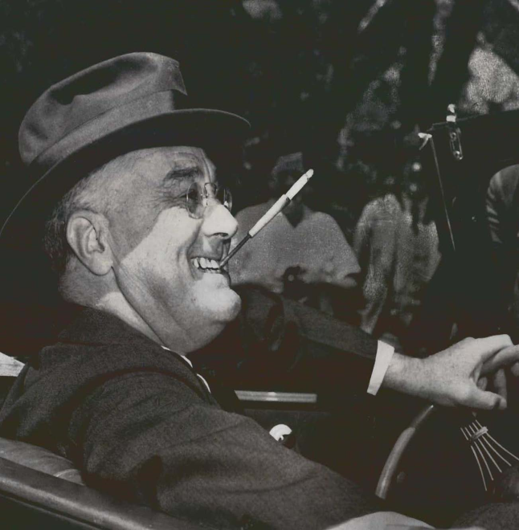
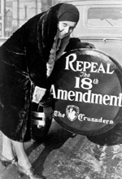
Refinements
12th requires electors to make separate choices for president and vice president
20th shortened length of time between elections and when official take office.
22nd limits president to 2 terms
25th addresses presidential succession
Morality
18th outlawed manufacture, sale,
and transport of alcohol (Prohibition)
21st repeals the 18th

Slide 9
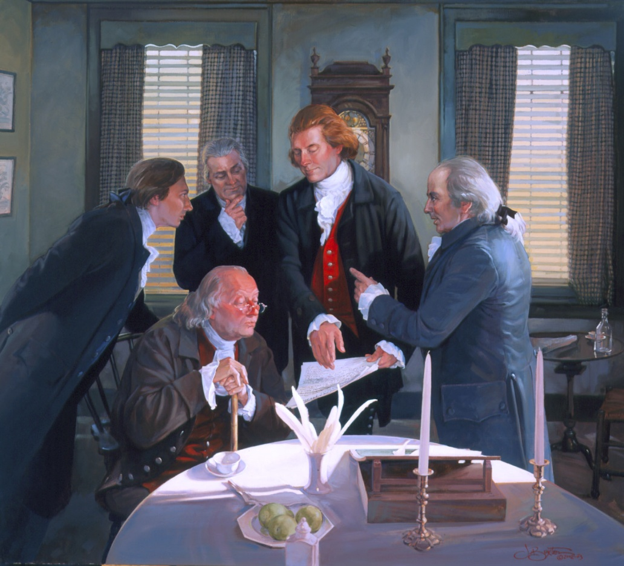
Why a Bill of Rights was Proposed
Many states and prominent figures argued for specific protections and listed rights
Madison followed through on his promise to immediately add amendments (bill of rights) in first session of Congress

Slide 10
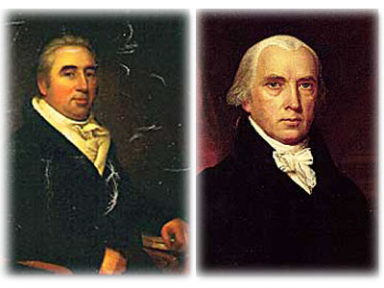
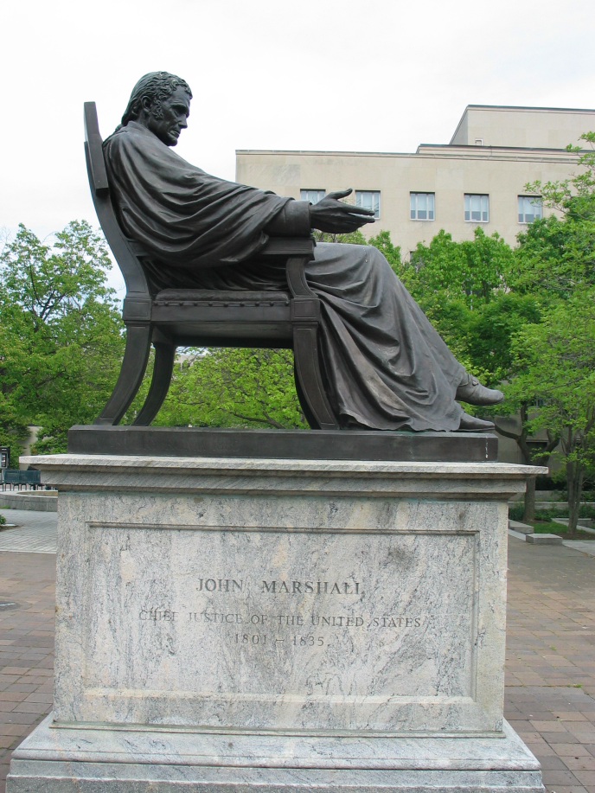
The Development of Judicial Review
Marbury v. Madison (1803)
Chief Justice John Marshall concludes that judges have the power to decide whether acts of Congress, the executive branch, state laws, and even State Constitutions violate the US Constitution
Supreme Court justices have the final say about the meaning of the Constitution
This power to declare what the Constitution means and whether government actions violate the Constitution is know as JUDICIAL REVIEW

Slide 11
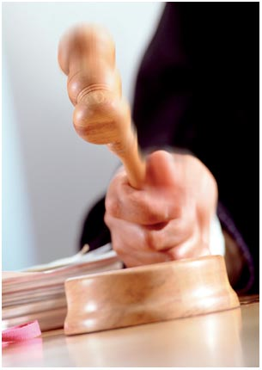
Controversy Over Judicial Review
No mention of judicial review in Constitution
However, founders assumed this power would be developed (Practice has roots in English Law)
Marshall asserted that it is the “duty of the judicial department to say what law is.”

Slide 12
Premises of Judicial Review
The Constitution is a superior, paramount law that cannot be changed by ordinary means.
Acts of Congress, the Executive, and the States reflect temporary, fleeting views of what law is.
Acts of Congress, the Executive, and the States that conflict with the Constitution are not entitled to enforcement and must be disregarded.
Judges are in the best position to declare what the Constitution means.

Slide 13
Arguments Against Judicial Review
Popular Sovereignty is represented in the Legislatures. Judicial Review disregards sovereignty of the people.
Judicial Review could lead to political turmoil if other branches or states to not follow the courts’ interpretations.
Judicial Review makes judiciary equal or even superior to legislatures, even though judges are not elected
All government officials take oath to consider constitutionality of their actions
Judges errors in interpretation cannot be corrected through voting, but only through amendments

Slide 14
https://www.youtube.com/watch?v=KwciUVLdSPk

