Slide 1
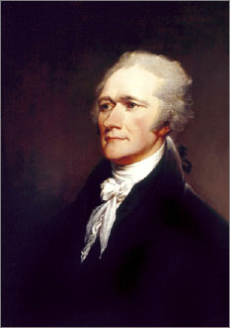
Lesson 14:
What Was the Federalist Position in the Debate about Ratification?

Slide 2
Purpose
Those who supported ratification, which created a stronger government, called themselves Federalists.
This lesson describes the arguments and strategies Federalists used to win support for the Constitution.

Slide 3
Objectives
Explain the key arguments of the Federalists and the process by which the Constitution was finally ratified.
Evaluate, take, and defend positions on the continuing relevance and validity of the Federalists’ argument.

Slide 4
Terms to Know
"new science of politics"
James Madison's term in The Federalist for a study of politics utilizing reason, observation, and history that would help the Founders construct a new government on a rational and informed basis.
faction
(1) A small group within a larger group. (2) In its political sense, according to James Madison in Federalist 10, a faction is a "number of citizens, whether amounting to a majority or a minority of the whole, who are united...by some common impulse of passion, or of interest, adverse to the rights of other citizens or to the permanent and aggregate interests of the community."
Federalists
Advocates for a strong central government who urged ratification of the U.S. Constitution. They flourished as a political party in the 1790s under the leadership of Alexander Hamilton. The party disappeared from national politics in 1816.
majority tyranny
A situation in which a majority uses the principle of majority rule but fails to respect the rights and interests of the minority. See also majority rule
The Federalist
A series of articles written for newspapers urging the adoption of the Constitution and supporting the need for a strong national government.

Slide 5
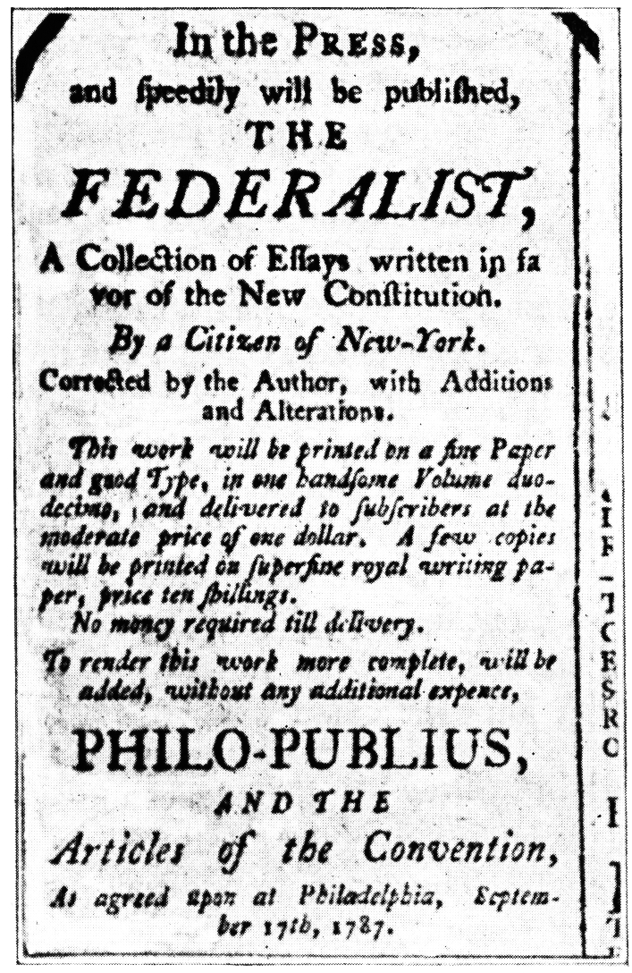
Federalists’ Strategies
Federalists acted quickly so that Ant-Federalists would not have a chance to organize opposition.
Over ten months of debate, Hamilton, Madison, and Jay published Federalist Papers to convince people to support ratification.
They presented Constitution as a well-organized, agreed-upon plan that reflected a “new science of politics.”

Slide 6
Federalists’ Response to Fears of a Large Republic
Most Americans agreed that large republics were unsuccessful
Madison creates new theory that factions are greatest danger
Factions promote own self-interest at expense of common good
Majority tyranny could be combated w/ a republic
Large republic’s would reduce large factions
Representatives “refine” public views by filtering out ideas based solely on self-interest.
Large republics would defeat dangers of faction.

Slide 7
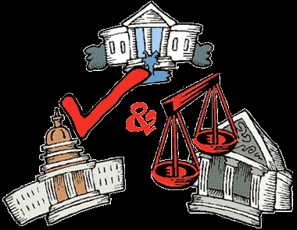
Federalists’ Central Arguments
Civic virtue alone will not protect people’s rights and promote their welfare.
With many interests and factions in a large republic, none would dominate
Constitution’s organization (Checks & Balances) promote goals of republicanism
Electoral system would ensure
qualified representatives
Complicated system would
prevent factions from serving
own interests at expense of
common good
Difficulty to pass laws was a
good thing

Slide 8
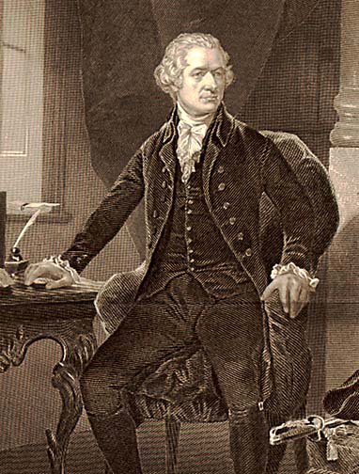
Federalists’ Central Arguments
Representation of different interests in the government will protect basic rights
In Legislative Branch, House represents local interests, Senate represents state’s interests
In Executive, President safeguards nation’s interests
In Judicial, Supreme Court ensures good judgments since they are independence of politics, responsible only to Constitution.

Slide 9
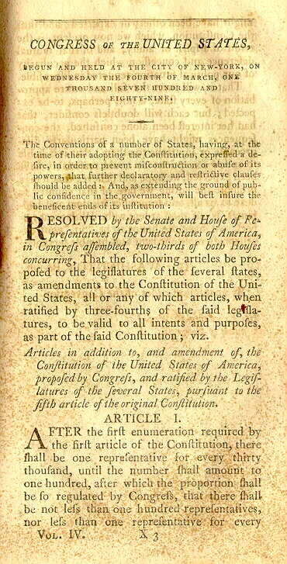
Ratification’s Success
By June 1788, 9 states voted to ratify.
However, no NY or VA (needed, wealthy & populous)
Federalists agreed to add a Bill of Rights during first Congress, depriving Anti-Fed’s of their most powerful argument.
NC and RI eventually forced to ratify by 1790 or else be treated as foreign nations.

