Slide 1
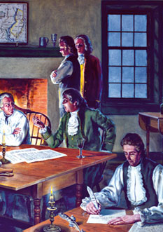
Lesson 13: What Was the Anti-Federalist Position in the Debate about Ratification?

Slide 2
Purpose
The signed Constitution would only become official if ratified by 9 of 13 states. This lesson explains the ratification process and public debate between the Federalists (supported) and Anti-Federalists (opposed).

Slide 3
Objectives
Explain why the Anti-Federalists opposed ratifying the Constitution.
Explain the role of Anti-Federalists in proposing a bill of rights.
Identify other contributions their views have made toward interpreting the Constitution.
Evaluate, take and defend a position on the validity and relevance of Anti-Federalist arguments.

Slide 4
Terms to Know
Anti–Federalists
Opponents to ratification of the U.S. Constitution who believed that it gave excessive power to the federal government and failed to protect the rights and liberties of the people.
Bill of Rights
The first ten amendments to the U.S. Constitution. The Bill of Rights lists many basic rights that the federal government may not interfere with and must protect. Nearly all these rights are now also protected from violation by state governments.
ratification
(1) Formal approval of some formal legal instrument such as a constitution or treaty. (2) In U.S. constitutional history, the approval of the U.S. Constitution in 1788 by the ratifying conventions held in each state, except for Rhode Island, which initially voted the Constitution down by popular referendum.

Slide 5
The Ratification Process
Ratifying conventions set up in each state
Sole purpose was to debate and approve/reject the Constitution
Delegates elected by popular vote
9 States needed to ratify Constitution for it to go into effect
Example of Social Contract Theory

Slide 6
Debating the Proposed Constitution
As soon as delegates released the proposal, opposition emerged.
Anti-Federalists published objections in newspapers and pamphlets (George Mason, Elbridge Gerry)
Oppositions believed in reasoned discourse to educate citizens
They drew on political philosophy ad history to make arguments.
Americans read and discussed the arguments in their homes, coffeehouses, taverns and public meetings across the nation.

Slide 7
Key Elements of Anti-Federalists’ Opposition
Representative gov’t could only work in small communities of people with similar beliefs
In large nations, gov’t no longer reflects wishes of most citizens, resorting to force to maintain authority
National gov’t will reduce power / role of local gov’t
Small, agrarian communities are more likely to have civic virtue than large, diverse nations

Slide 8
Anti-Federalists’ Philosophy
Strong national gov’ts needed in large nations have always destroyed republics
Each branch had potential for tyranny
No adequate limit on Congress’ necessary & proper clause
President has unlimited power to grant pardons
National courts could destroy state judicial branches
Gov’t is not truly representative. House of Reps has only 65 members out of 3 million citizens.

Slide 9
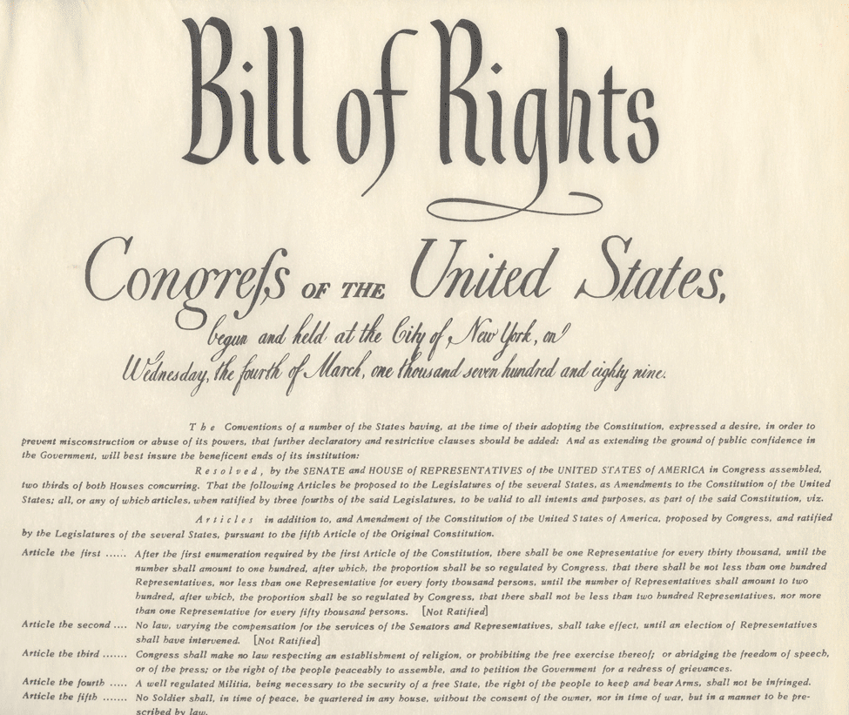
Bill of Rights Debate
National gov’t did not protect rights.
National gov’ts power is so general and vague that it is essentially unlimited.
Nothing keeps gov’t from violating all rights it does not explicitly protect.
State’s bill of rights does not protect against national government.
Bill of Rights would remind people of the principles of our political system.

