Slide 1
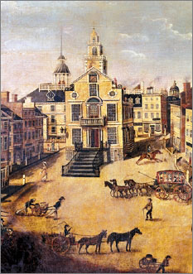
Lesson 12:
How Did the Delegates Distribute Powers between National and State Governments?

Slide 2
Purpose
The relationship between national and state powers was at the core of the first Convention debates.
The delegates eventually worked out a series of regulations & compromises that defined what national and state government could and could not do.
Several compromises involved slavery, the most divisive issue among states.

Slide 3
Objectives
Describe the major powers and limits on the national government, powers specifically left to states, and prohibitions the Constitution placed on states.
Explain how the Constitution did and did not address slavery and other unresolved issues.
Evaluate, take, and defend positions on how limited government in the US protects individual rights and promotes the common good and on issues involving slavery.

Slide 4
Terms to Know
ex post facto law
A law that criminalizes an act that was not a crime when committed, that increases the penalty for a crime after it was committed, or that changes the rules of evidence to make conviction easier. Ex post facto laws are forbidden by Article I of the Constitution.
bill of attainder
An act of the legislature that inflicts punishment on an individual or group without a judicial trial.
secede
Formal withdrawal by a constituent member from an alliance, federation, or association.
supremacy clause
Article VI, Section 2 of the Constitution, which states that the U.S. Constitution, laws passed by Congress, and treaties of the United States "shall be the supreme Law of the Land" and binding on the states.
tariff
A tax on imported or exported goods. Also known as a duty.

Slide 5
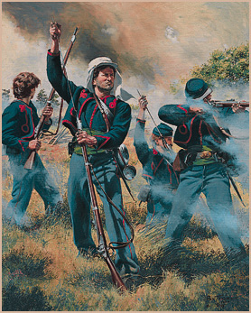
National Government’s Powers
Powers given to national gov’t over states:
Make or change state election laws
Call state militias into national service
Create new states
Guarantee each state a “republican for of gov’t”
Protect states from invasion or domestic violence
Constitution & laws / treaties made by Congress are supreme law of the land (Supremacy Clause)

Slide 6
Limits on Power of National Gov’t
These provisions protected individual rights
Cannot suspend habeas corpus
Cannot pass ex post facto laws or bills of attainder
Cannot suspend trial by jury in criminal cases
Cannot modify definition of treason
The following protect rights of public officials
Members of Congress cannot be arrested during session unless a major crime
No religious tests for public office
Impeachment clauses protect right to a fair trial
Gov’t cannot take money from treasury without an appropriation law

Slide 7
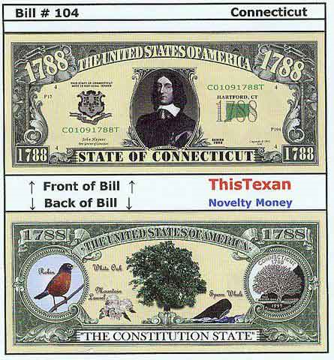
Limits on Power of State Gov’ts
States cannot
Coin their own money
Pass laws that enable people to violate contracts
Make ex post facto laws or bills of attainder
Enter into foreign treaties or declare war
Tax imports or exports
Keep troops or ships of war in peace time
No discrimination against citizens of other states
Must return fugitives from other states

Slide 8
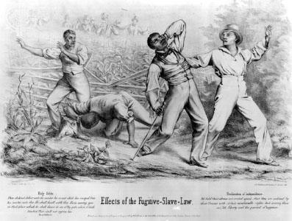
Slavery’s Affect on Distribution of National & State Powers
Many delegates were opposed to slavery, kept terms out of Constitution (but protected institution)
Southern states considered slaves property, and property issues should be state matters
NC, SC, and GA would create own nation if Constitution interfered w/ slavery
Northern delegates agree to put in “fugitive slave clause” and not to interfere with slave trade until 1808.

Slide 9
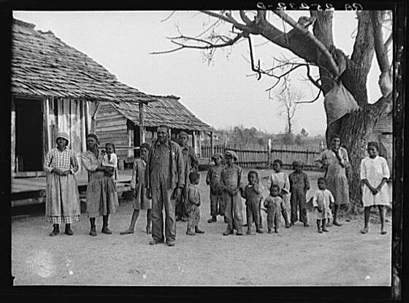
Issues Unaddressed
Citizenship
Voting Rights
Where national power ends / state power begins
“Necessary & Proper Clause”
State’s right to secede from the US

