Slide 1
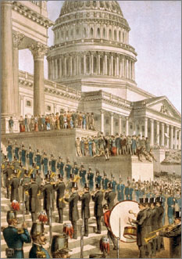
Lesson 11: What Questions Did the Framers Consider in Designing the Three Branches of the National Government?

Slide 2
Purpose
Political philosophers claim that governments must do three things: make, execute, and judge laws.
The Constitution assigns these functions to three separate branches. This lesson explains how the Framers envisioned the role of each.

Slide 3
Objectives
Explain the role of each of the three branches and describe how the Constitution organizes them.
Explain how and why the system of checks and balances contributes to limited government.
Evaluate, take, and defend positions on how the President should be elected and issues relating to the appointment of Supreme Court justices.

Slide 4
Terms to Know
Deliberative Body
A legislative assembly that meets to debate issues.
Electoral College
The group of presidential electors who cast the official votes for president and vice president after a presidential election. Each state has a number of electors equal to the total of its members in the Senate and House of Representatives.
Necessary and Proper Clause
Clause of the Constitution that gives Congress the power to make all laws that are "necessary and proper" to carry out the powers specifically delegated to it by the Constitution. It is also known as the "elastic clause" because of the vagueness of the phrase "necessary and proper."
Separated Powers
The division of the powers of government among the different branches. Separating powers is a primary strategy of promoting constitutional or limited government by ensuring that no one individual or branch has excessive power that can be abused.
Shared Powers
Legislative powers not completely separated between the branches of government.

Slide 5
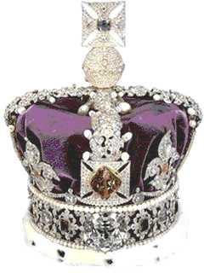
Balance of Power Among the Branches of Government
Framers believed there was an imbalance of power between British Crown and Parliament
Led to tyranny of British Crown
Many state government created weak executives, but led to legislative corruption
Delegates needed to create system of balanced powers (checks & balances)

Slide 6
Legislative Power & Organization
Congress should be a deliberative body
Thorough debate, no hasty decisions
Bicameral legislature makes law passage difficult
(on purpose)
Delegates felt power to make laws greatest power
Enumerated Powers are specifically listed
Congress also granted powers Necessary & Proper

Slide 7
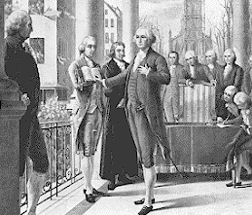
Executive Powers & Organization
Executive needed “energy” to act quickly when necessary for
Common defense
Preserve public peace
International relations
Must be strong enough to
check power of legislature,
but can not endanger republic
A single chief executive needed, 4-yr term
No limit set for reelection

Slide 8
Presidential Selection
Delegates reject idea of direct election
Citizens of large country would “not know” best candidates
Other felt Indirect elections would be corrupt
Instead, Electoral College proposed
Organized every 4 years, then dissolved
Each state selects electors, number based on total members in Congress
Electors voted for two people (at least one outside home state)
Majority wins presidency, 2nd becomes VP
If tie, House selects with majority vote

Slide 9
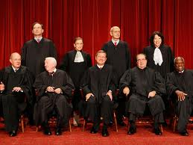
Judicial Power & Organization
Judges chosen by President, confirmed by Senate
Supreme Court is head of judiciary
Judges independent of politics
Cannot be removed unless accused & convicted of high crimes

Slide 10
Division of Power
Veto
President can veto bill passed in Congress
Congress can override veto with 2/3 vote
Appointment
President nominates, Senate must approve
Treaties
President negotiates, Senate approves (2/3 vote)
War
President is commander in chief, Congress declares war & controls $$$
Impeachment
Congress can remove executive or judicial branch members if they commit high crimes
Judicial Review
Judicial branch (eventually) can determine whether acts of Congress are Constitutional

