Slide 1
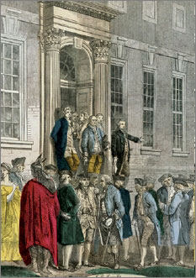
Lesson 10:
Why Was Representation a Major Issue at the Philadelphia Convention?

Slide 2
Purpose
This lesson examines:
The debate over what, or who, the national government will represent.
The Great Compromise, which dealt with the makeup of the House and Senate.
How population would be counted for representation in the House.
How new states might receive representation in Congress.

Slide 3
Objectives
Explain the differences between the Virginia Plan and the New Jersey Plan and the importance of the Great Compromise.
Explain how the Framers addressed regional issues with the 3/5ths compromise and the provision for periodic census of the population.
Evaluate, take, and defend positions on why major issues debated at the Convention are still on the national agenda.

Slide 4
Terms to Know
Great Compromise
A plan accepted at the Philadelphia Convention in 1787 that called for a Congress of two houses: in the upper house, or Senate, representation of the states would be equal, with each state having two senators; in the lower house, or House of Representatives, representation would be apportioned according to the population of each state, so that states with more people would have more representatives. Also called the Connecticut Compromise.
Three-Fifths Compromise
Article I, Section 2, Clause 3 of the U.S. Constitution, later eliminated by the Fourteenth Amendment. The clause provided that each slave should be counted as three–fifths of a person in determining the number of representatives a state might send to the House of Representatives. It also determined the amount of direct taxes Congress might levy on a state.

Slide 5
Disagreement Over Representation
No disagreement over two-house Congress
Proportional representation was the issue
Madison – states should not be represented as states in national government. Instead, representatives should serve the people.
Those who sought Equal representation thought national government derived from and represented the States, not the people.
Big states favored Proportional rep, small states favored Equal rep.

Slide 6
The New Jersey Plan
Similar to Articles of Confederation
One house Congress, equal representation
Most delegates were convinced that a unicameral Congress would not work, and NJ Plan voted down.
However, many small state delegates refused to accept Virginia Plan due to their concerns over large states’ power under proportional representation.
Disagreement over this issue almost ended the convention.

Slide 7
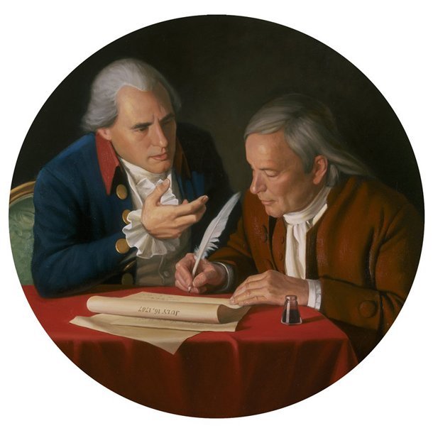
The Great Compromise
Great/Connecticut Compromise’s provisions
House of Representatives= Proportional Rep.
Senate = Equal Rep. (2 per state – chosen by state legislature)
Senate appeased small states, House appeased big states
The compromise passed
by 1 vote

Slide 8
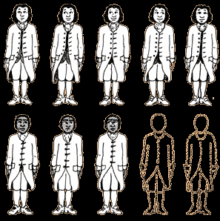
The 3/5ths Compromise
What did proportional representation mean?
Southern states want slaves to count towards representation
Northern states thought counting them would only benefit, and empower, slave owners
If they are considered property, why should property be represented?
The Compromise
state’s population, in regards to apportioning representation, would be equal to free population plus 3/5ths slaves
Slaves also counted as 3/5ths when computing taxes paid by each state to federal government

Slide 9
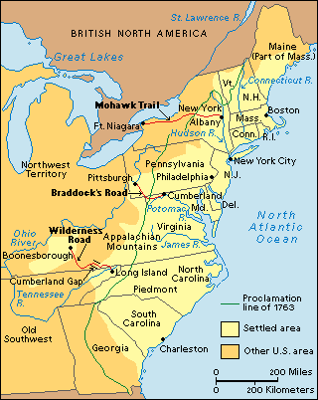
Representation of New States
New states would have full representation in congress
A census would be taken every 10 years to reapportion seats in the House based on the shift in America’s population.

