Slide 1
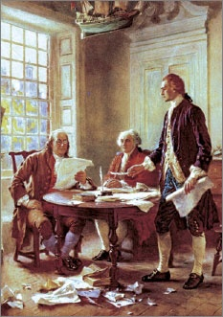
Lesson 1: What Did the Founders Think about Constitutional Government?

Slide 2
Lesson 1 Purpose
This lesson introduces the basic ideas and experiences the founding generation drew on to create the kind of government they believed would best protect natural rights and the common good.
Participation in colonial self-government and early America’s diversity fostered rich dialogue about the purpose of government and how it should be organized.

Slide 3
Lesson 1 Objectives
Describe the diverse features of the early American colonies and their populations.
Explain what the Founders learned about government from history and their firsthand experiences of government and how this shaped their thinking.
Explain the meanings of the terms “constitution” and “constitutional government” and describe the forms of constitutional governments.
Evaluate, take, and defend positions on
the sources that should be consulted if a new constitution were written today.
whether the founders’ concerns about abuse of power are still valid.
the importance of written Constitutions.

Slide 4
Lesson 1 Terms & Concepts
constitution
A plan of government that sets forth the structures and powers of government. In democracies, a constitution is an authoritative law through which the sovereign people authorize a government to be established and grant it certain powers.
constitutional government
Limited government; the rule of law. A form of government in which a written, unwritten, or partly written constitution serves as a higher or fundamental law that everyone, including those in power, must obey. The rule of law is an essential feature of constitutional government.
democracy
Literally defined as "rule of the people," democracy is a form of government in which all citizens exercise political power, either directly or through their elected representatives.
forms of government
(1) Aristotle's idea of three forms of government based on the number of people exercising power. Each has a "right" form and a "corrupt" form. The right form of government by a single person is a "monarchy." The right form of government by a few people is an "aristocracy." And the right form of government by many people is called "polity." (2) Types of democratic governments. For example, parliamentary systems, such as those of Britain and India; separation of powers systems, such as that of the United States; and presidential systems, such as that of France. (3) General forms of government, such as monarchies, republics, and autocracies.

Slide 5
Lesson 1 Terms & Concepts
limited government
In natural rights philosophy, a system restricted to protecting natural rights that does not interfere with other aspects of life. More generally, limited government is constitutional government governed by the rule of law. Written or unwritten constitutions are used to empower and limit government.
Parliament
The British legislature, which consists of two houses: the House of Lords, which once represented the nobility, and the House of Commons, which formally represents the common people. Most members of the House of Lords are appointed for life by the government of the day and are not members of the hereditary aristocracy, who once dominated it.
republic
According to James Madison, a form of government that derives its powers directly or indirectly from the people, is administered by officials holding power for a limited time, and incorporates representative institutions.
unwritten constitution
The body of political practices developed through custom and tradition. Only three of the world's major democracies have constitutions that are not single, written documents: Britain, Israel, and New Zealand. In each of these nations, the constitution is a combination of written laws and precedents.
written constitution
A written plan of government that sets forth the structures and powers of government.

Slide 6
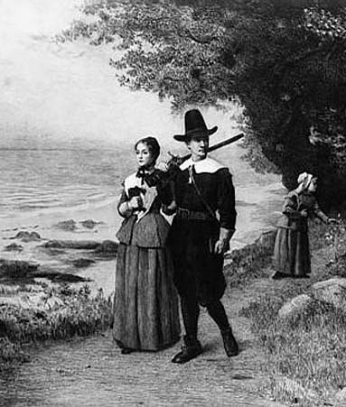
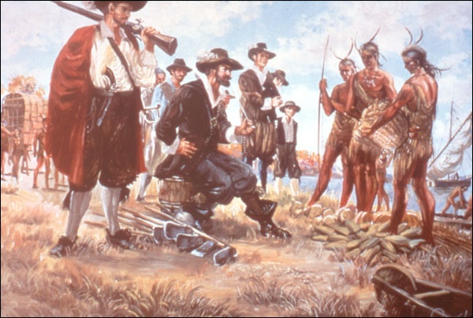
Characteristics of Colonial America
Europeans first settled two centuries before the Treaty of Paris (1783)
Native American Population on the Decline (war, disease)
Diverse European backgrounds (German, French, Dutch)
Came for religious (Puritans) and economic (Jamestown) reasons

Slide 7
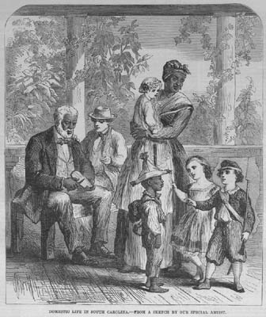
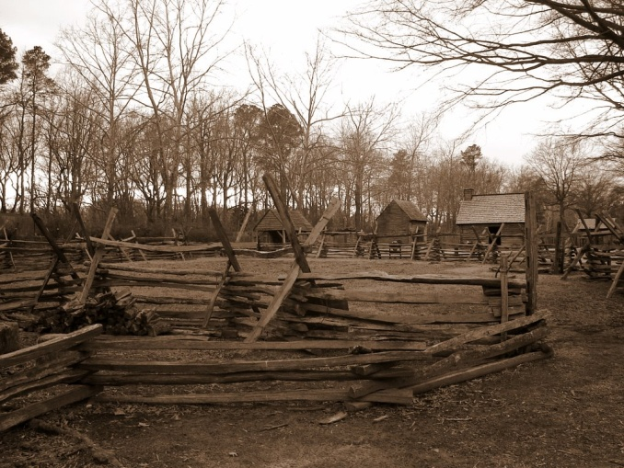
Characteristics (cont…)
Vast estates in Middle to South, smaller towns in New England
Southern farms grew export crops, were larger with many more slaves
New England – subsistence farming, livestock, local markets

Slide 8
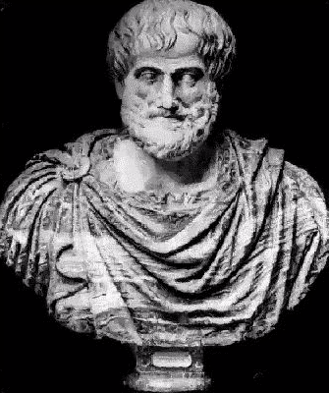
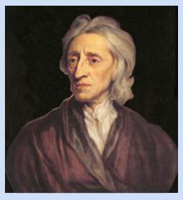
How Did The Founders Learn About Government?
Read classical texts about gov’t & politics (Aristotle)
Studied newer 16th & 17th c. philosophers (Locke)
Also fell back on 150 years of local self-government
Free white men served on juries, attended town meetings, and voted in local elections

Slide 9
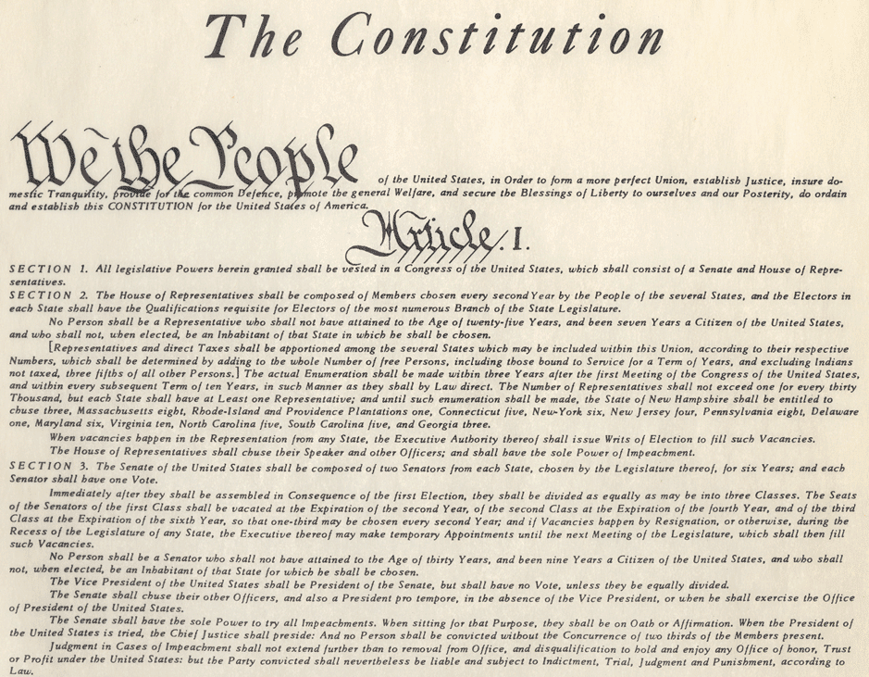
What did the Founders Learn?
Government should be a servant, not the master, of the people
A fundamental higher law, or constitution, should limit government

Slide 10
Forms of Government
Aristotle’s forms of government
Rule of One= Monarchy (corrupt = Tyranny)
Rule of Few= Aristocracy (corrupt = Oligarchy)
Rule of Many= Polity (corrupt = Democracy)
Aristotle feared that in a direct democracy, the poor would seize the wealth of the rich through warfare
Founders favored a representative (republican) form of government

Slide 11
What is a Constitution?
Def: A plan that sets forth the structure and powers of a government
Constitutional government also means limited government
Government limited by the provisions of the constitution
Written Constitutions are controversial since it involved interpretation, change, and the power of who has the final say

Slide 12
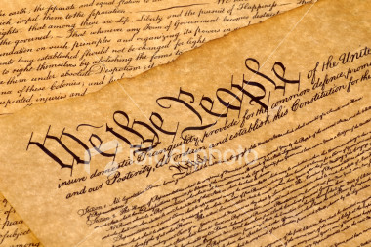
Characterizing Higher Law
Different from legislative statute in following ways:
Sets forth basic rights of citizens
Establishes responsibility of the gov’t to protect those rights
Establishes limitations on gov’t power regarding rights, distribution of resources, and conflict management
Can be changed only with consent of the people and according to established procedures

Slide 13
Characterizing Higher Law
Different from legislative statute in following ways:
Sets forth basic rights of citizens
Establishes responsibility of the gov’t to protect those rights
Establishes limitations on gov’t power regarding rights, distribution of resources, and conflict management
Can be changed only with consent of the people and according to established procedures

